Slide 1
Towards a Vecsigrafo Portable Semantics in Knowledge-based Text Analytics
Ronald Denaux & José Manuel Gómez Pérez
HSSUES– Oct. 21st, 2017

Slide 2
The Cognitive Chasm
How can humans and AI interact with and understand each other?
Machine understanding vs.
Human understanding
Is this possible or are they cognitively disconnected?
What mechanisms are needed to cross the cognitive chasm?
How can knowledge representation be both flexible, scalable, deep and logical?
Notes:
Several chams dimensions:
Approach: statistic ML vs. knowledge-based
Machine understanding vs. Human understanding
Until the chasm is addressed AI and their applications to LT will not effectively reach the mainstream market
How can humans and AI interact with and understand each other?
Is this possible or do they reason at levels of abstraction so different that they are cognitively disconnected?
What mechanisms are needed to cross the cognitive chasm?
How can AI explain their reasoning and be accountable?
How can AI have both highly expressive and flexible knowledge representation and reasoning schemes? Is this even possible?

Slide 3
Pros and cons of structured knowledge
PROS
CONS
Humans have a rich understanding of the domain, resulting in detailed, expressive models
Underlying formalisms support logical explanations
Reasonable response times
Tooling can optimize cost, enabling user-entered knowledge
Requires a considerable amount of well trained, centralized labor to manually encode knowledge
Lacks scalability with large corpora and still costly due to humans in the loop
Possible bias, hard to generalize
Brittleness
Notes:
What we learnt from Halo

Slide 4
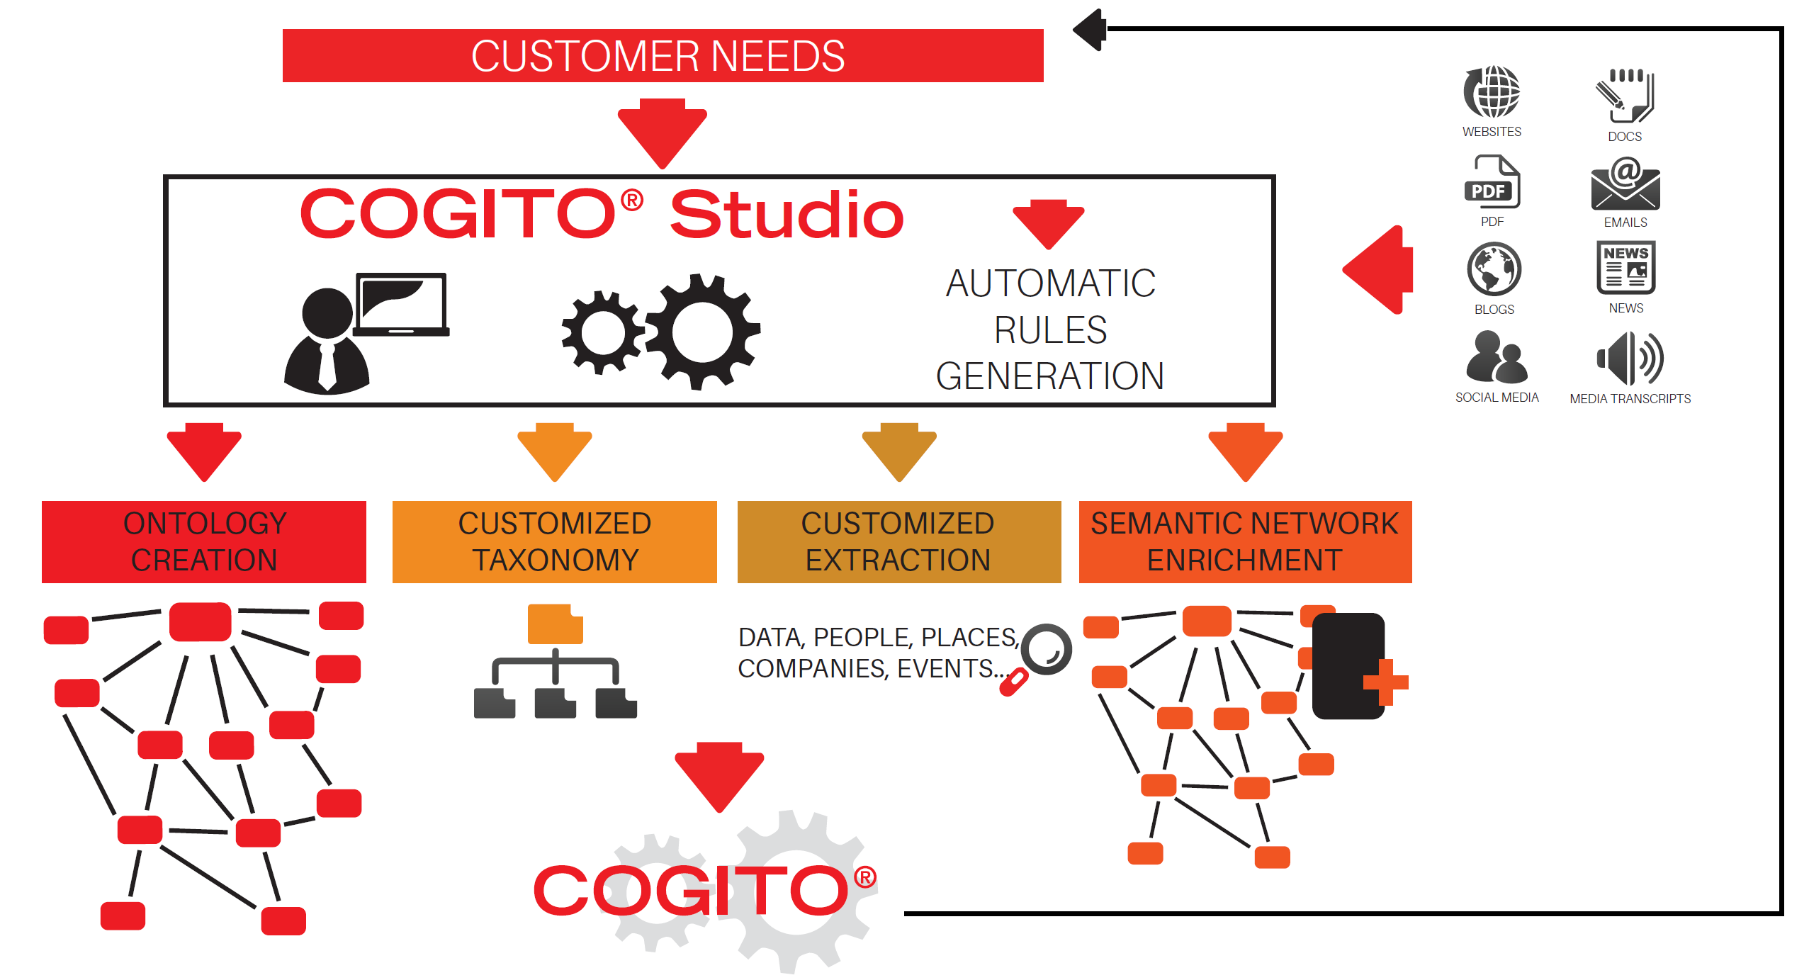
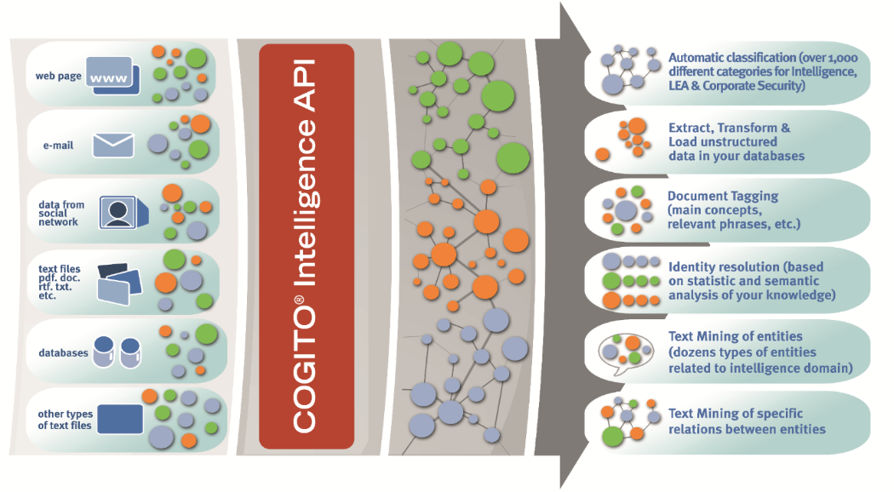
Structured knowledge (Sensigrafo)
Sensigrafo, a knowledge graph containing word definitions, related concepts and linguistic information
Main entities include syncons (concepts), lemmas (canonical representation of a word) and relations (properties, taxonomical, polysemy, synonymy…)
301,582 syncons
401,028 lemmas
80+ relation types that yield ~2.8 million links
Internal representation that leverages external resources, both general and domain-specific
Word-sense disambiguation, based on the context of a word in Sensigrafo
Categorization and extraction supported through Sensigrafo plus lexical-syntactic rules
Notes:
First piece (structured knowledge): Sensigrafo

Slide 5
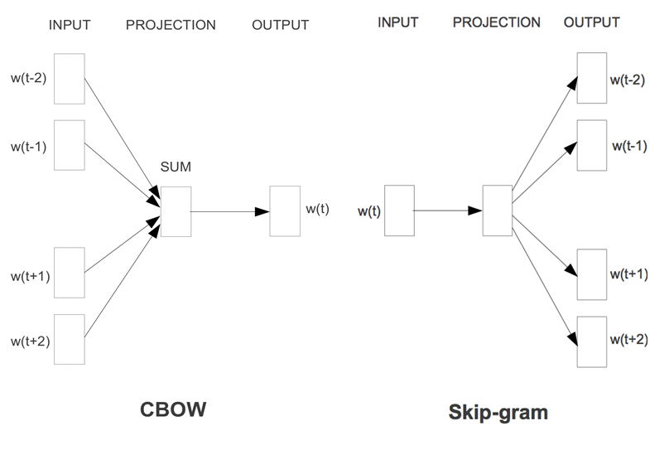
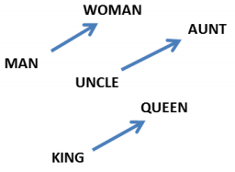
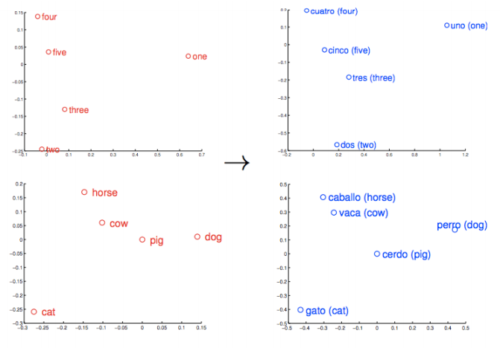
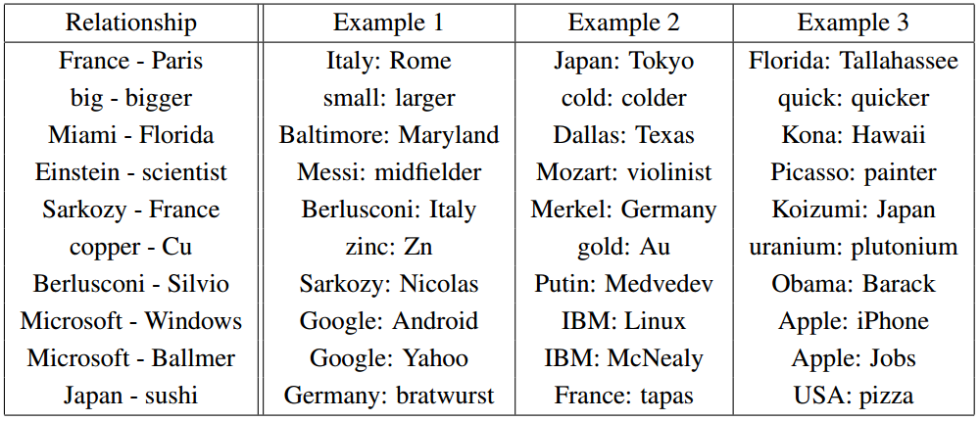
Building multiple language models
Word2vec represents words in a vector space, making natural language computer-readable
Neural word embeddings enable word similarity, analogy and relatedness based on vector arithmetic (cosine similarity)
Essential property: Semantic portability
Notes:
Second piece (building a language model): Word2Vec

Slide 6
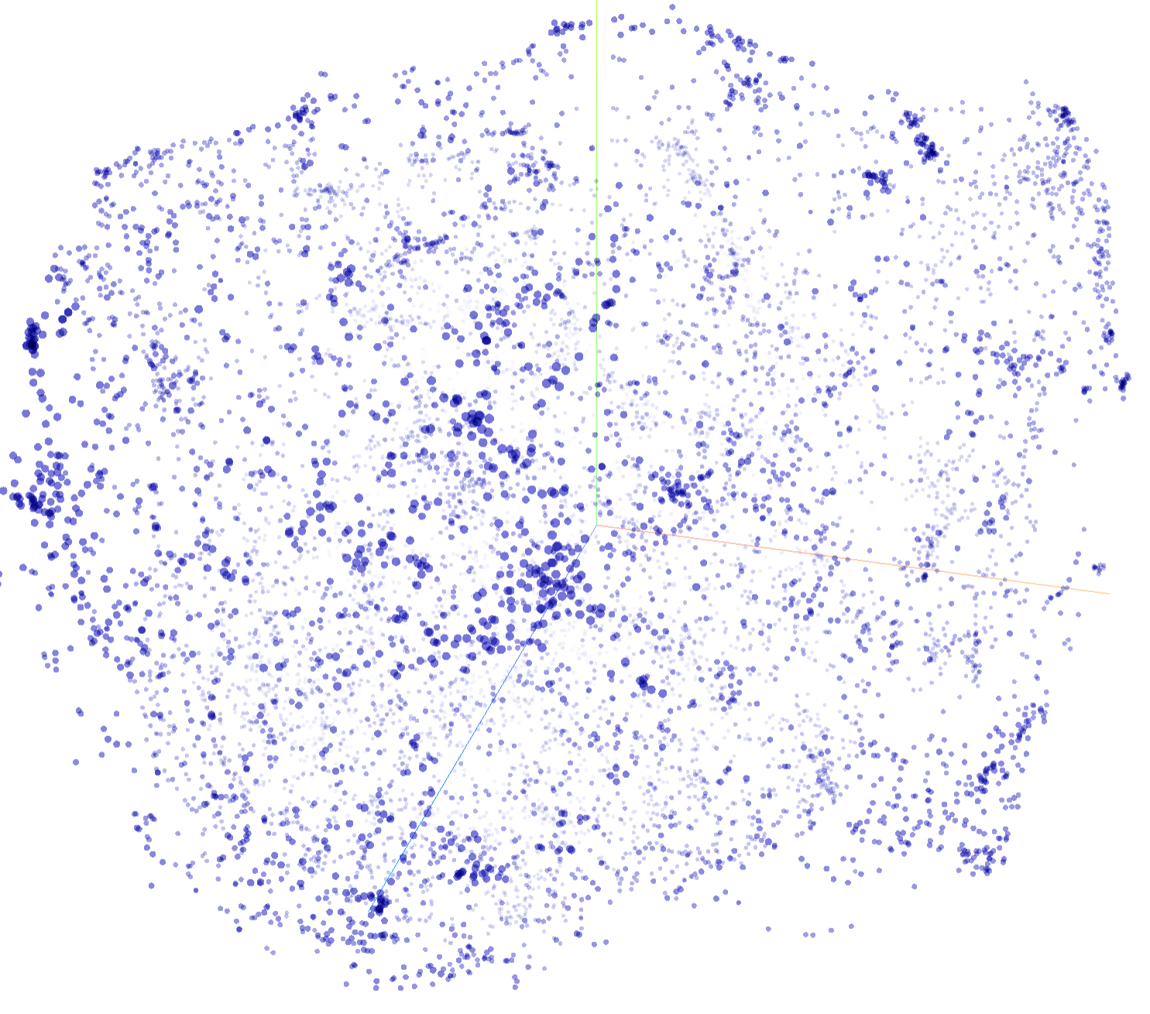
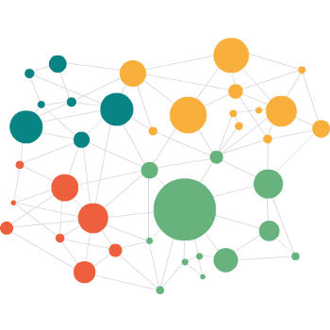
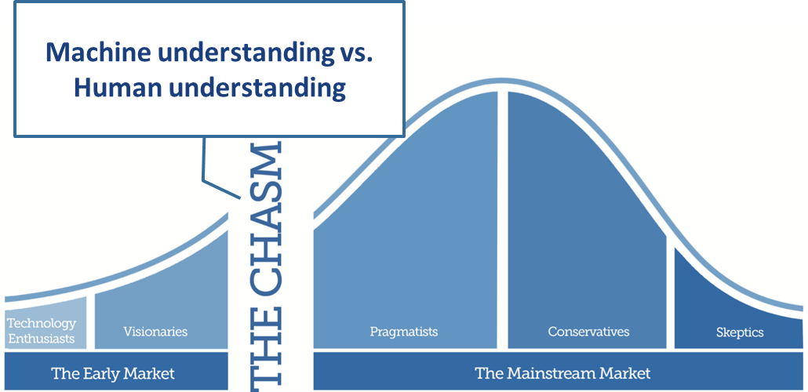
Towards Natural Learning at Expert System
Knowledge encoded in the mind of the expert
Structured knowledge base
Good for logical deduction and explanation
Deep, but rigid and brittle
Human is a bottleneck: hand-engineered features and powerful modeling tools needed
Knowledge embedded in document corpora
Broad, flexible, scalable
Good for POS tagging, parsing, semantic relatedness
Statistic induction, not logical explanation
Lack of true understanding of real-world semantics and pragmatics
Vecsigrafo
Automatically learning how language is used in real life and materializing that in structured knowledge graphs
Notes:
Hybrid approach based on the notion of natural learning

Slide 7
Vecsigrafo – Putting it all together
Two parallel corpora, focused on English and Spanish (Europarl and UN)
Meaning extracted from corpora and related to Sensigrafo (21% and 30% Sensigrafo covered, resp.)
Tokenized, lemmatized and disambiguated with COGITO
Learned monolingual joint word-concept models and a (non-linear) transformation between vector spaces for crosslinguality
Deeplearning4j with Skip-gram, minFreq 10, vector dimensionality 400
TensorFlow and Swivel for better vectorization time (~16x & ~20x speedup, 80 epochs)
Vocab elements | EN-grafo |  | ES-grafo
 | Sensi | Vecsi | Sensi | Vecsi
Lemmas | 398 | 80 | 268 | 91
Concepts | 300 | 67 | 226 | 52
Total | 698 | 147 | 474 | 143
Corpus | Sentences | Spanish words | English words
Euparl | 1,965,734 | 51,575,748 | 49,093,806
UN.en-es | 21,911,121 | 678,778,068 | 590,672,799
Notes:
Different from other systems e.g. vectorizing RDF datasets
Denaux R, Gomez-Perez JM. Towards a Vecsigrafo: Portable Semantics in Knowledge-based Text Analytics. To appear in proceedings of the Intl. Workshop on Hybrid Statistical Semantic Understanding and Emerging Semantics (HSSUES), collocated with the 16th Intl. Semantic Web Conference (ISWC), Vienna, 2017.
Coverage of the UN Corpus: 10% and 34%
Euparl (http://www.statmt.org/europarl)
UN (https://conferences.unite.un.org/uncorpus)

Slide 8
Vecsigrafo - Evaluation
Corpus size and distribution matters
Overall performance equivalent at lemma level (Swivel, same corpus)
Including concepts has a cost
Visual inspection (t-SNE, PCA) and manual (relatedness, analogy…)
Further insight needed
Model | WSim | WSrel | Simlex999 | Rarewords | Simverb
SotA 2015 | 79.4 | 70.6 | 43.3 | 50.8 | n/a
Swivel | 74.8 | 61.6 | 40.3 | 48.3 | 62.8
Swivel_{UN, en} | 58.8 | 45.0 | 18.3 | 37.8 | 15.3
Vecisgrafo_{UN,en} | 47.6 | 24.1 | 12.4 | 30.8 | 13.2
Word Prediction Plots
(quality validation and hypothesis checking)
average cosim
most frequent
a) Random baseline
b) Buggy correlations
least frequent
c) Uncentered
d) Re-centered

Slide 9
Vecsigrafo – Word Similarity Redux
Model | WSim | WSrel | Simlex999 | Rarewords | Simverb
SotA 2015 | 79.4 | 70.6 | 43.3 | 50.8 | 62.8
Swivel | 74.8 | 61.6 | 40.3 | 48.3 | n/a
Swivel_{UN, en} | 58.8 | 45.0 | 18.3 | 37.8 | 15.3
Swivel_{UN, en} _{recentered} | 57.7 | 47.2 | 21.3 | 39.2 | 17.0
Vecisgrafo_{UN,en} | 47.6 | 24.1 | 12.4 | 30.8 | 13.2
Vecisgrafo_{UN,en} | 69.9 | 51.6 | 38.2 | 50.3* | 30.6
Vecisgrafo_{UN,en} _{recentered} | 59.3 | 43.0 | 42.4 | 49.3 | 30.4
Vecisgrafo_{UN,en} _{NN aligned to es} | 65.8 | 45.3 | 39.2 | 49.3 | 28.5
Better than swivel for same corpus
Effect of recentering
Effect of aligning to Spanish
Further insight needed
How similar are two vecsigrafos?
Which relations are inferred?
How are relations encoded in the embedding space?

Slide 10
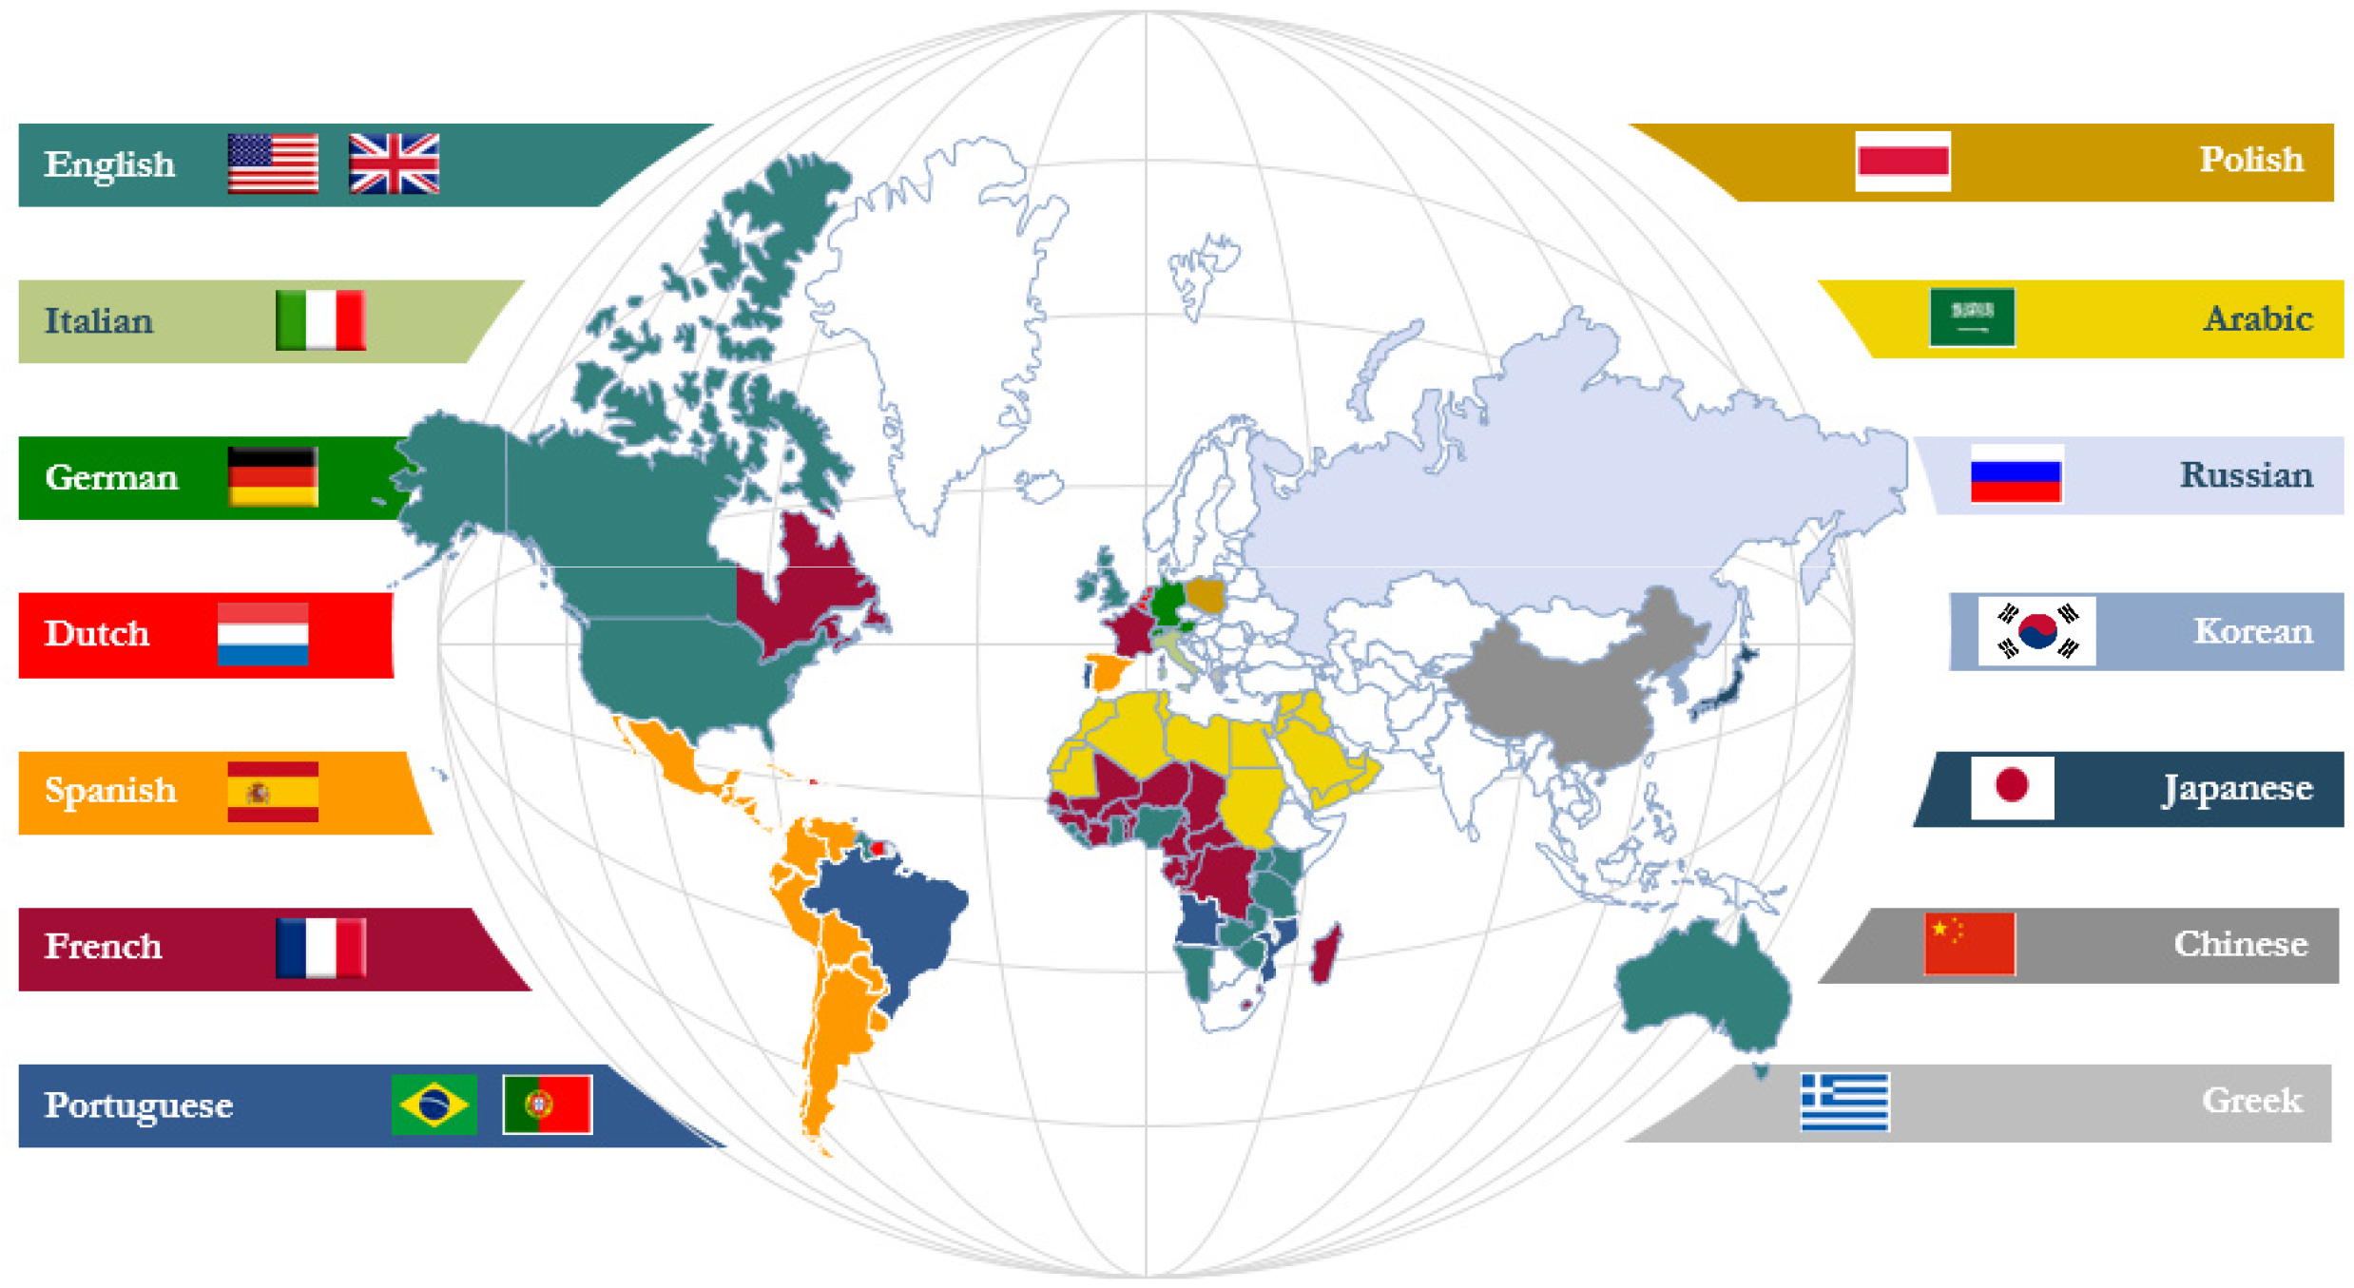
Vecsigrafo – Application Roadmap
Map individual Vecsigrafos
Correlate and identify modeling gaps in Sensigrafos
Suggest crosslingual synonyms
Crosslinguality
Assisted Sensigrafo Learning
Fast internationalization at Expert System (EU, US, LATAM) and growing customer needs in 14 languages

Slide 11
Mapping and correlation
Alignment performance
Mapping vector spaces in different languages: Linear transformation suggested by (Mikolov, 2013) produced poor results. Non-linear transformation using NNs: hit@5 = 0.78 and 90% semantic relatedness
Manual inspection showed only 28% exact correspondence EN→ES, due to volume (75K concepts less in Spanish Sensigrafo) and strategic modeling decisions
How to address the gap?
Method | Nodes | hit@5
TM | n/a | 0.36
NN2 | 4K | 0.61
NN2 | 5K | 0.68
NN2 | 10K | 0.78
NN3 | 5K | 0.72
Manual inspection EN→ES
 | in dict. | out dict.
#concepts | 46 | 64
hit@5 | 0.72 | 0.28
no concept_{ES} | 2 | 33
Notes:
Crosslingual -> working seamlessly in multiple languages
Curation and identification of modeling gaps
Conceptual alignment across different languages
Automatic identification of disambiguation errors

Slide 12
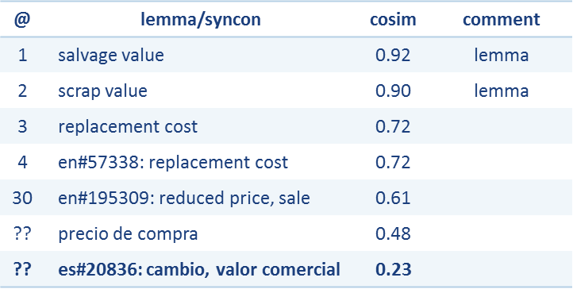
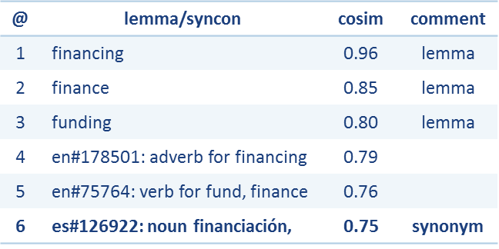
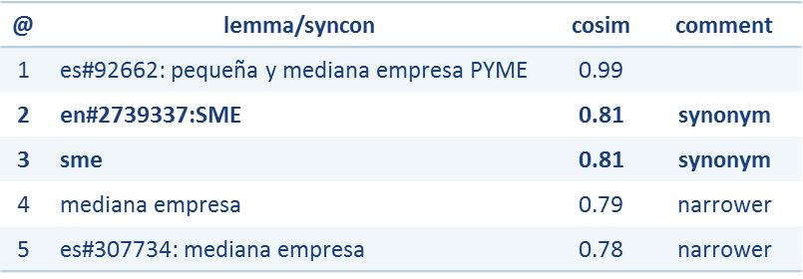
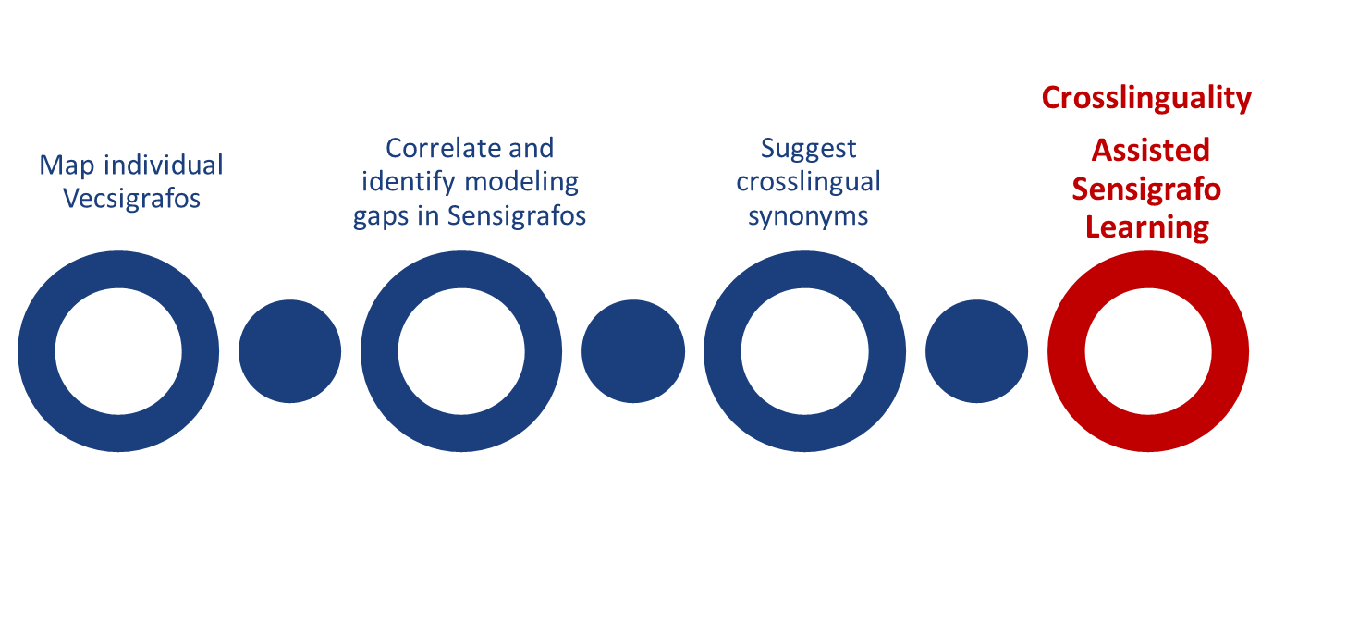
Examples
“Scrap value” (EN→ES)
“Financing” (EN→ES)
“PYME” (ES→EN)

Slide 13
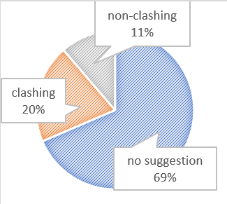
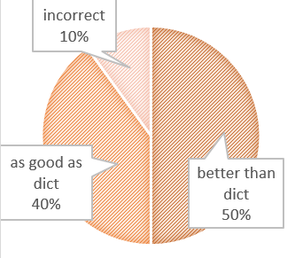
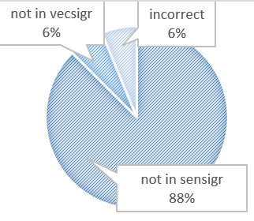
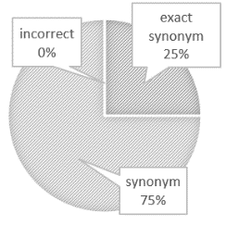
Crosslingual synonym suggester
Manual inspection EN→ES
(1546 concepts, IPTC)
Combines features from bilingual vecsigrafo, the target and source Sensigrafos and a dictionary (PanLex)
For each concept in the source language, find the n nearest concepts in the target language that match grammar type (noun, verb, adjective, etc.)
For each candidate, calculate hybrid features (lemma translation, glossa similarity, cosine similarity, shared hypernyms and domains)
Combine into a single score and rank
Check if suggested synonym candidate is already mapped to a different concept and compare
Suggestion made if score is over a threshold
1546 IPTC concepts
Clashing
No suggestions
Non clashing

Slide 14
Wrapping up

Slide 15
Jose Manuel Gomez-Perez Director R&D
Ronald Denaux Senior Researcher
rdenaux@expertsystem.com
jmgomez@expertsystem.com
Denaux R, Gomez-Perez JM. Towards a Vecsigrafo: Portable Semantics in Knowledge-based Text Analytics. To appear in proceedings of the Intl. Workshop on Hybrid Statistical Semantic Understanding and Emerging Semantics (HSSUES), collocated with the 16th Intl. Semantic Web Conference (ISWC), Vienna, 2017.

Slide 16
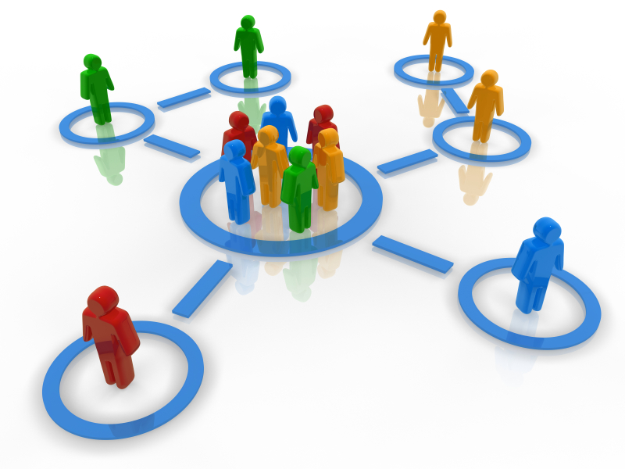
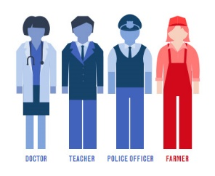

Slide 17
Correlation calculation
Develop an indicative list of advisory and conciliatory measures to encourage full compliance;
Tokenize & WSD
en#67083|develop en#89749|indicative en#113271|list en#88602|advisory en#85521|conciliatory
en#33443|measure en#77189|encourage en#84127|full en#4941|compliance
Correlation for en_lem_list (window 2, harmonic weight)
token | Distance | weight
en#67083 | 2 | ½
develop | 2 | ½
en#89749 | 1 | 1
indicative | 1 | 1
en#113271 | 0 | 1
token | Distance | weight
list | 0 | 1
en#88602 | 1 | 1
advisory | 1 | 1
en#85521 | 2 | ½
conciliatory | 2 | ½

