Slide 1
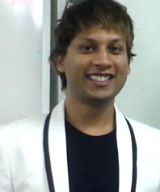
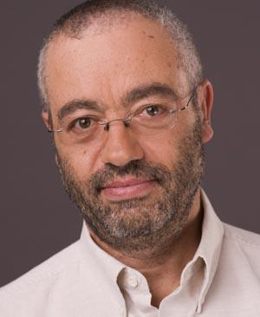
Commonsense Knowledge Graphs
Filip
Ilievski
ilievski@isi.edu
Mayank
Kejriwal
kejriwal@isi.edu
Pedro
Szekely
pszekely@isi.edu
USC Information Sciences Institute

Slide 2
Agenda
08:00 PST | 1 hr 50 mins | Part I - Review of CSKGs
 | 15 min | Introduction to commonsense knowledge (slides) - Pedro
 | 25 min | Review of top-down commonsense knowledge graphs (slides) - Mayank
 | 70 min | Review of bottom-up commonsense knowledge graphs (slides+demo) - Mayank, Filip, Pedro
 | 10 min | Break
10:00 PST | 45 min | Part II - Integration and analysis
 | 35 min | Consolidating commonsense graphs (slides) - Filip
 | 10 min | Consolidating commonsense graphs (demo) - Pedro
 | 10 min | Break
10:55 PST | 1 hr 05 mins | Part III - Downstream use of CSKGs
 | 50 min | Answering questions with CSKGs (slides+demo) - Filip
 | 15 min | Wrap-up (slides) - Mayank

Slide 3
Introduction to commonsense knowledge
Pedro Szekely

Slide 4
What Is Common Sense?
Common sense is sound practical judgement concerning everyday matters,
or a basic ability to perceive, understand, and judge that is shared by ("common to") nearly all people.
Wikipedia

Slide 5
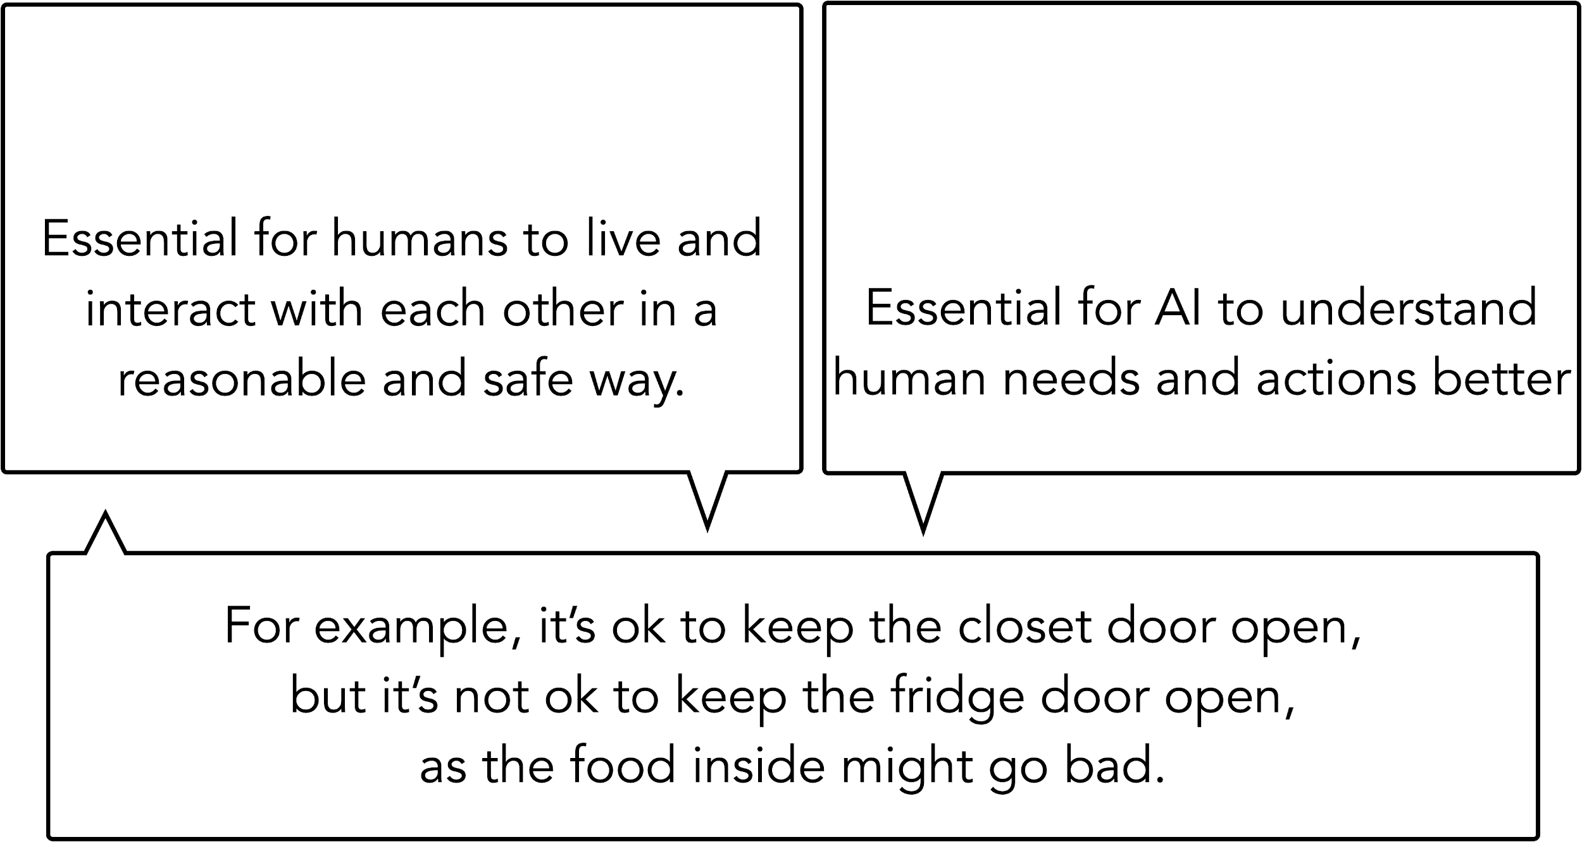
Slide by Yejin Choi

Slide 6
Humans reason about the world with mental models [Graesser, 1994]
Personal experiences
[Conway et al., 2000]
World knowledge
[Kintsch, 1988]

Slide 7
Humans reason about the world with mental models [Graesser, 1994]
Personal experiences
[Conway et al., 2000]
World knowledge
[Kintsch, 1988]

Slide 8
A Common Sense Task
Input: a set of common concepts
dog | frisbee | catch | throw
Output: a sentence using these concepts
https://inklab.usc.edu/CommonGen/

Slide 9
A Common Sense Task
Input: a set of common concepts
dog | frisbee | catch | throw
Output: a sentence using these concepts
https://inklab.usc.edu/CommonGen/

Slide 10
A Common Sense Task
Input: a set of common concepts
dog | frisbee | catch | throw
Output: a sentence using these concepts
https://inklab.usc.edu/CommonGen/

Slide 11
Role Of Knowledge
catch frisbee
has property
fun for dog
created by
is a
related to
others then
game
wants to
play
type of
located at
catch
dog
PersonX throws a frisbee
play
game
park
antonym
capable of
used for
located at
throw
play frisbee
frisbee
used for
synonym
flying
disk
disc
subclass of

Slide 12
Common Sense Knowledge Graphs
COMET
[Bosselut et al., 2019]
Atomic
[Sap et al., 2019]
WebChild
[Tandon et al., 2014]
WebChild 2.0
[Tandon et al., 2017]
Open Mind Common Sense
[Minski, Singh, Havasi,1999]
ConceptNet
[Liu, Singh, 2004]
ConceptNet 5.5
[Speer et al., 2017]
NELL
[Carlson et al., 2010]
NELL
[Mitchell et al., 2015]
Wikidata
[Vrandečić, 2012]
Cyc
[Lenat et al., 1984]
OpenCyc 4.0
[Lenat 2012]

Slide 13
Dimensions Of Common Sense Knowledge
Representation
symbolic
natural language
neural
Creation method
expert input
crowdsourcing
information extraction, machine learning
Knowledge type
entities and actions
inferential/rules
Topic
general
social
COMET
Atomic
WebChild
ConceptNet
NELL
Wikidata
OpenCyc

Slide 14
Representation Method
Representation
symbolic: frisbee, dog
natural language: "PersonX throws a frisbee"
neural: <black box>
Creation method
expert input
crowdsourcing
information extraction, machine learning
Knowledge type
entities and actions
inferential/rules
Topic
general
social
COMET
Atomic
WebChild
ConceptNet
NELL
Wikidata
OpenCyc

Slide 15
Creation Method
Representation
symbolic
natural language
neural
Creation method
expert input
crowdsourcing
information extraction, machine learning
Knowledge type
entities and actions
inferential/rules
Topic
general
social
COMET
Atomic
WebChild
ConceptNet
NELL
Wikidata
OpenCyc

Slide 16
Knowledge Type
Representation
symbolic
natural language
neural
Creation method
expert input
crowdsourcing
information extraction, machine learning
Knowledge type
entities and actions: frisbee, dog, throw, catch
inferential/rules:
PersonX throws frisbee, as a result others then, catches frisbee
Topic
general
social
COMET
Atomic
WebChild
ConceptNet
NELL
Wikidata
OpenCyc

Slide 17
Topic
Representation
symbolic
natural language
neural
Creation method
expert input
crowdsourcing
information extraction, machine learning
Knowledge type
entities and actions
inferential/rules
Topic
general
social
COMET
Atomic
WebChild
ConceptNet
NELL
Wikidata
OpenCyc

Slide 18
Design Approach
Representation
symbolic
natural language
neural
Creation method
expert input
crowdsourcing
information extraction, machine learning
Knowledge type
entities and actions
inferential/rules
Topic
general
social
COMET
Atomic
WebChild
bottom up
ConceptNet
NELL
Wikidata
OpenCyc
top
down

Slide 19
Agenda
08:00 PST | 1 hr 50 mins | Part I - Review of CSKGs
 | 15 min | Introduction to commonsense knowledge (slides) - Pedro
 | 25 min | Review of top-down commonsense knowledge graphs (slides) - Mayank
 | 70 min | Review of bottom-up commonsense knowledge graphs (slides+demo) - Mayank, Filip, Pedro
 | 10 min | Break
10:00 PST | 45 min | Part II - Integration and analysis
 | 35 min | Consolidating commonsense graphs (slides) - Filip
 | 10 min | Consolidating commonsense graphs (demo) - Pedro
 | 10 min | Break
10:55 PST | 1 hr 05 mins | Part III - Downstream use of CSKGs
 | 50 min | Answering questions with CSKGs (slides+demo) - Filip
 | 15 min | Wrap-up (slides) - Mayank

Slide 20
Review of top-down commonsense knowledge graphs
Mayank Kejriwal

Slide 21
Why is top-down knowledge necessary?
“In Artificial intelligence, commonsense knowledge is the set of background information that an individual is intended to know or assume and the ability to use it when appropriate.”
Argument: This knowledge cannot be acquired simply through text (or in an otherwise ‘inductive’ fashion)

Slide 22
Some important concepts necessary in a top-down CSKG
Scales, time, spaces and dimension, material, causal connections, (in other domains) force, shape, systems and functionality, hitting, abrasion, wear (and related concepts)
Competency vs. coverage theories
Naive physics vs. psychology theories

Slide 23
All reasoning (ultimately) depends on axioms...
What are the ‘axioms’ of commonsense ‘psychology’?
This is a controversial question
A more fruitful approach might be to understand the ‘representational areas’ of commonsense psychology (Gordon and Hobbs, 2004)

Slide 24
30 representational areas
Gordon (2001a) noted that there is an interesting relationship between concepts that participate in commonsense psychology theories and planning strategies
Described 30 representational areas by studying planning strategy

Slide 25
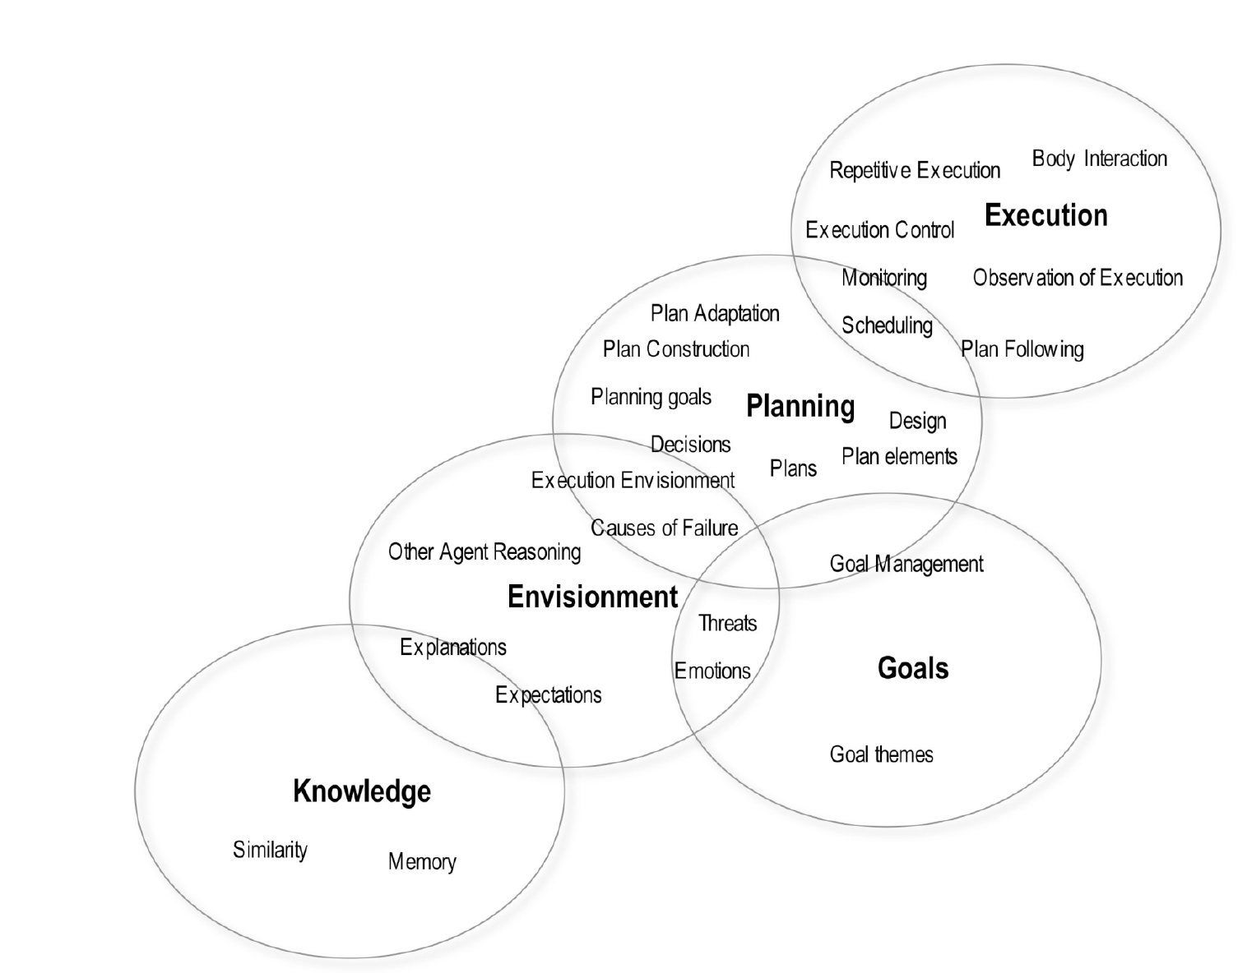
Taxonomy of 30 representational areas

Slide 26
Examples of representational areas
Explanations: the process of generating satisfying explanations for effects that have unknown causes
Similarity Comparison: the mental process of making comparisons and drawing analogies in order to find similarities and differences
Managing knowledge: concepts of knowledge, belief, assumptions, justifications and the mental processes that manipulate these concepts in reasoning

Slide 27
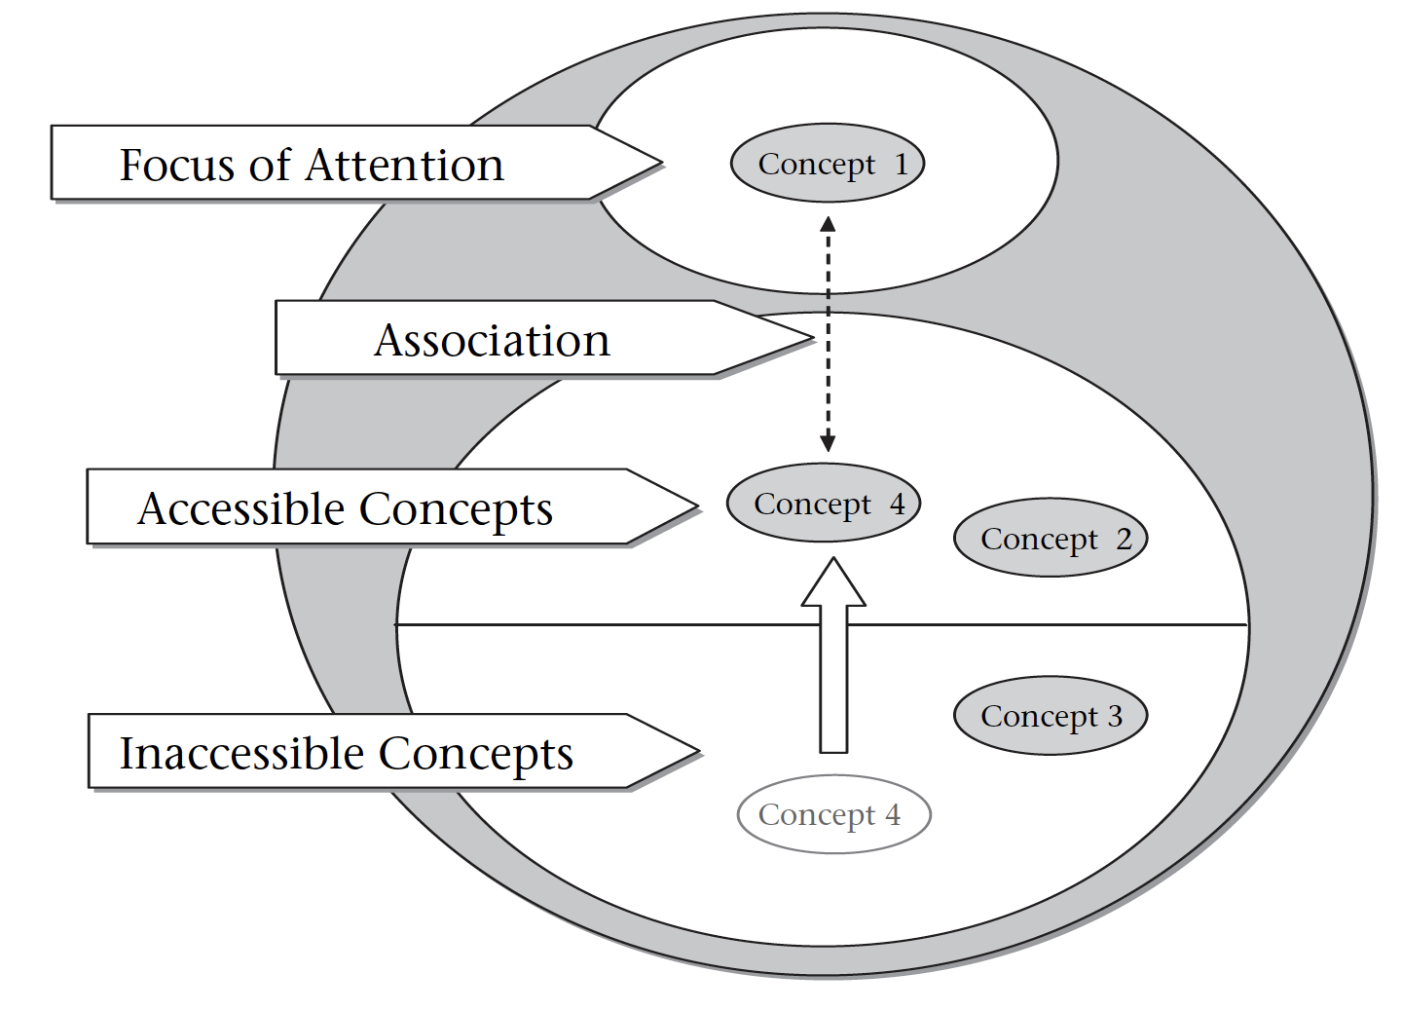
Example of ‘theory’: Accessibility by association
Memory retrieval by association is well-known in psychology
‘Encode’ it as a theory by defining appropriate predicates and concepts

Slide 28
‘Encoding knowledge’ of commonsense psychology
Not an easy problem, reminiscent of ‘expert system’ era
Open question how we can encode such knowledge in a way that makes it robust to noisy or incomplete data

Slide 29
Some more examples (belief in goals)

Slide 30
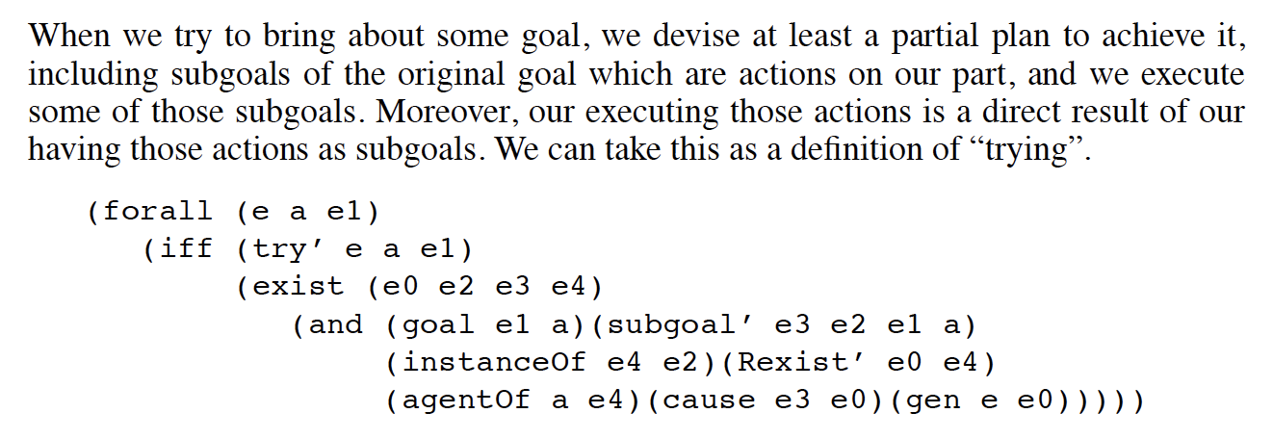
Some more examples (trying, succeeding and failing)

Slide 31
Other representational work

Slide 32
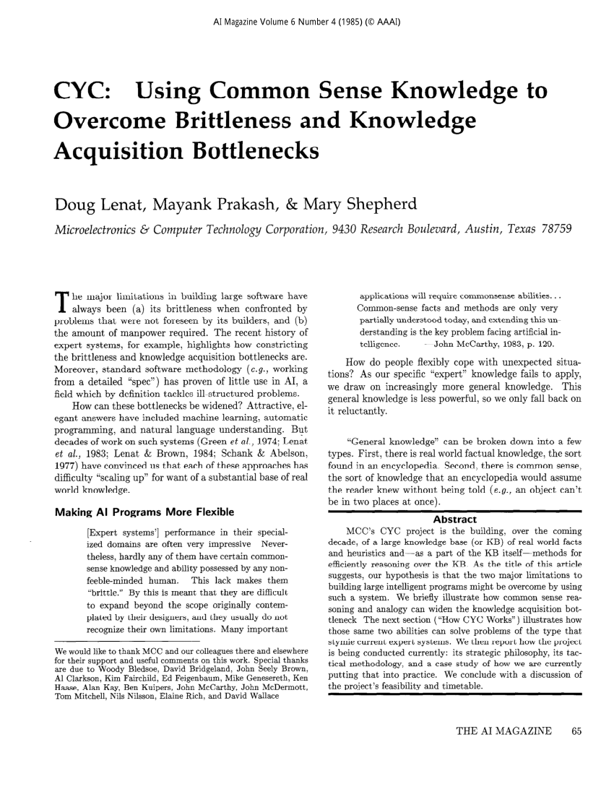

Slide 33
Example of a ‘top-down’ CSKG: Cyc

Slide 34
Evolution of Cyc

Slide 35
Limitations of top-down CSKGs
Many of the same issues that other top-down systems (including, famously, expert systems) have, such as brittleness, expense of acquisition…
When does work in AI stop, and work in philosophy and psychology begin?
Even if it were possible, we can never get away from language models completely

Slide 36
Agenda
08:00 PST | 1 hr 50 mins | Part I - Review of CSKGs
 | 15 min | Introduction to commonsense knowledge (slides) - Pedro
 | 25 min | Review of top-down commonsense knowledge graphs (slides) - Mayank
 | 70 min | Review of bottom-up commonsense knowledge graphs (slides+demo) - Mayank, Filip, Pedro
 | 10 min | Break
10:00 PST | 45 min | Part II - Integration and analysis
 | 35 min | Consolidating commonsense graphs (slides) - Filip
 | 10 min | Consolidating commonsense graphs (demo) - Pedro
 | 10 min | Break
10:55 PST | 1 hr 05 mins | Part III - Downstream use of CSKGs
 | 50 min | Answering questions with CSKGs (slides+demo) - Filip
 | 15 min | Wrap-up (slides) - Mayank

Slide 37
Review of bottom-up commonsense knowledge graphs: ConceptNet
Mayank Kejriwal

Slide 38
ConceptNet: An introduction
“a freely-available semantic network, designed to help computers understand the meanings of words that people use”
“an open, multi-lingual knowledge graph”
https://www.conceptnet.io/

Slide 39
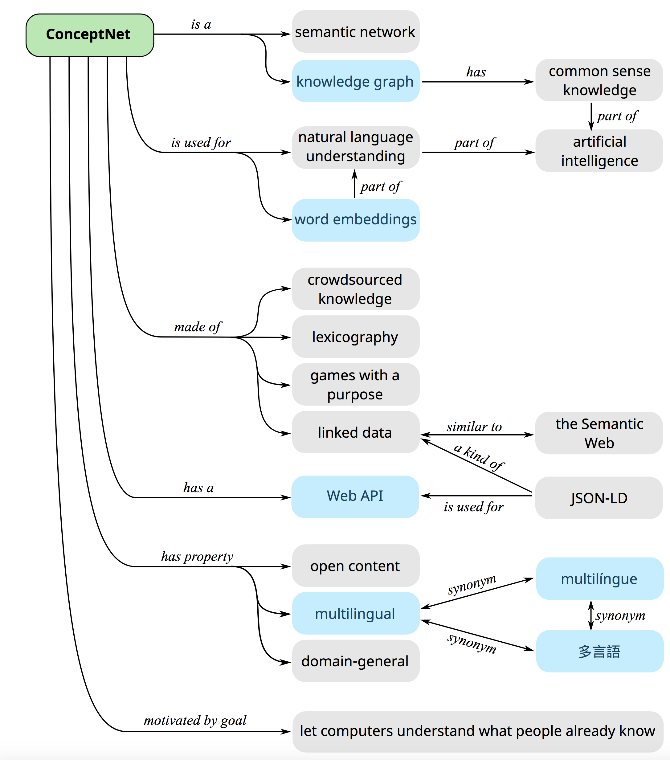
The many faces of ConceptNet

Slide 40
Sources of knowledge
Similar to previous versions, relational knowledge contributed to Open Mind Common Sense and its sister projects in other languages
Subset of DBpedia
Wiktionary (a dominant source)
Dictionary-style information also used from Open Multilingual WordNet
High-level ontology from OpenCyc

Slide 41
Human-generated knowledge: Games with a purpose (GWAP)
“multi-player online game that is designed to be fun and accomplish tasks that are easy for humans but beyond the capability of today's computers.”
https://www.cmu.edu/homepage/computing/2008/summer/games-with-a-purpose.shtml

Slide 42
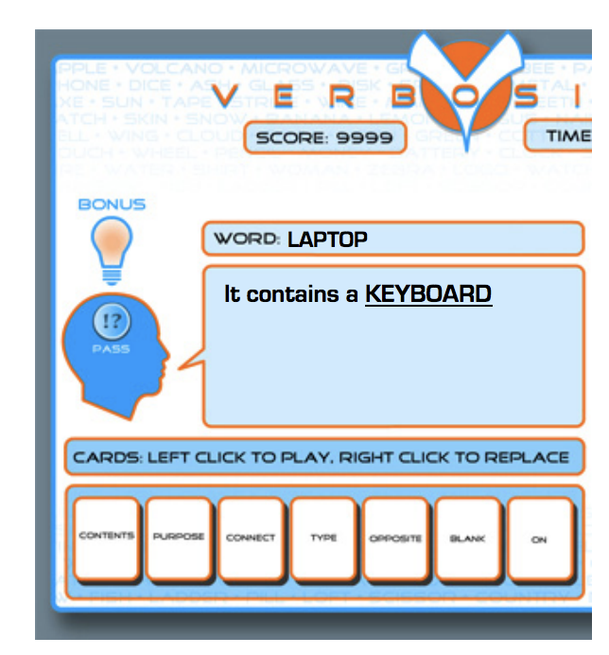
Example: Verbosity
https://www.cs.cmu.edu/~biglou/Verbosity.pdf
Notes:
Verbosity is meant to be played online by two players selected at random. One of the players is chosen as the “Narrator” while the other is the “Guesser.” The Narrator gets a secret word and must get the Guesser to type that word by sending hints to the Guesser. The hints take the form of sentence templates with blanks to be filled in. The Narrator can fill in the blanks with any word they wish except the secret word (or any string containing the secret word). See Figure 1. For example, if the word is LAPTOP, the Narrator might say: “it has a KEYBOARD.”
The sentence templates that the narrator can use come in the form of cards. The Narrator starts with 7 cards in their hand, and each card contains one sentence template. To give hints about the secret word, the Narrator chooses a card, fills in the blanks in the card and sends it to the Guesser. Given the hints, the Guesser can type what they LAPTOP It contains a KEYBOARD think the word is. The Narrator can see all of these guesses, and can tell the Guesser whether each is “hot” or “cold.” By observing the Narrator’s hints, we can collect commonsense facts about each word. For instance, when the narrator says “It contains a keyboard” about the word “laptop,” we learn that a laptop contains a keyboard. Players take turns in narrating and guessing. Each session of the game lasts six minutes, and the players go through as many words as they can in that amount of time. The players can agree to pass on a word if they believe it is too difficult.

Slide 43
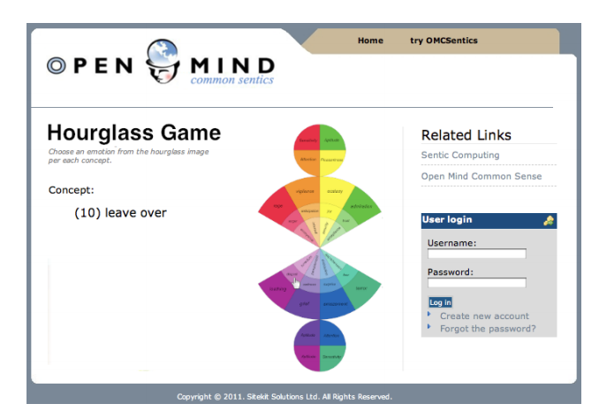
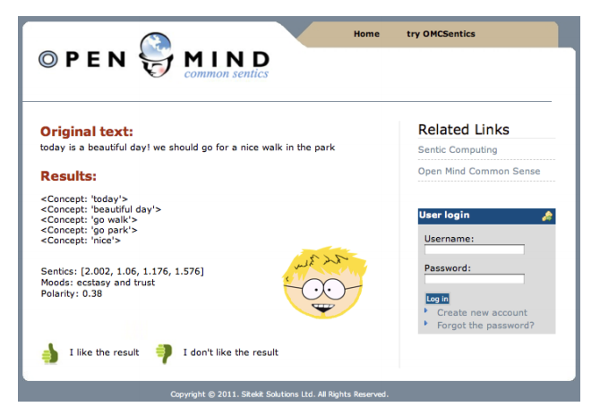
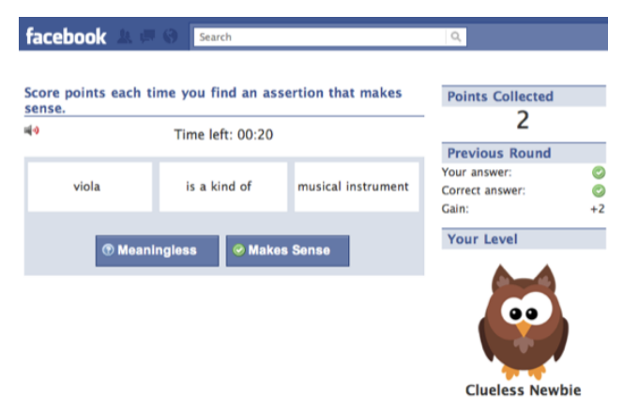
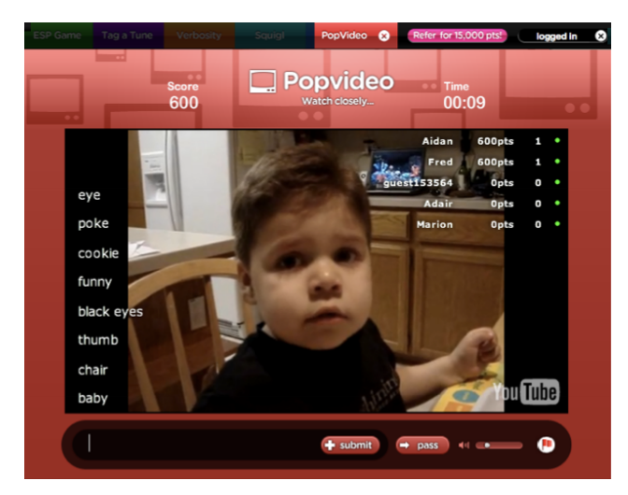
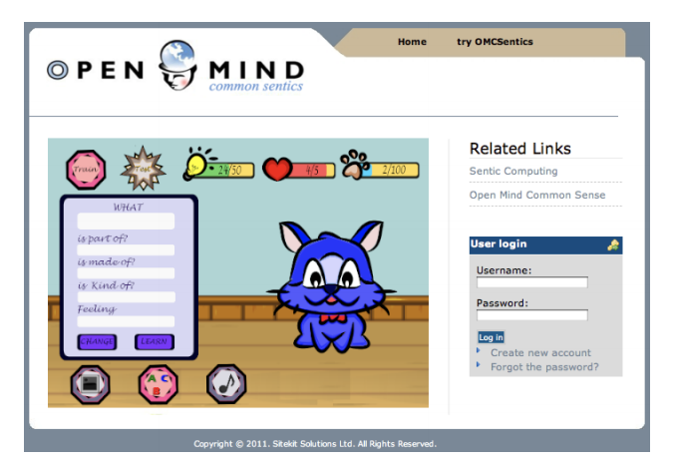
Lesson: GWAPs are useful for acquiring crowdsourcing CS acquisition
Notes:
https://citeseerx.ist.psu.edu/viewdoc/download?doi=10.1.1.684.846&rep=rep1&type=pdf

Slide 44
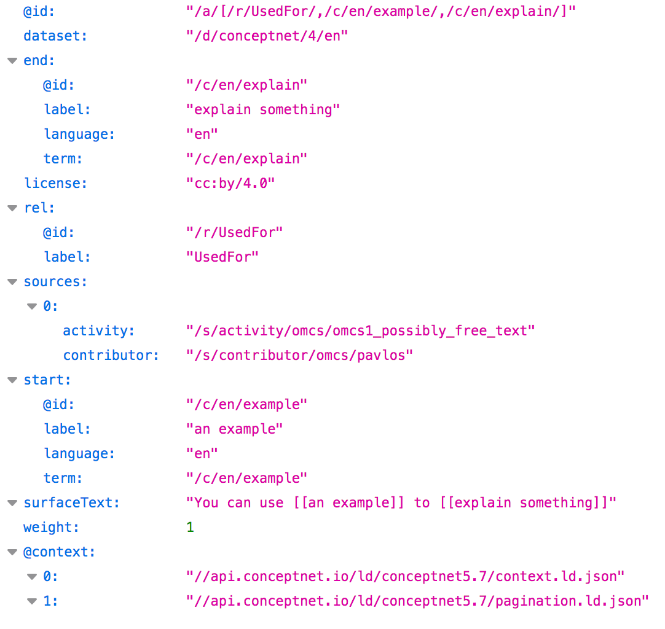
Accessing ConceptNet
ConceptNet has a Linked Open Data API
Available as JSON-LD
ExternalURL links in ConceptNet are used to fulfill LD Principle 4
Linked to several other vocabularies, including WordNet, DBPedia, and OpenCyc
API documentation: https://github.com/commonsense/conceptnet5/wiki/API

Slide 45
With all this knowledge...
Why not use it to understand the nature of commonsense knowledge?
Key idea: Analyzing ConceptNet using a rigorous methodology can enable data-driven understanding of concepts like ‘context’ and ‘negation’

Slide 46
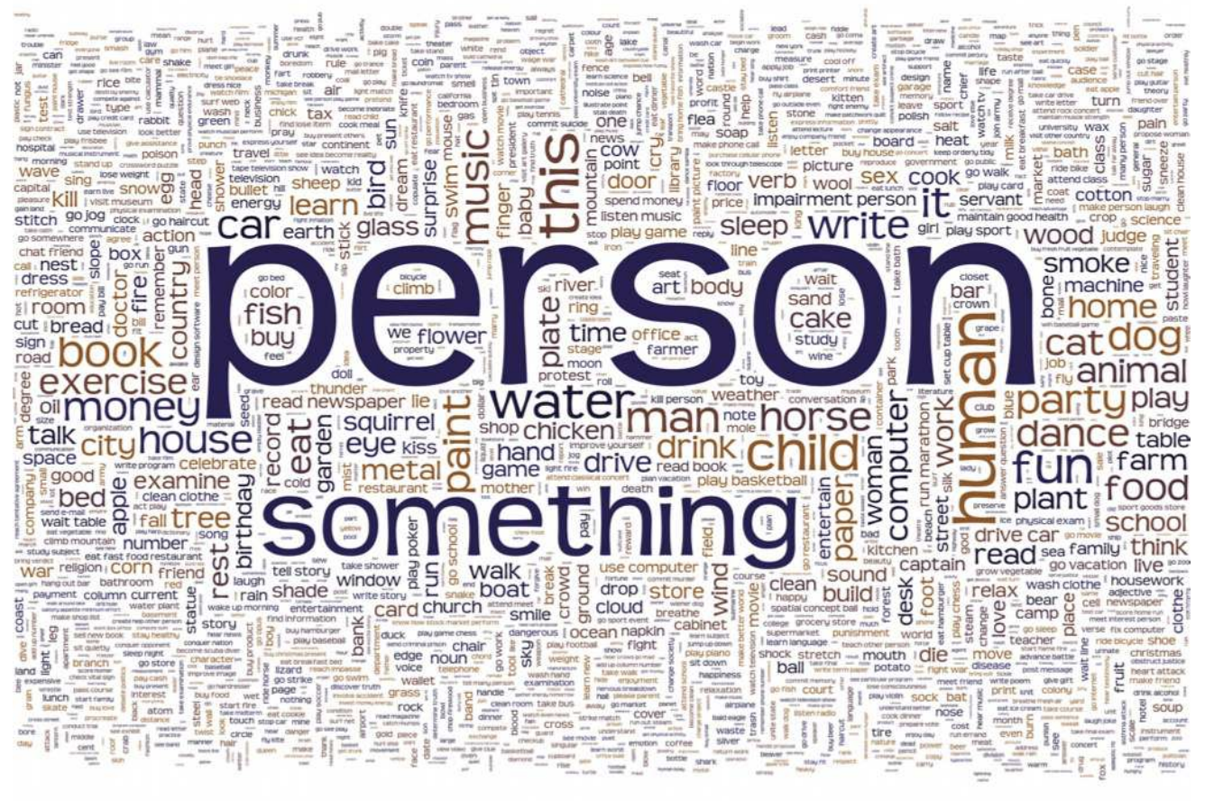
Early work
In 2013, a report showed what we would expect from inductively derived KGs like ConceptNet: inconsistency
Structural analysis showed that some concepts are much more frequent than others
Notes:
Figure 4.1: The 2013 concepts with highest total degree in the directed multigraph induced by assertions of positive score in the English language. For clarity the total degree for the concept person was scaled down to 1/3 of its actual value (see Table 4.1) for better visual output.

Slide 47
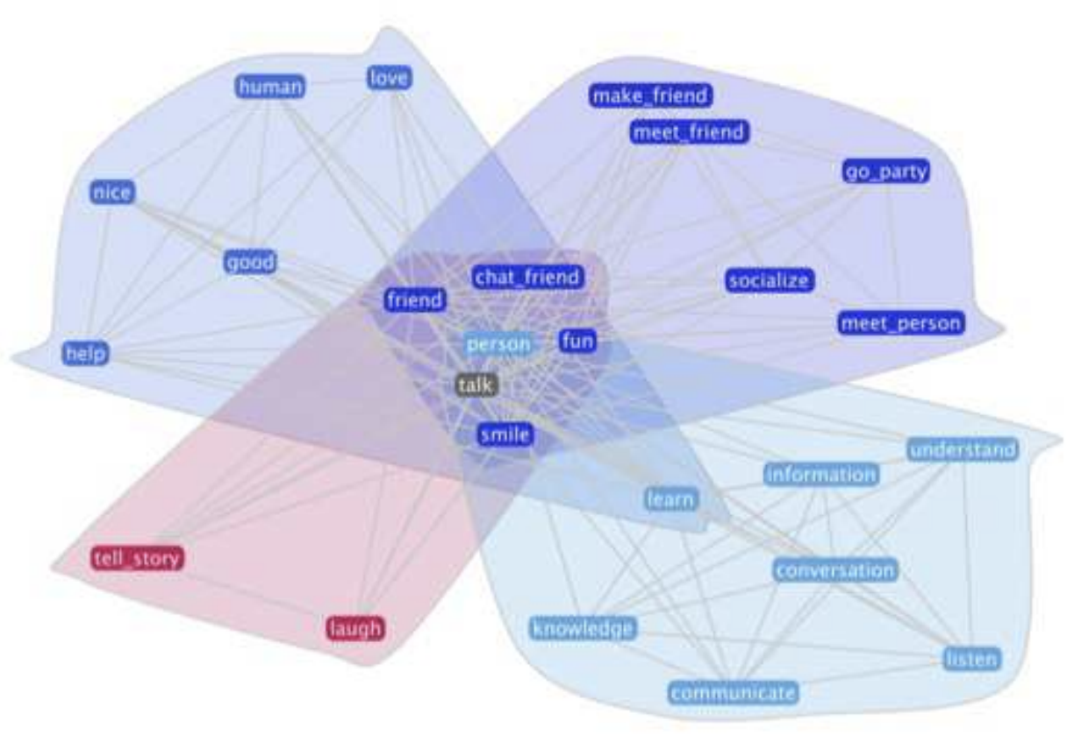
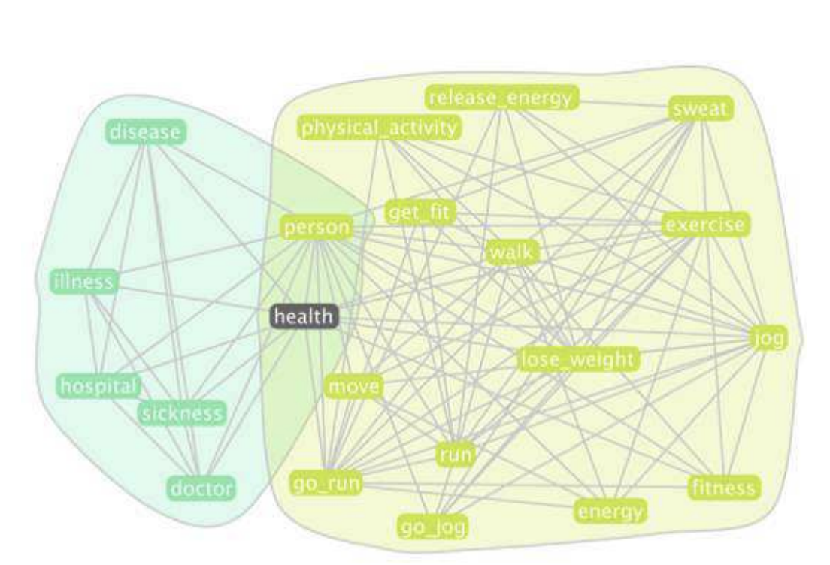
More recent work: using ConceptNet to study ‘context’
What is context and why is it important?
We used PBG for getting KG embeddings on a 4 million-triples sample, and Fit-SNE for visualizations

Slide 48
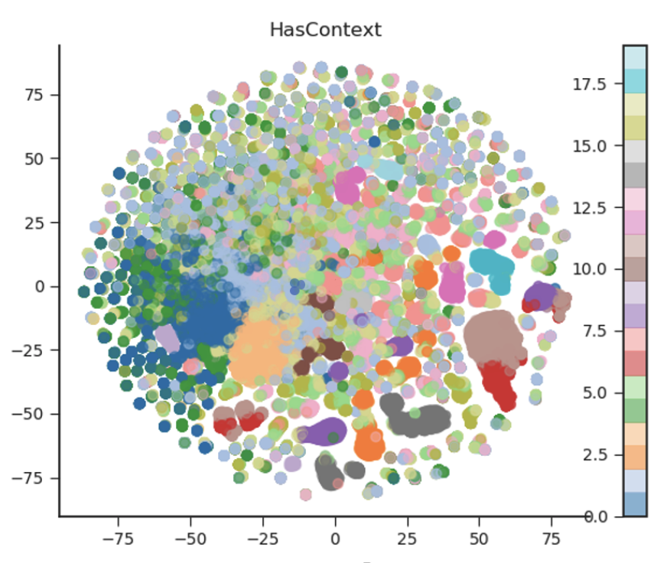
Findings: HasContext sub-structures
Example triples from two ‘obvious’ clusters (1 and 6)

Slide 49
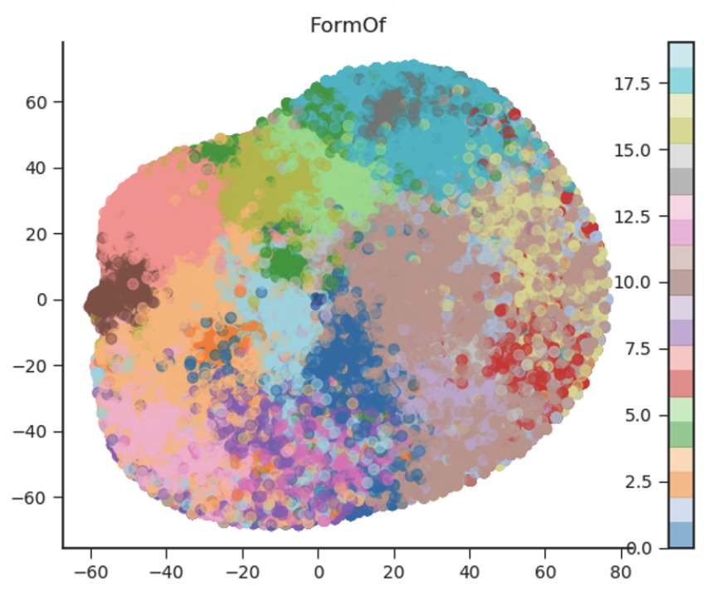
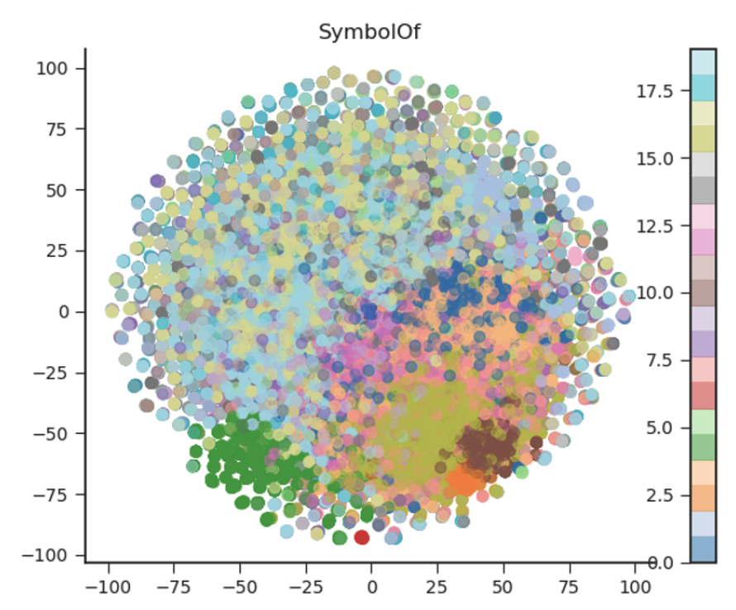
Similar results

Slide 50
Another experiment: Understanding ‘negation’
Can we distinguish between a relation, its negation and its ‘unknowns’ in a visual space?
What if we train a classifier on the embeddings?

Slide 51
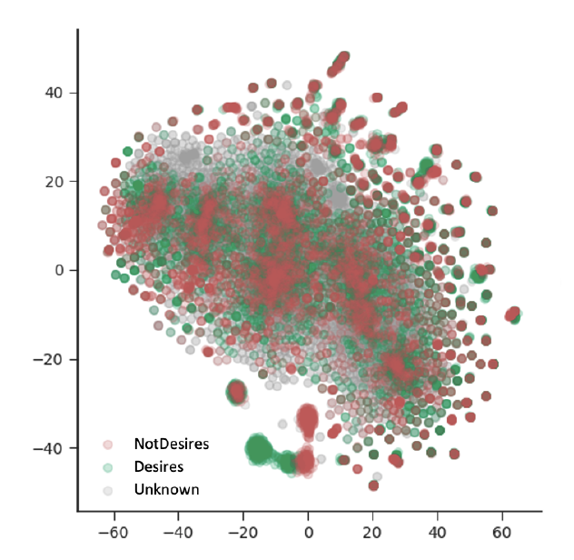
Results (Desires/NotDesires)
Answer to the first question is no, though ‘unknowns’ are more distinctive
Answer to the second question is yes
May help explain why language models don’t (or can’t) do well on negation tasks without extra work

Slide 52
Review of bottom-up commonsense knowledge graphs: Other KGs
Filip Ilievski

Slide 53
Atomic: inferential knowledge in natural language form
https://mosaickg.apps.allenai.org/kg_atomic
Slides adapted from Sap et al. https://homes.cs.washington.edu/~msap/acl2020-commonsense/

Slide 54
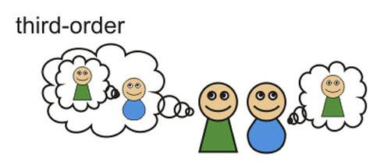
Knowledge of causes and effects
Theory of Mind
Humans have theory of mind, allowing us to
make inferences about people’s mental states
understand likely events that precede and follow (Moore, 2013)
AI systems struggle with inferential reasoning
only find complex correlational patterns in data
limited to the domain they are trained on
(Pearl; Davis and Marcus 2015; Lake et al. 2017; Marcus 2018)
Notes:
The motivation behind choosing the type of knowledge in ATOMIC

Slide 55
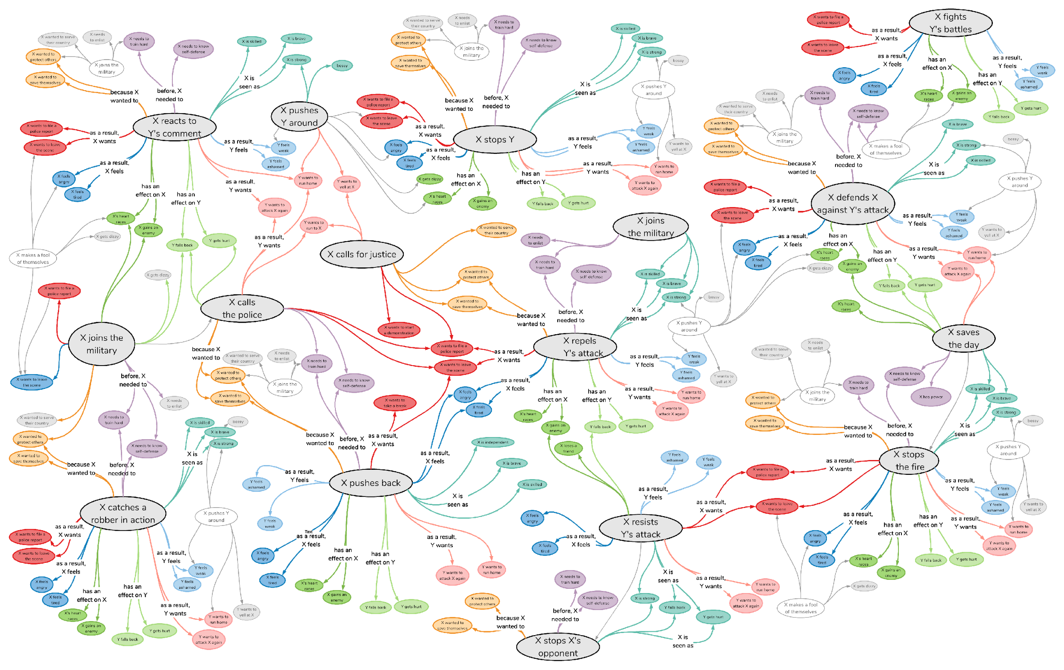
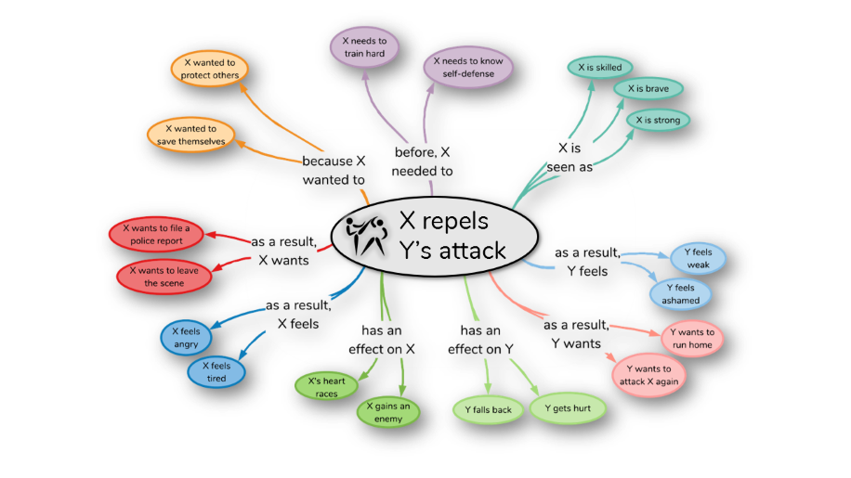
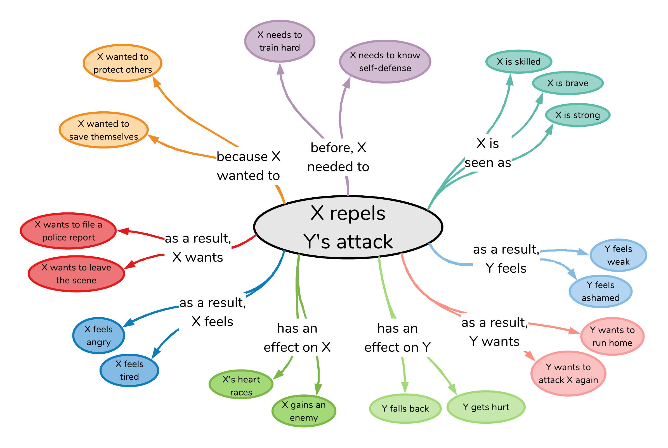
X repels Y’s attack
Atomic: 880,000 triples for AI systems to reason about causes and effects of everyday situations
Notes:
and what I mean by ATLAS is this HUGE knowledge graph that covers knowledge about the causes and effects of everyday situations.
What I mean by this is, given an event like

Slide 56
X repels Y’s attack
Notes:
What I mean by this is, given an event like “X repels Y’s attack”, as humans we have commonsense that allows us to make all sorts of inferences around this situation;
why did it happen? how do participants feel? etc.

Slide 57
nine inference dimensions
X repels Y’s attack
Notes:
ATOMIC distills this type of inferential knowledge into NINE different of knowledge dimensions, shown here around the event.
These dimensions cover knowledge around the CAUSES of the event,

Slide 58
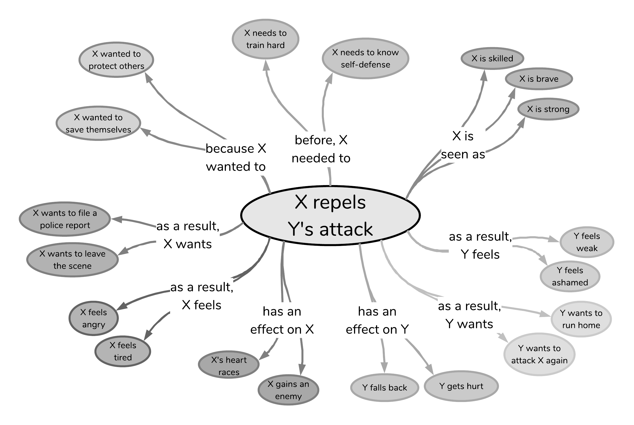
Causes
X repels Y’s attack
Effects
Notes:
These dimensions cover knowledge around the CAUSES of the event, ….
And knowledge around the EFFECTS of the event

Slide 59
Static
Dynamic
X repels Y’s attack
Notes:
In addition to all these dynamic cause and effect inferences humans can make around events,
ATOMIC also covers static knowledge about how event participants are seen or described while the event happens, such as here where X is seen as strong, skilled or brave.

Slide 60
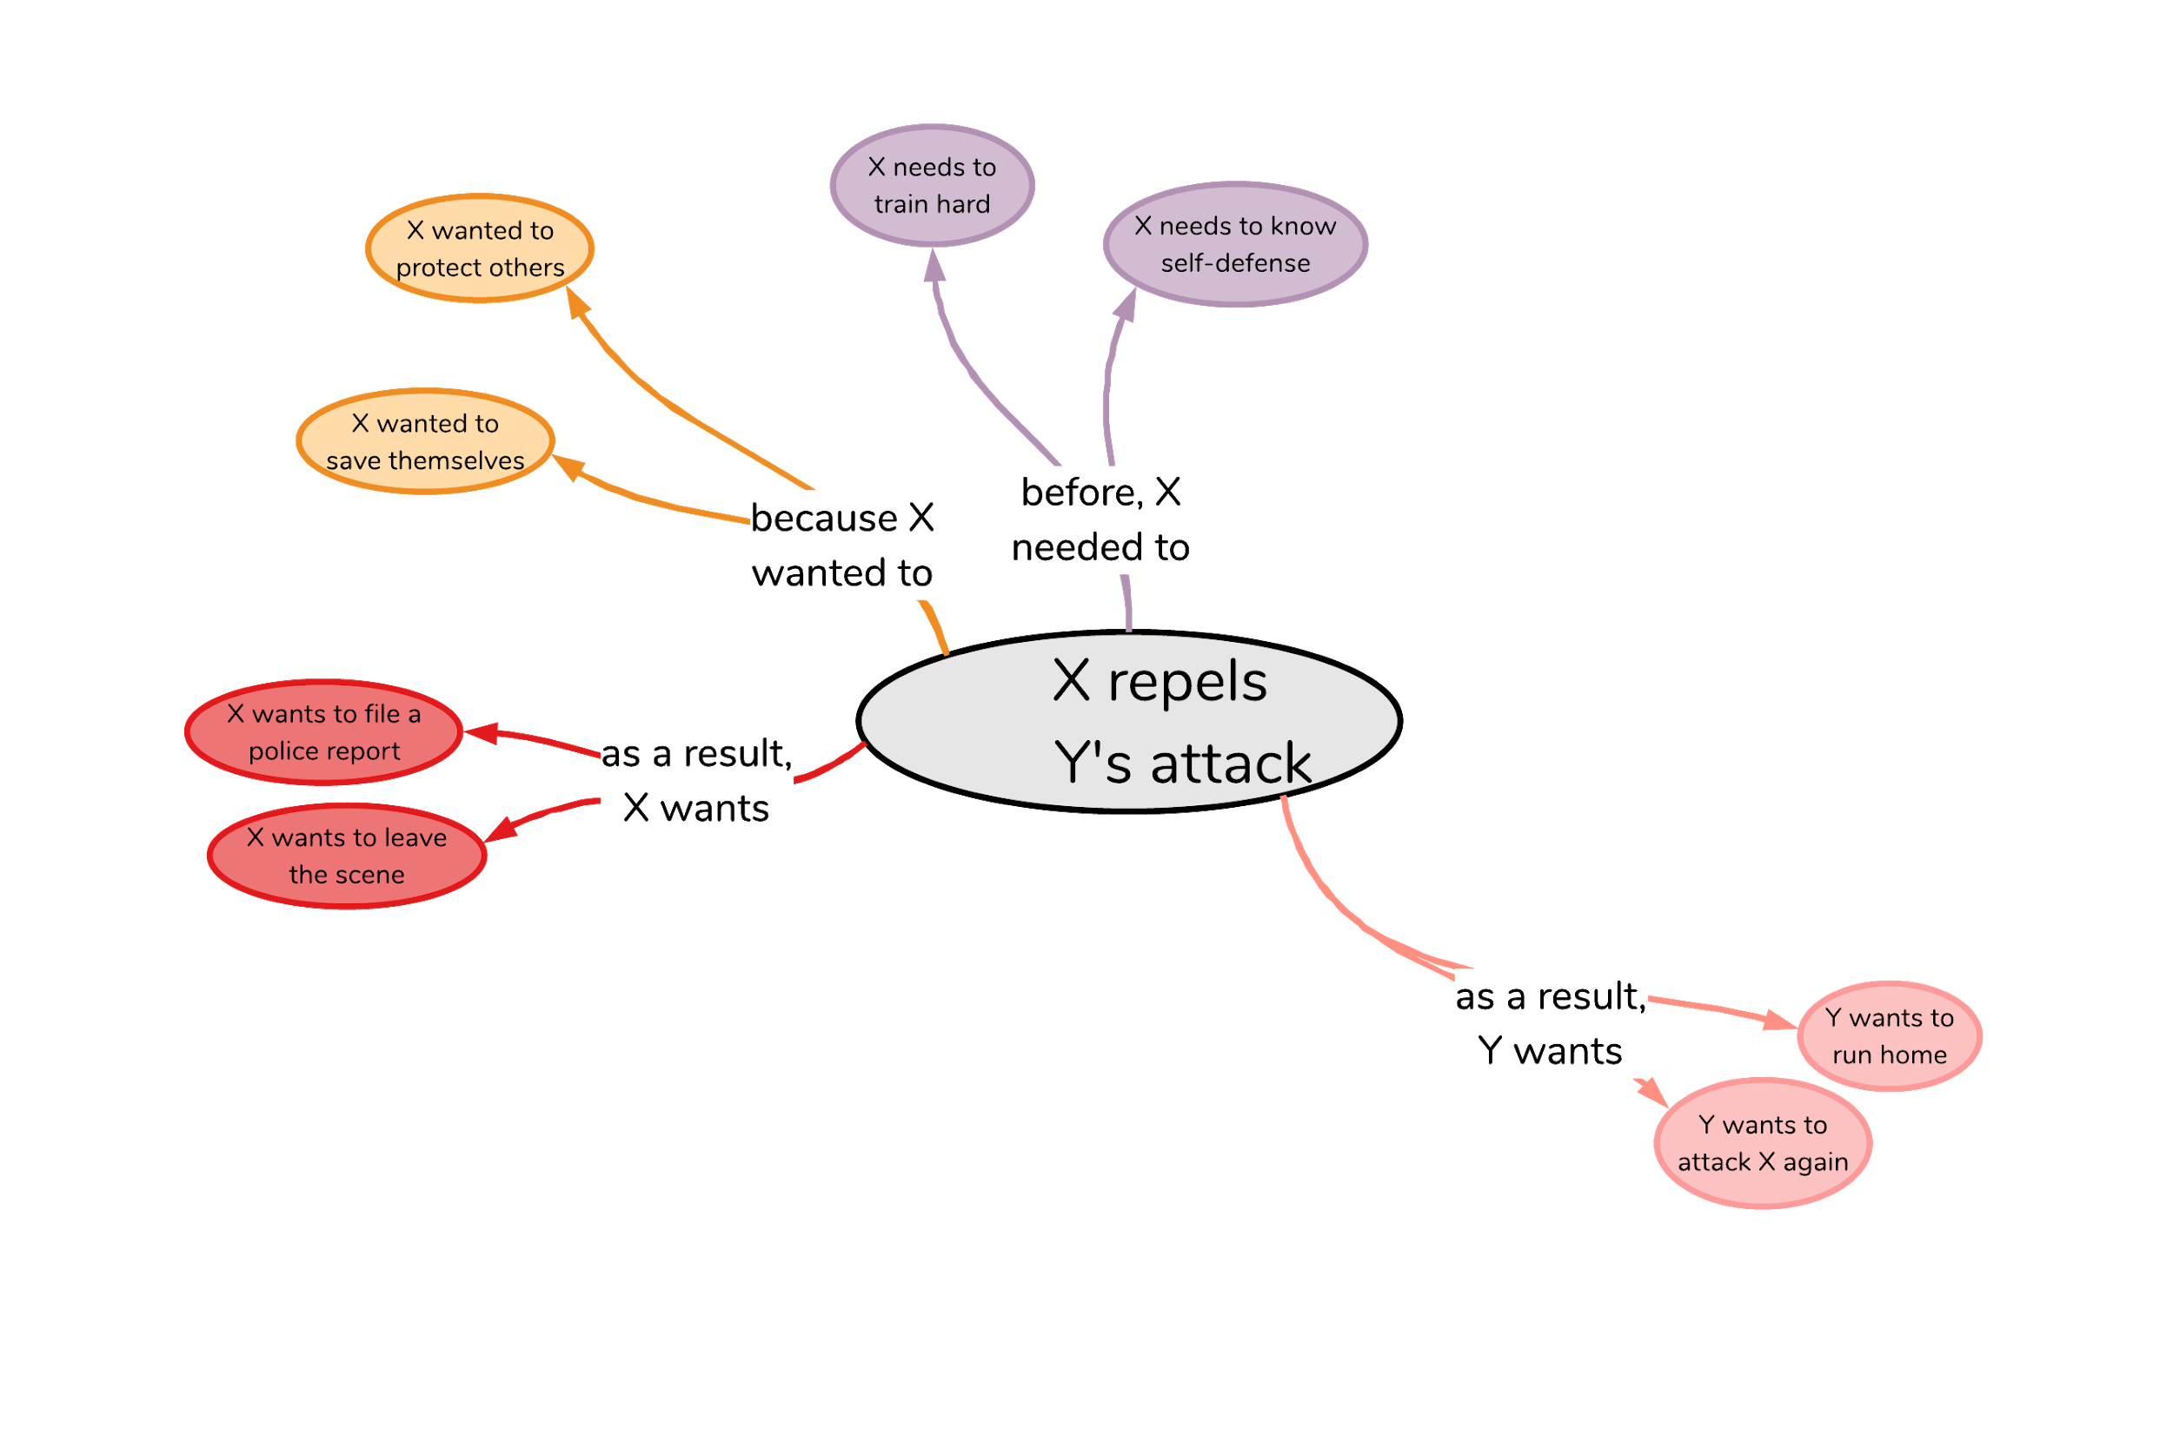
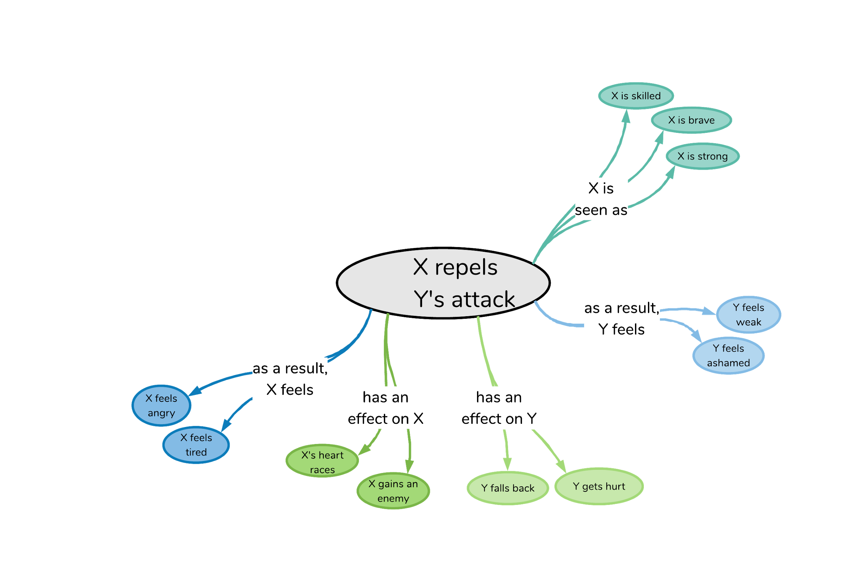
Voluntary
X repels Y’s attack
Involuntary
Notes:
Another way to look at this knowledge is in terms of volitionality.
ATOMIC covers both the more voluntary dimensions, such as what people need or want to do,
As well as more involuntary effects or implications of events, such as people’s reactions or how people are seen.

Slide 61
X repels Y’s attack
Theme
Agent
Notes:
And last but not least, the knowledge in ATOMIC can also be thought about in terms of “what happens to whom”.
So specifically, what inferences can we make about the AGENT of the event, here, X,
Versus what inferences can we make about the THEME of the event, here, Y

Slide 62
300,000 event nodes to date
880,000 if-Event-then-* knowledge triples
X repels Y’s attack
Notes:
All this knowledge is contained in our knowledge graph that, to date, contains OVER 300 THOUSAND event nodes, connected in NEARLY 900 THOUSAND if-Event-then-SOMETHING triples

Slide 63
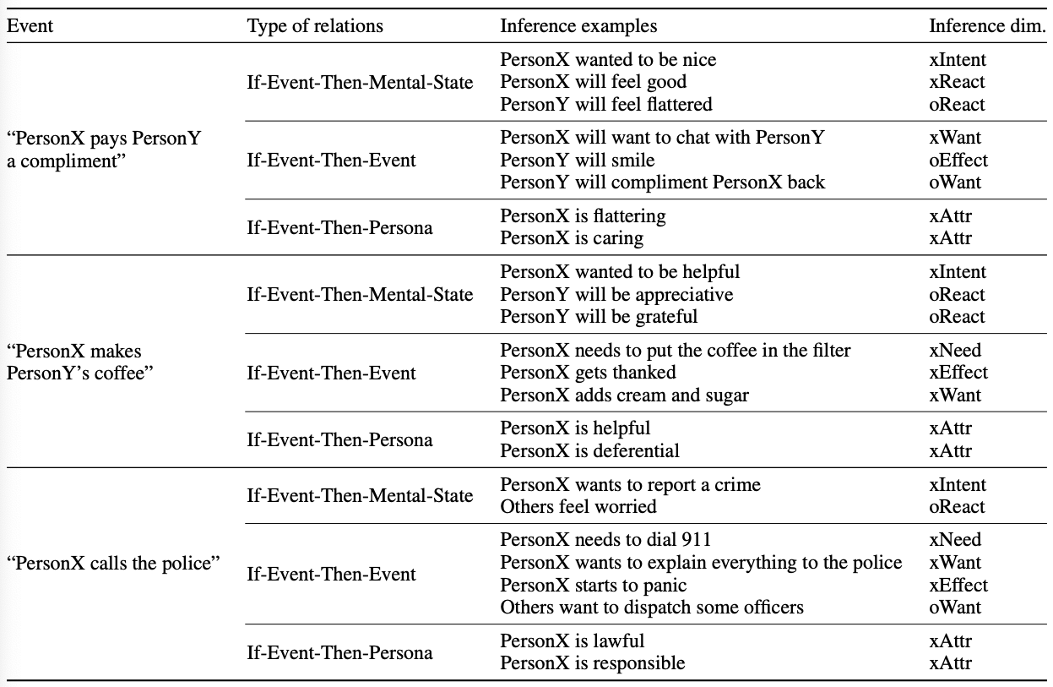

Slide 64
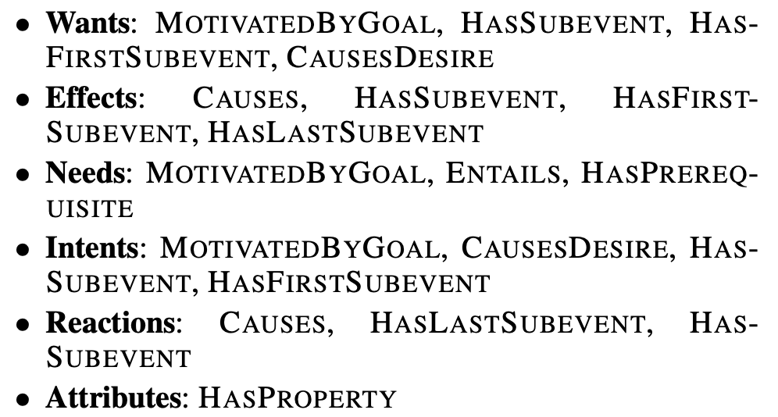
Best-effort mappings to ConceptNet

Slide 65
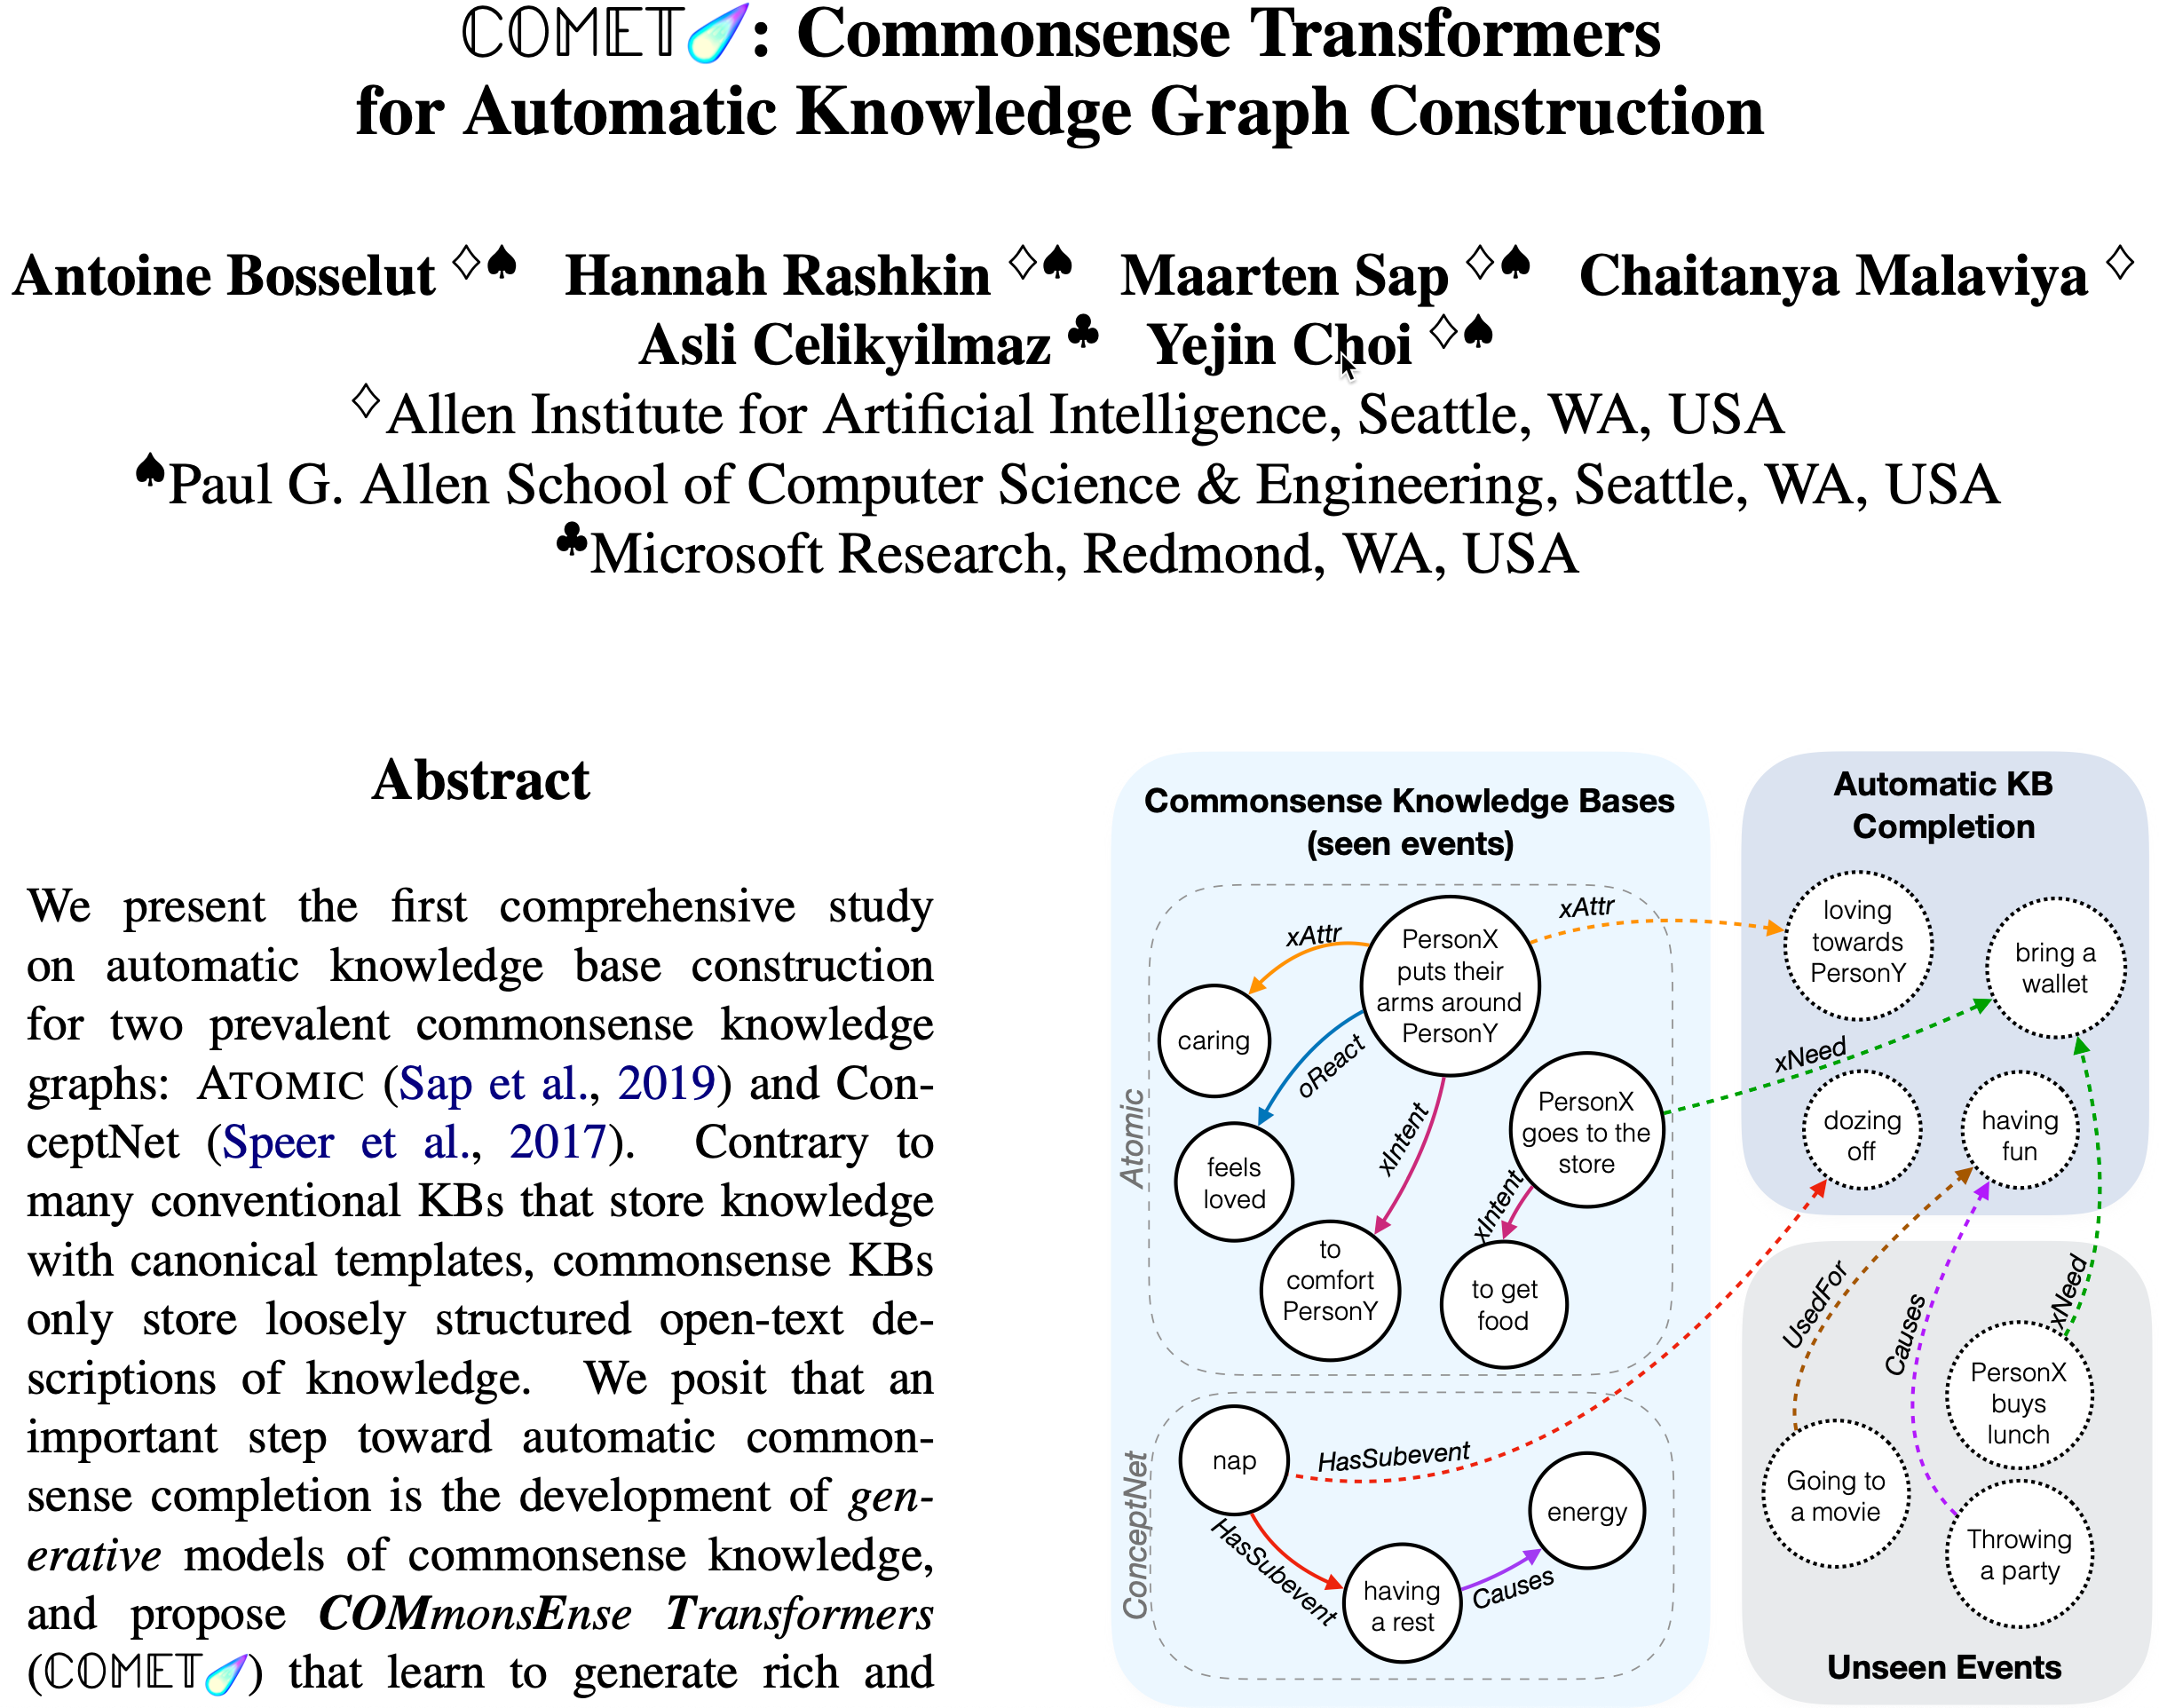

Slide 66
Building Common Sense KGs Is Hard
Commonsense knowledge is immeasurably vast, making it impossible to manually enumerate
Commonsense knowledge is often implicit, and often can’t be directly extracted from text
Slide by Antoine Bosselut

Slide 67
Traditional KB Completion
Slide by Antoine Bosselut

Slide 68
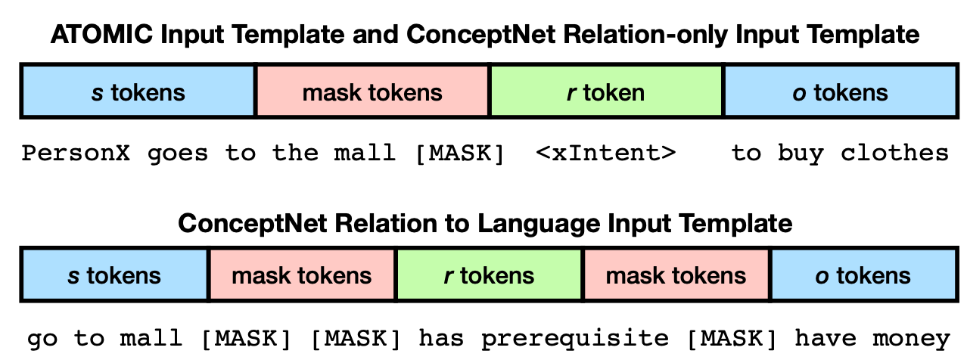
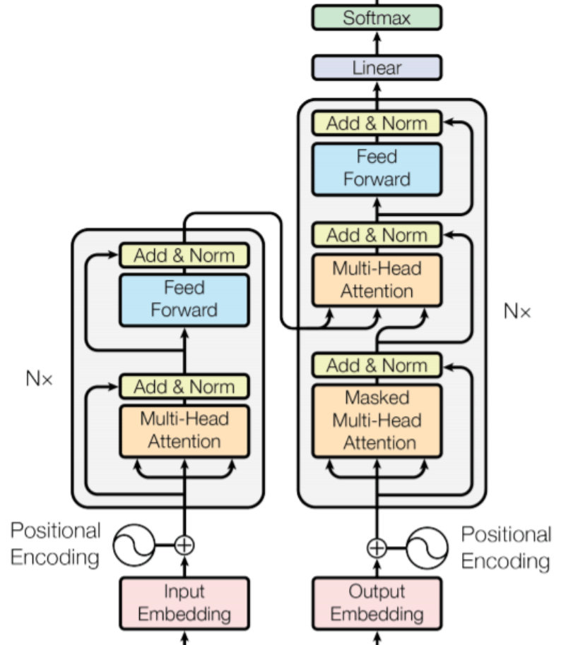
COMET Idea
Transformer
Architecture
COMET

Slide 69
Symbolic Knowledge Graph
Knowledge stored as triples
Knowledge is not contextualized
Knowledge is incomplete

Slide 70
Symbolic Knowledge Graph
Knowledge stored as triples
Knowledge is not contextualized
Knowledge is incomplete
COMET Knowledge Base Transformer
Knowledge generated dynamically
Input format is natural language
Kai knew that things were getting out of control and managed to keep his temper in check
Kai wants to avoid trouble
Kai intends to be calm
Kai stays calm
Kai is viewed as cautious

Slide 71
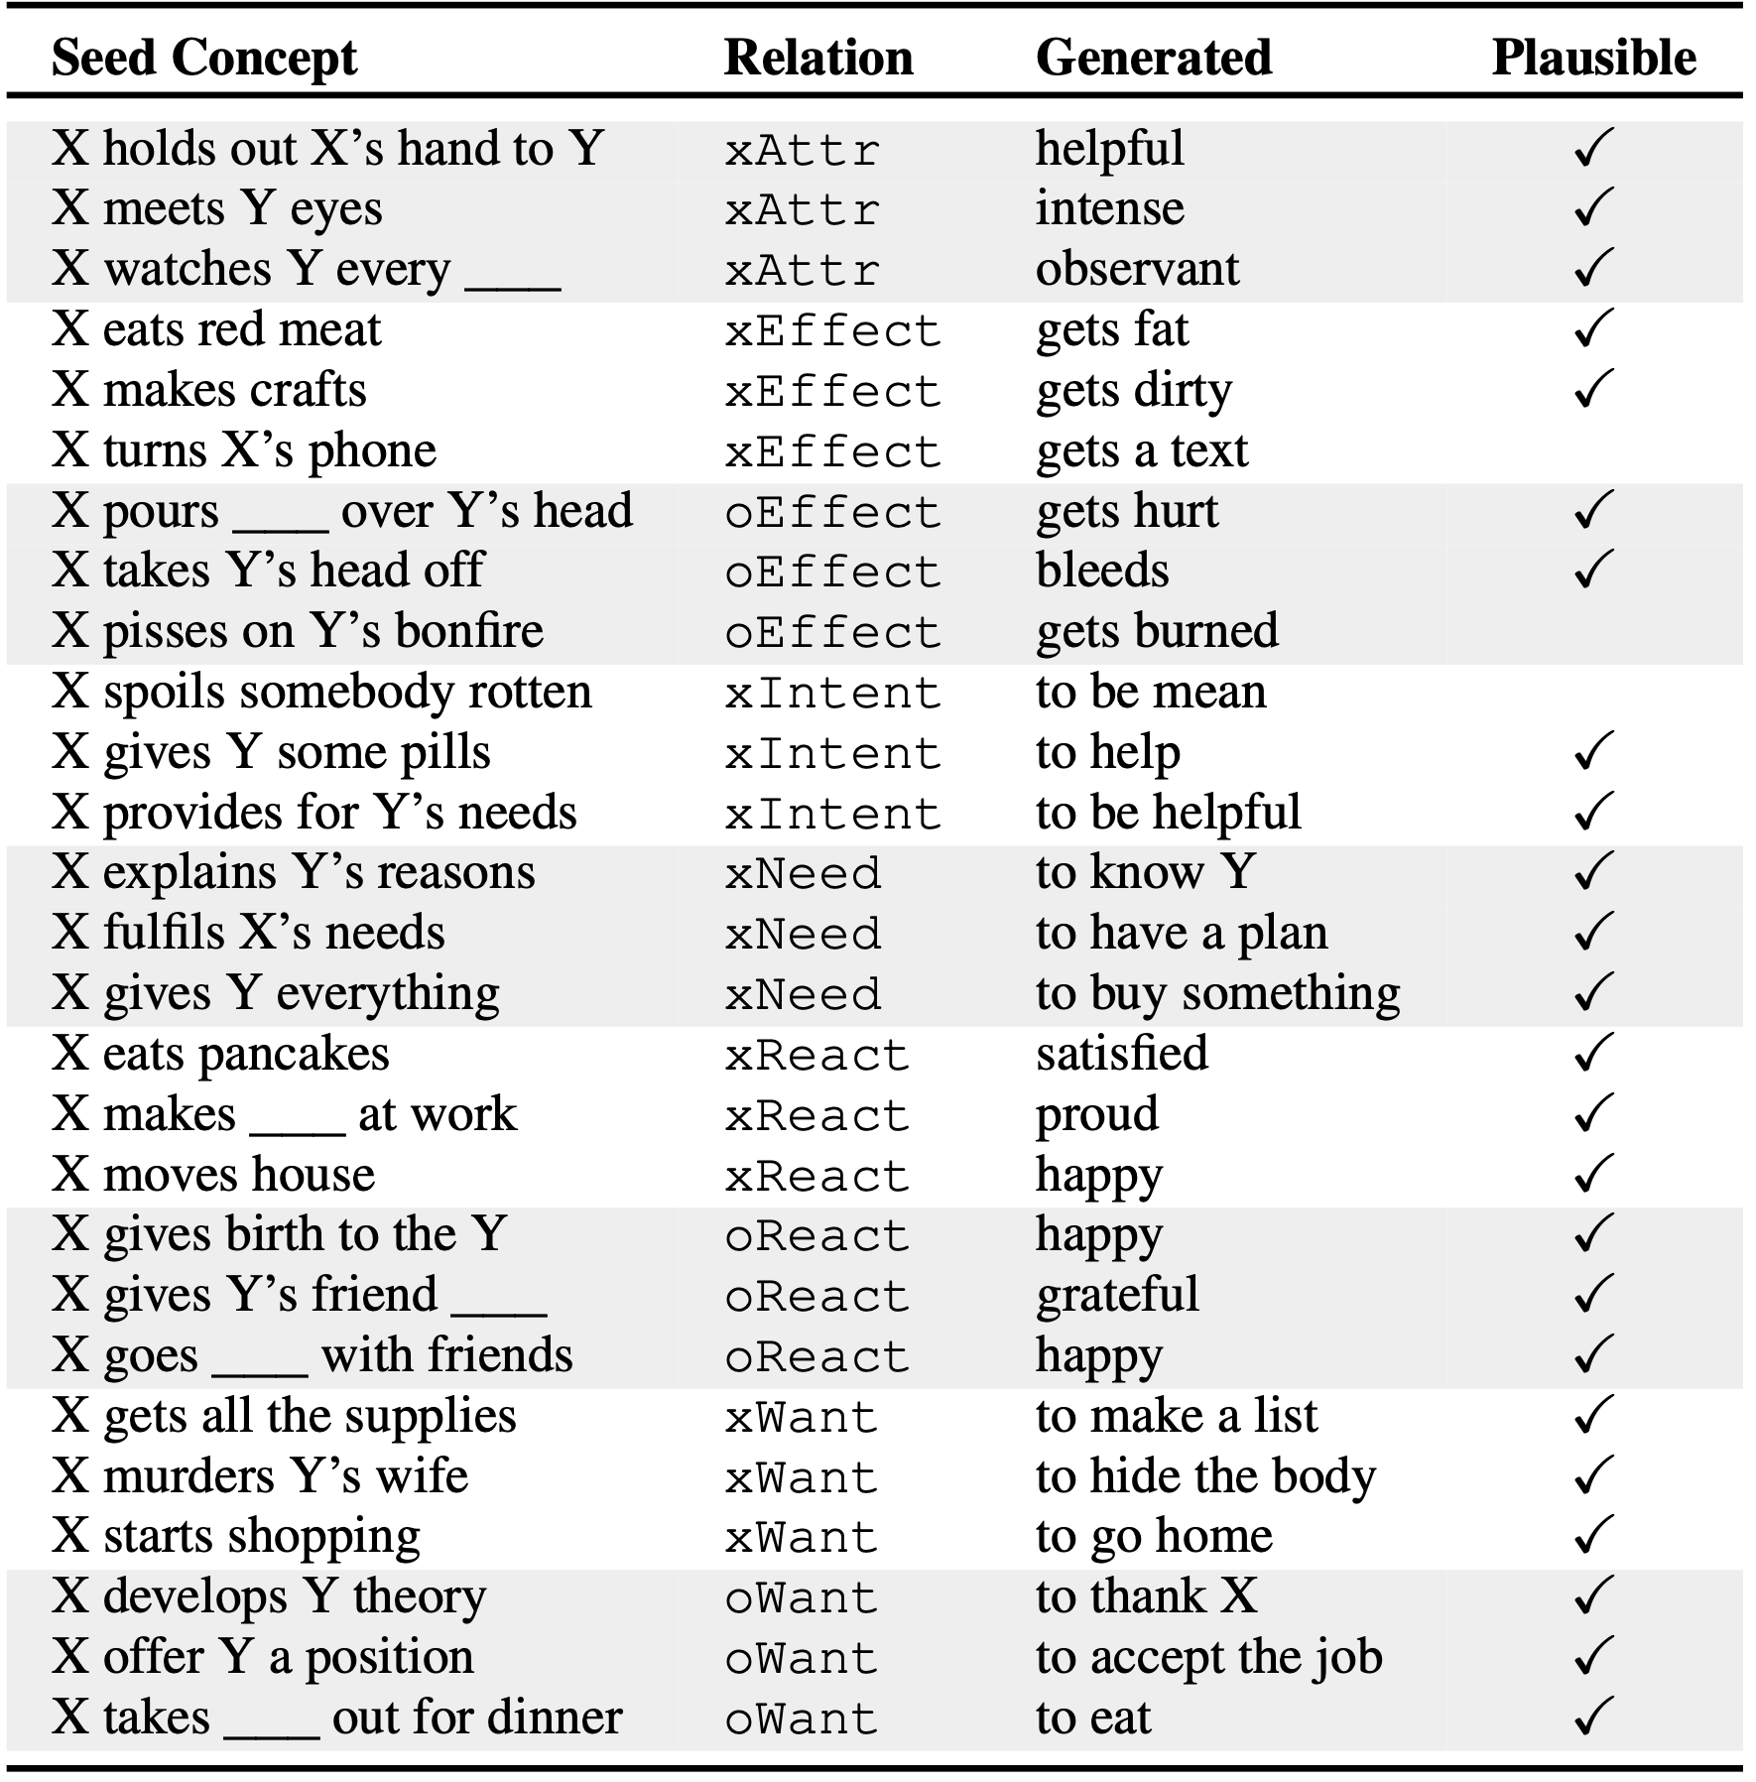
Randomly selected novel generations from ATOMIC

Slide 72
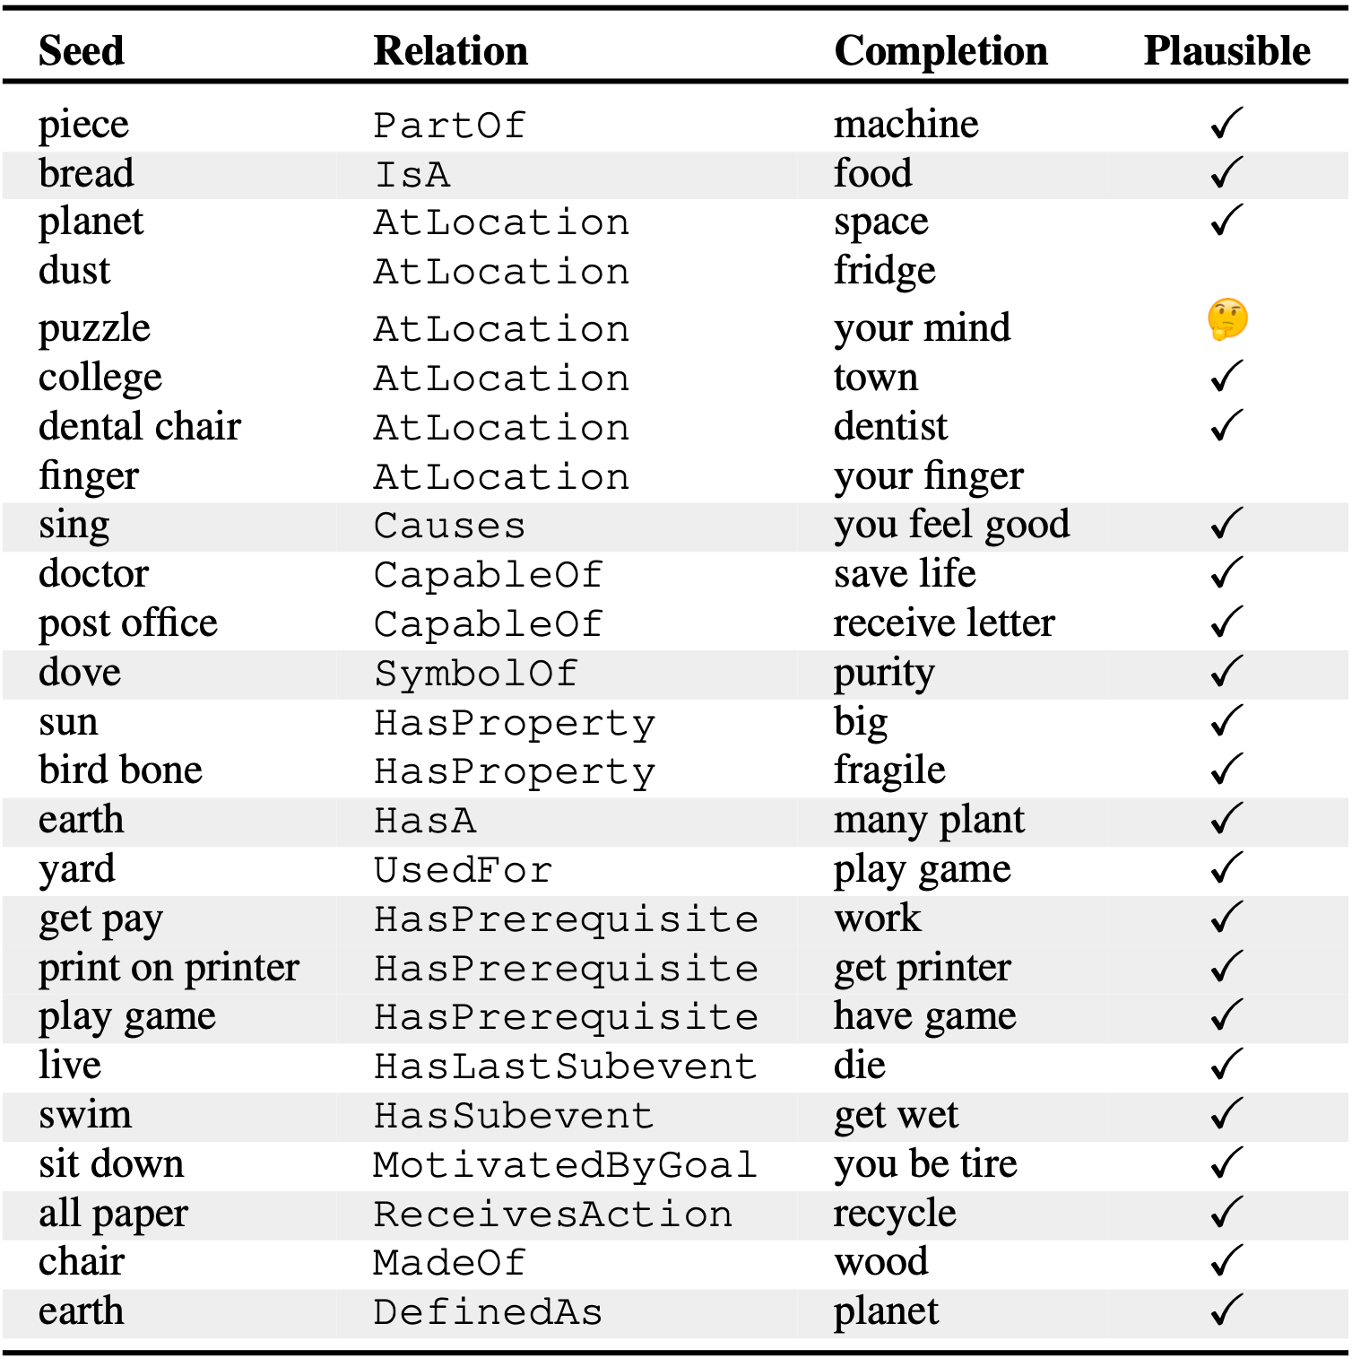
Randomly selected novel generations from ConceptNet

Slide 73
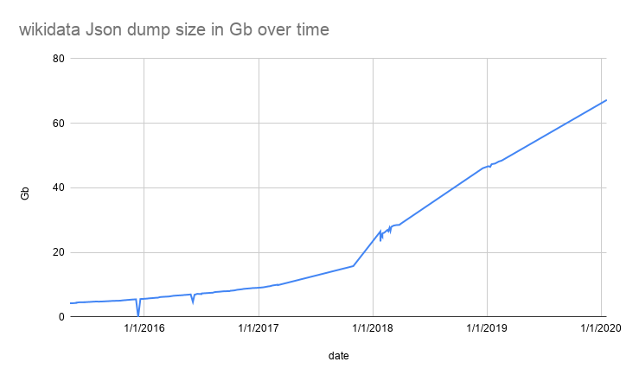
Wikidata
90M nodes >1.1B edges 8k properties
How to distill commonsense knowledge?
Slides from Ilievski et al. (2020). Commonsense Knowledge in Wikidata. Wikidata Workshop at ISWC 2020

Slide 74
Principles of Commonsense Knowledge
P1: Concepts, not entities houses have rooms Versailles Palace has 700 rooms
WD guidelines on entity capitalization

Slide 75
Principles of Commonsense Knowledge
P1: Concepts, not entities houses have rooms Versailles Palace has 700 rooms
WD guidelines on entity capitalization
P2: Common concepts Container used for storage Noma subclass of aphthous stomatitis
Corpus frequency

Slide 76
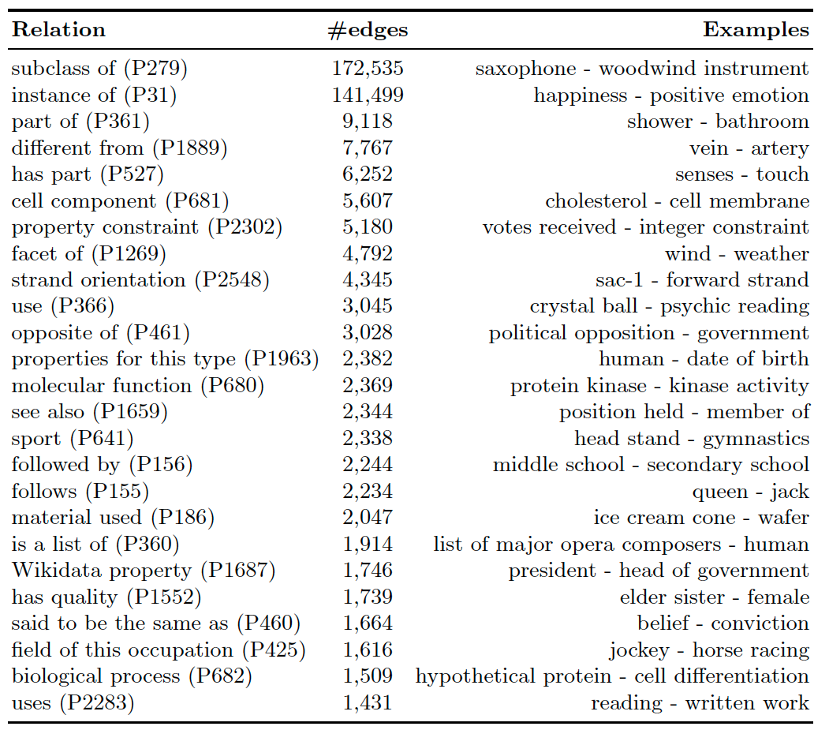
After step 1 & 2:
414 relations
421k edges

Slide 77
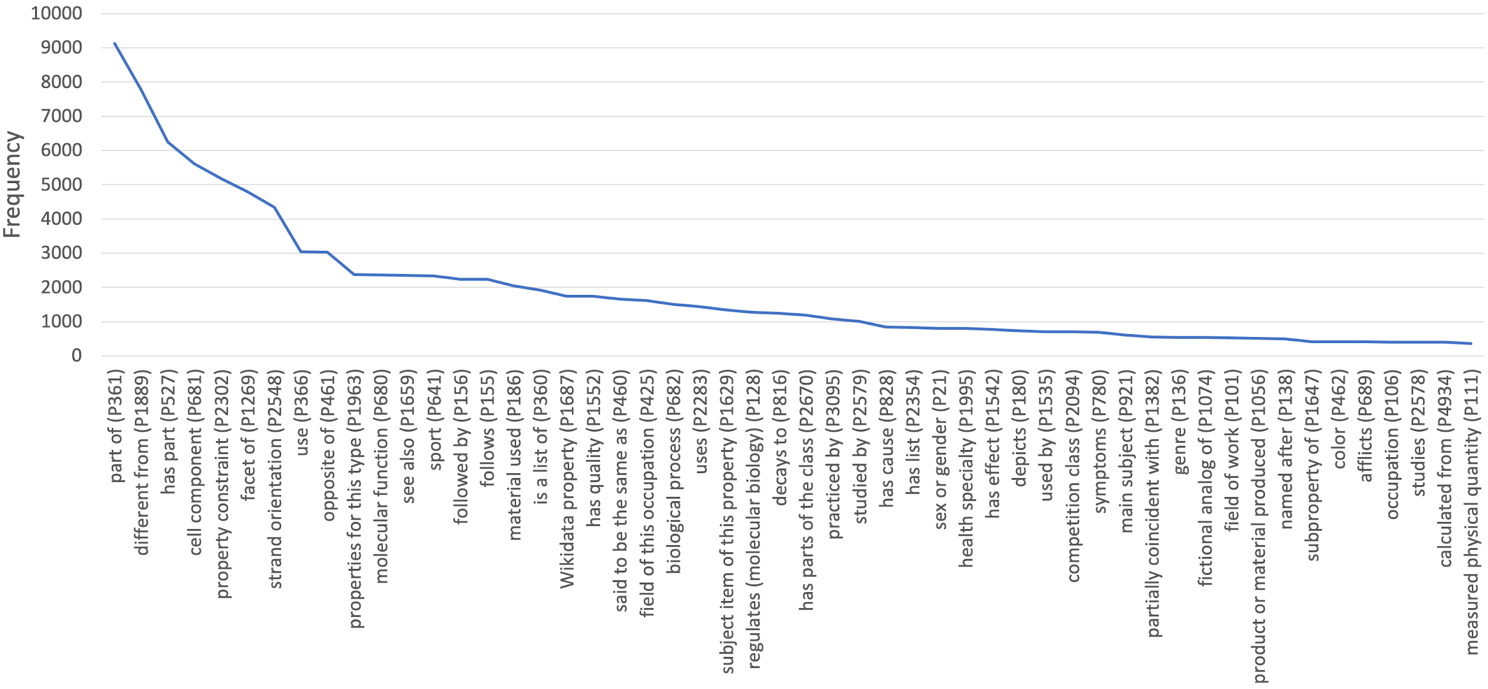

Slide 78
Principles of Commonsense Knowledge
P1: Concepts, not entities houses have rooms Versailles Palace has 700 rooms
WD guidelines on entity capitalization
P2: Common concepts Container used for storage Noma subclass of aphthous stomatitis
Corpus frequency
P3: General-domain relations wheel is part of a car cholesterol has component cell membrane
Mapping to ConceptNet

Slide 79
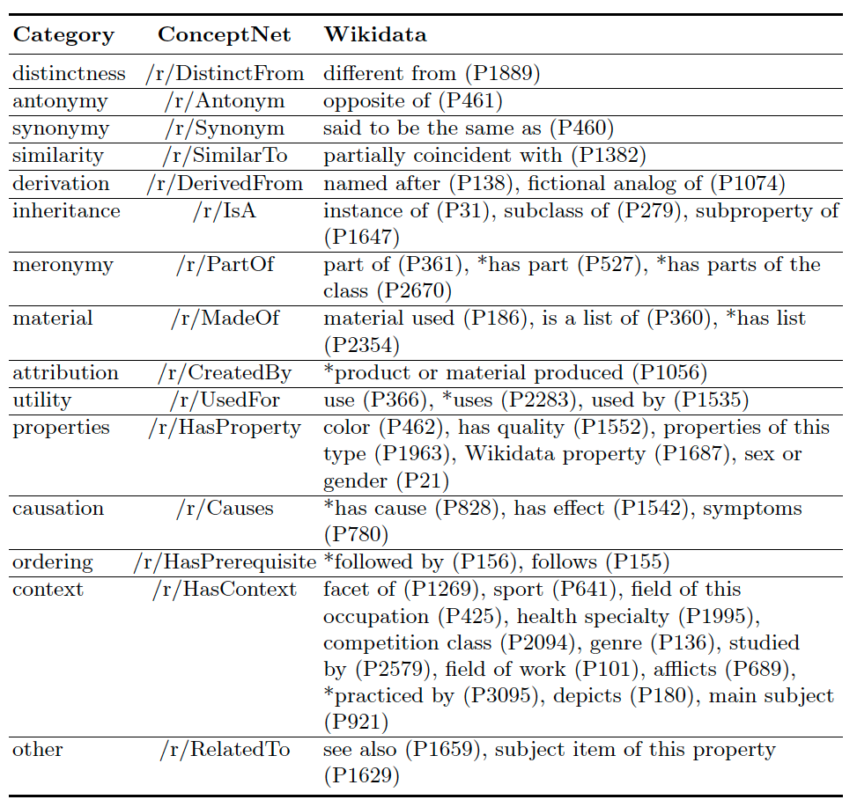
Mapping general-domain relations to ConceptNet

Slide 80
Wikidata-CS = 0.01% * Wikidata
 | Wikidata-CS | Wikidata | Ratio
# nodes | 71,243 | 84 million | 0.08%
# edges | 101,771 | 1.5 billion | 0.01%

Slide 81
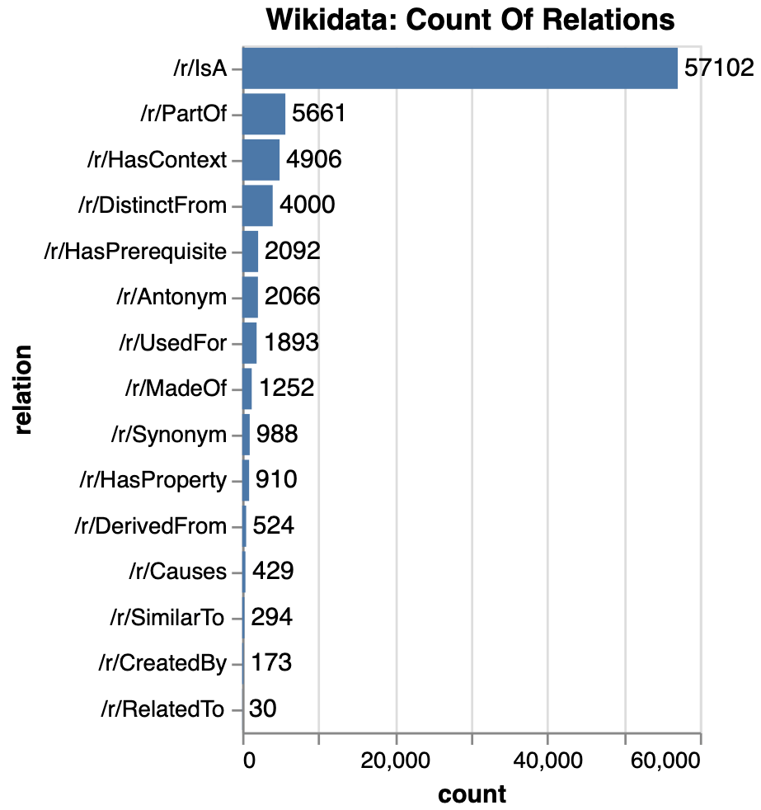

Slide 82
Commonsense Knowledge in Wikidata
shower part of bathroom
reading uses written work
queen follows jack
political opposition opposite of government

Slide 83
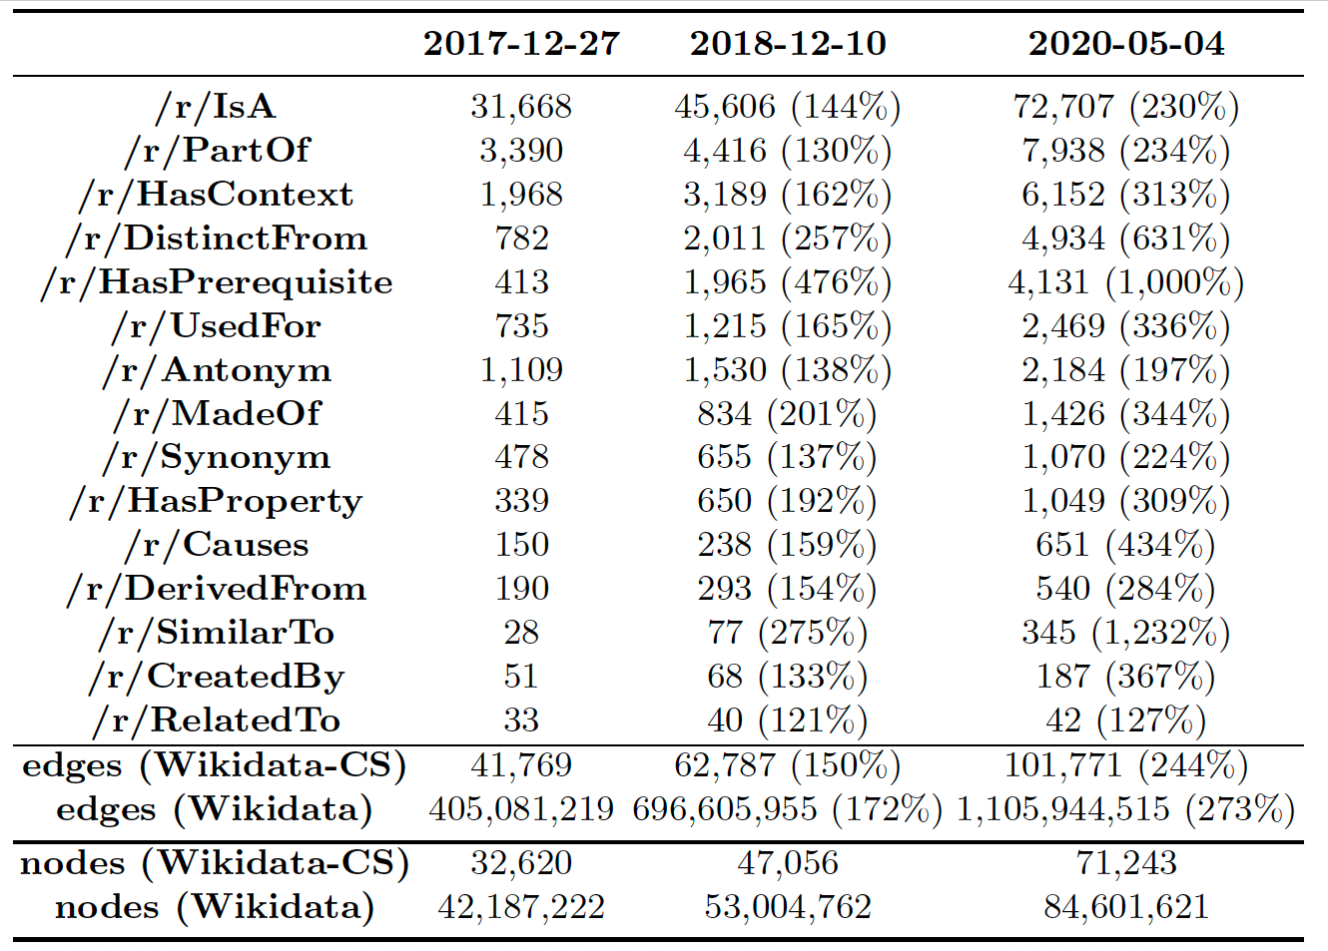
Has it been growing over time?

Slide 84
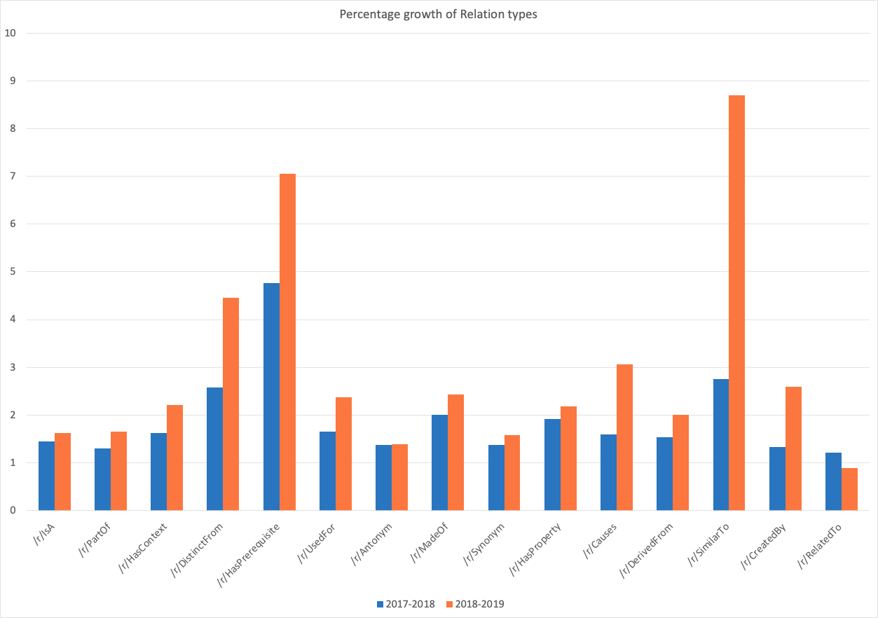
Growth per relation type (12-month)

Slide 85
Wikidata-CS Is Small But Novel
ConceptNet
3.4M edges
2.4K edges
Wikidata-CS
102K edges

Slide 86
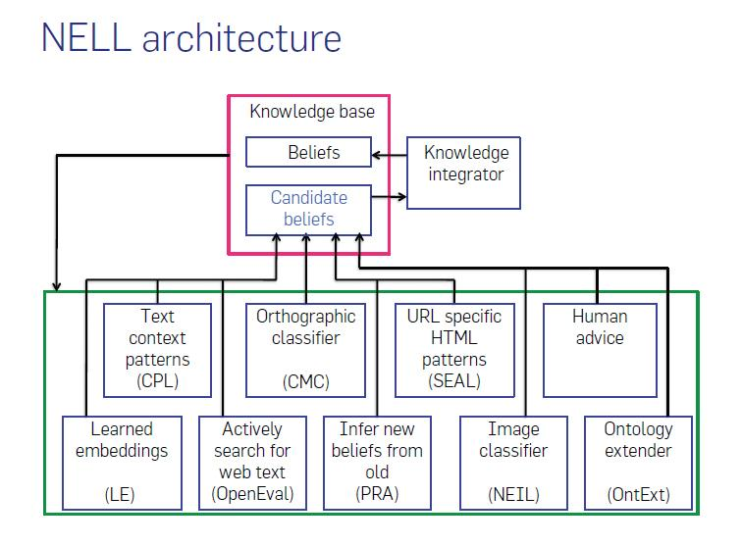
Never-Ending Language Learning (NELL)
https://cacm.acm.org/magazines/2018/5/227193-never-ending-learning/fulltext

Slide 87
NELL statistics
100M candidate beliefs
3M high-confidence facts
~3K predicates
https://cacm.acm.org/magazines/2018/5/227193-never-ending-learning/fulltext

Slide 88
https://cacm.acm.org/magazines/2018/5/227193-never-ending-learning/fulltext

Slide 89
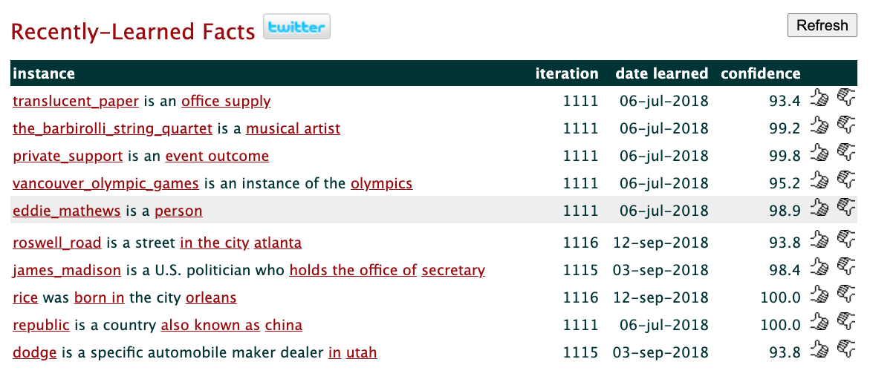
Latest learned facts

Slide 90
WebChild
Automatic acquisition and organization of common sense
>18M assertions
>2M disambiguated concepts and activities
Tandon et al. (2017). Webchild 2.0: Fine-grained commonsense knowledge distillation. ACL 2017

Slide 91
WebChild relations
1. object properties hasTaste, hasShape, evokesEmotion
2. comparative fasterThan, smallerThan
3. part-of member of, physical part of, substance of
4. activities

Slide 92
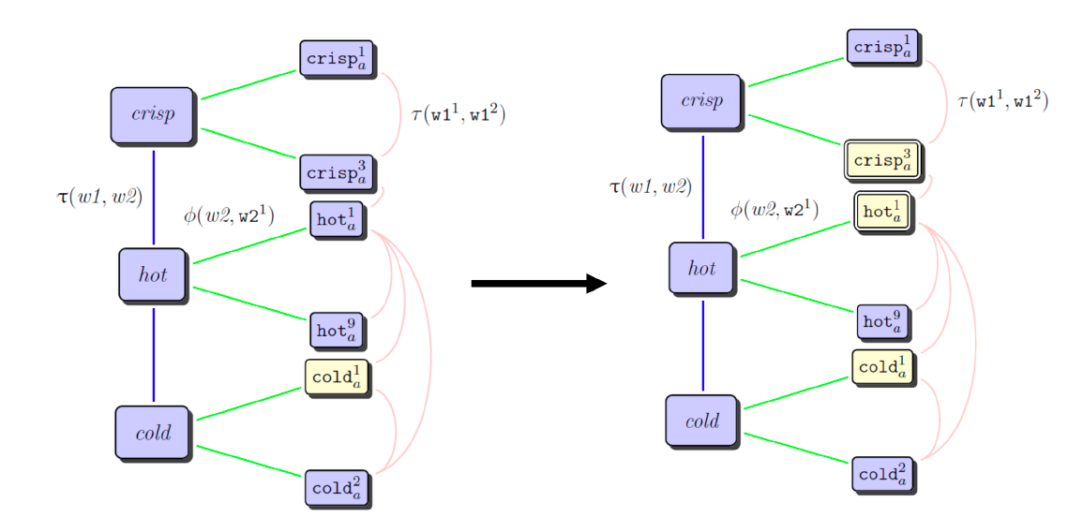
WebChild label propagation

Slide 93
WebChild activity extraction

Slide 94
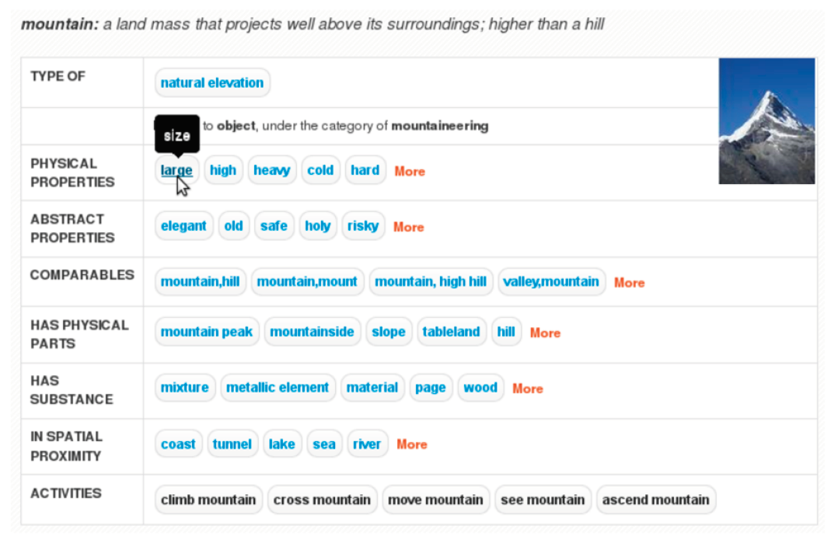
Example
Demo

Slide 95
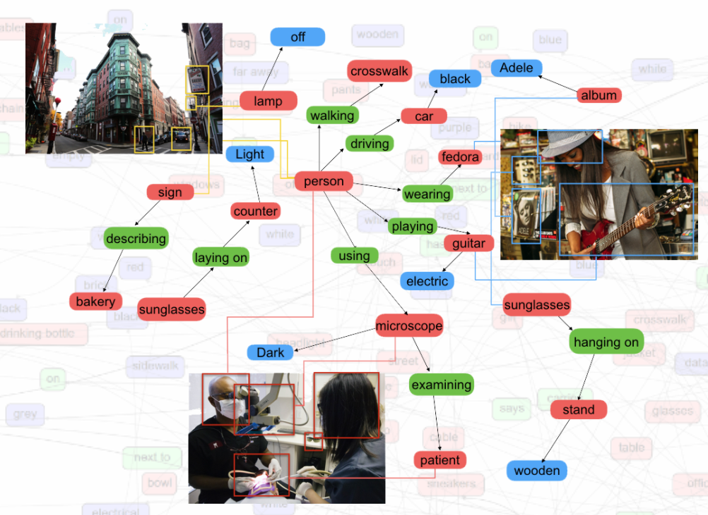
Visual Genome
108k images
annotated with scene graphs
canonicalized to WordNet senses
Krishna et al. (2017). Visual genome: Connecting language and vision using crowdsourced dense image annotations. International journal of computer vision

Slide 96
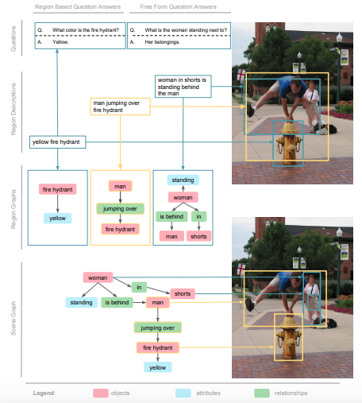
Components
region descriptions
objects
attributes
relationships
region graphs
scene graphs
question-answer pairs

Slide 97
Statistics
108,077 images
50 descriptions per image
objects
3.8M in total (35 objects per image)
33,877 categories (synsets)
attributes
26 per image
68,111 categories (synsets)
relationships
21 per image
42,374 categories (synsets)
QA pairs
1.7 million

Slide 98
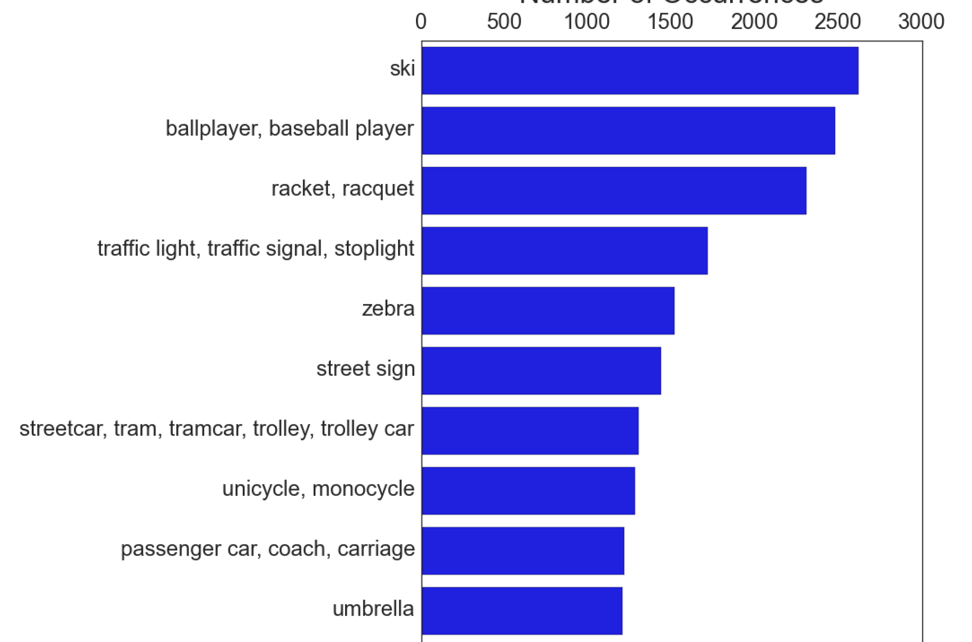
Top 10 synsets
Top 10 object categories
Top 10 words
Top 10 phrases

Slide 99
Visual Genome as a KG
Objects = WordNet senses ‘red shoe’ is the label shoe#n#1 is the node

Slide 100
Visual Genome as a KG
Objects = WordNet senses ‘red shoe’ is the label shoe#n#1 is the node
Relationships = proximity ‘on top of’ is the label /r/LocatedNear is the relation

Slide 101
Visual Genome as a KG
Objects = WordNet senses ‘red shoe’ is the label shoe#n#1 is the node
Relationships = proximity ‘on top of’ is the label /r/LocatedNear is the relation
Attributes
(POS=v) /r/CapableOf (POS=a) mw:MayHaveProperty (POS=n) -

Slide 102
Some other CKGs
WordNet
FrameNet
VerbNet
ROGET
Tuple KB
Quasimodo KB
PropStore

Slide 103
Demos

Slide 104
https://caninehq.com/best-dog-breeds-for-playing-frisbee/

Slide 105
Dog and Frisbee
Wikidata:
https://sqid.toolforge.org/#/view?id=Q144 (dog)
https://sqid.toolforge.org/#/view?id=Q131689 (frisbee)
ConceptNet:
https://www.conceptnet.io/c/en/dog
https://www.conceptnet.io/c/en/dogs
http://conceptnet.io/c/en/frisbee
https://www.conceptnet.io/c/en/dogs_catching_frisbees
VisualGenome
https://visualgenome.org/VGViz/explore?query=throwing%20frisbee%20dog
ATOMIC:
https://mosaickg.apps.allenai.org/kg_atomic/?l=PersonX%20throws%20a%20frisbee
COMET:
comet dog
https://mosaickg.apps.allenai.org/comet_atomic/?l=PersonX%20throws%20frisbee
DICE
https://dice.mpi-inf.mpg.de/subject/dog

Slide 106
PersonX throws frisbee
ATOMIC or COMET?

Slide 107
PersonX throws frisbee
ATOMIC
COMET

Slide 108
PersonX throws frisbee
ATOMIC or COMET?

Slide 109
PersonX throws frisbee
COMET
ATOMIC

Slide 110
1200px-Thomas_Röhler_2011.jpg
baseball-1615665-1920.jpg

Slide 111
Catch and Throw
Wikidata:
https://sqid.toolforge.org/#/view?id=Q17144564 (throw)
https://sqid.toolforge.org/#/view?id=Q91553195 (catch)
ConceptNet:
https://www.conceptnet.io/c/en/throw
https://www.conceptnet.io/c/en/catch
VisualGenome
https://visualgenome.org/VGViz/explore?query=catch%20frisbee

Slide 112
Agenda
08:00 PST | 1 hr 50 mins | Part I - Review of CSKGs
 | 15 min | Introduction to commonsense knowledge (slides) - Pedro
 | 25 min | Review of top-down commonsense knowledge graphs (slides) - Mayank
 | 70 min | Review of bottom-up commonsense knowledge graphs (slides+demo) - Mayank, Filip, Pedro
 | 10 min | Break
10:00 PST | 45 min | Part II - Integration and analysis
 | 35 min | Consolidating commonsense graphs (slides) - Filip
 | 10 min | Consolidating commonsense graphs (demo) - Pedro
 | 10 min | Break
10:55 PST | 1 hr 05 mins | Part III - Downstream use of CSKGs
 | 50 min | Answering questions with CSKGs (slides+demo) - Filip
 | 15 min | Wrap-up (slides) - Mayank

