Slide 1
Agenda
08:00 PST | 1 hr 50 mins | Part I - Review of CSKGs
 | 15 min | Introduction to commonsense knowledge (slides) - Pedro
 | 25 min | Review of top-down commonsense knowledge graphs (slides) - Mayank
 | 70 min | Review of bottom-up commonsense knowledge graphs (slides+demo) - Mayank, Filip, Pedro
 | 10 min | Break
10:00 PST | 45 min | Part II - Integration and analysis
 | 35 min | Consolidating commonsense graphs (slides) - Filip
 | 10 min | Consolidating commonsense graphs (demo) - Pedro
 | 10 min | Break
10:55 PST | 1 hr 05 mins | Part III - Downstream use of CSKGs
 | 50 min | Answering questions with CSKGs (slides+demo) - Filip
 | 15 min | Wrap-up (slides) - Mayank

Slide 2
Answering Questions with CSKGs
Filip Ilievski

Slide 3
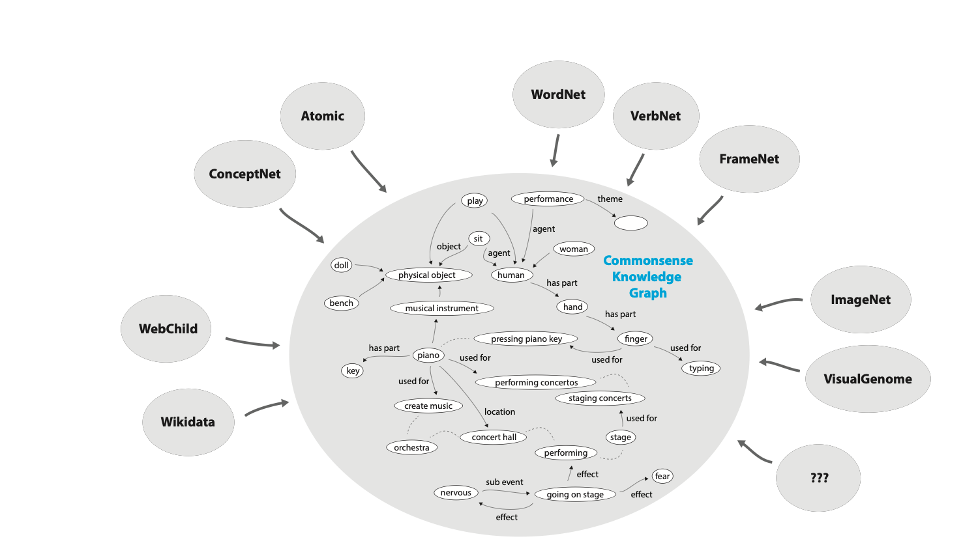
Commonsense Knowledge Graphs

Slide 4
The Commonsense Knowledge Graph (CSKG)
Roget
7 sources 2.3M nodes
6M edges
Preprint: Consolidating Commonsense Knowledge. Filip Ilievski, Pedro Szekely, Jingwei Cheng, Fu Zhang, Ehsan Qasemi.

Slide 5
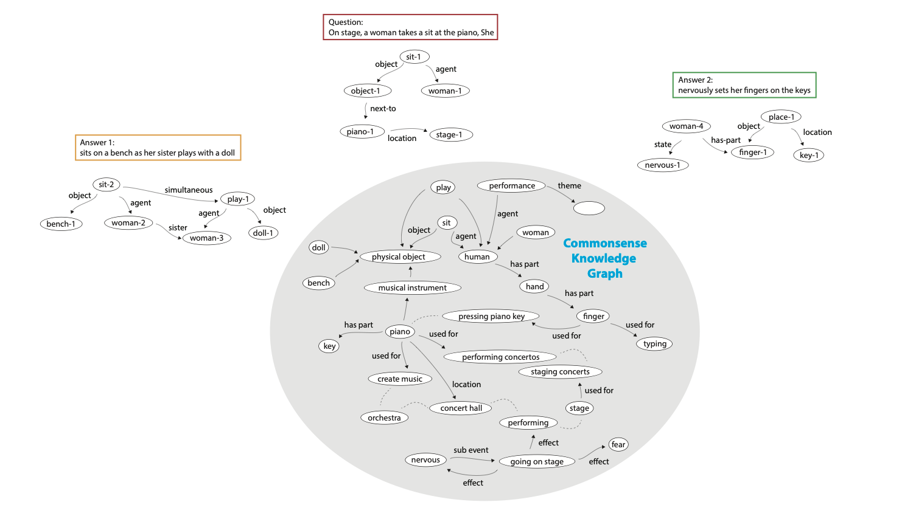
Semantic Parsing
Construct semantic
representations of
question and answers

Slide 6
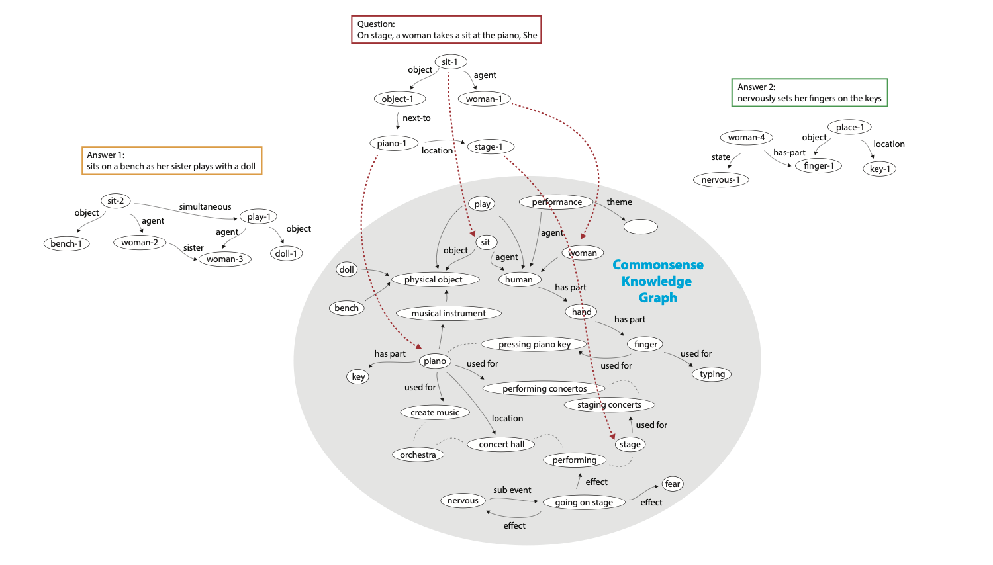
Grounding Questions
Link semantic
parses to KG

Slide 7
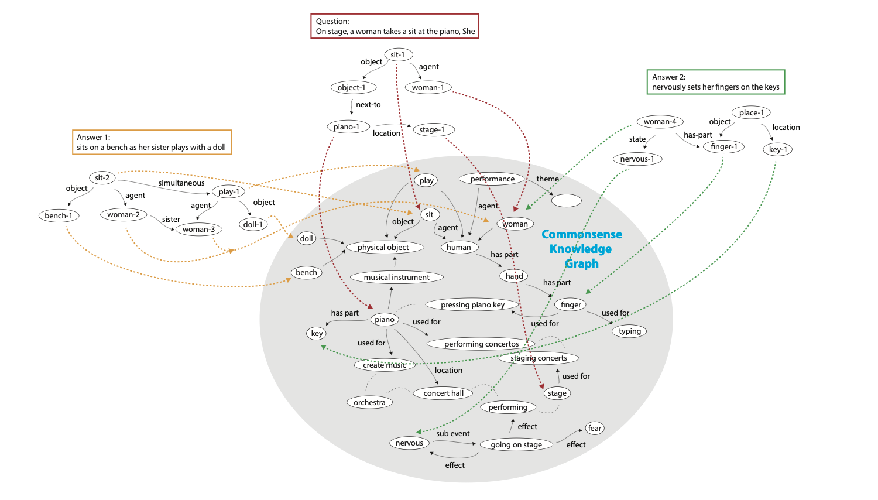
Grounding Answers
Link semantic
parses to KG

Slide 8
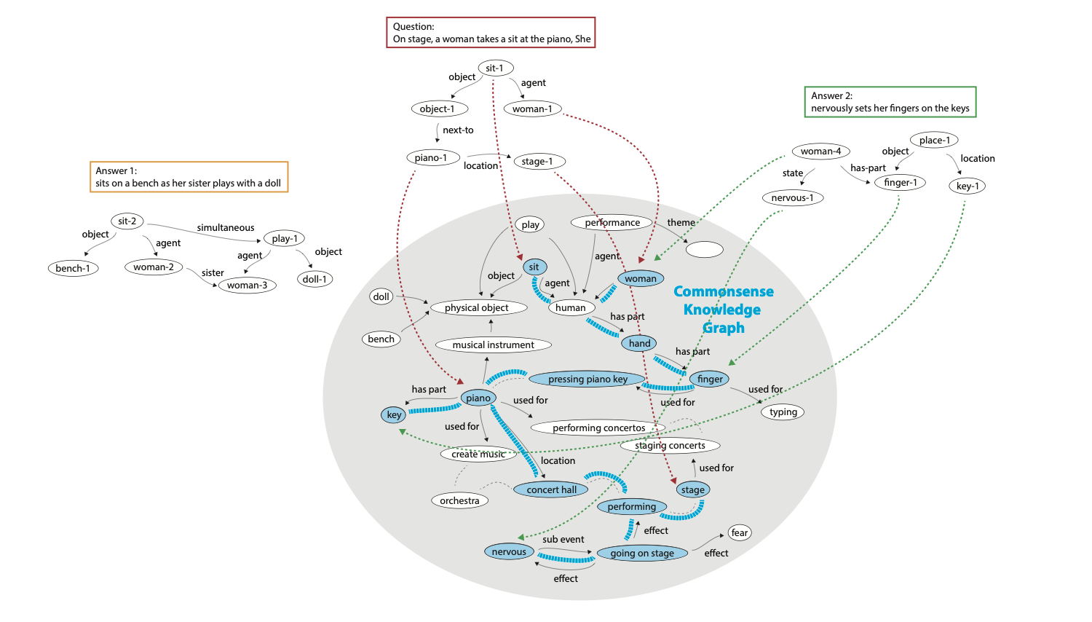
Reasoning
Connection subgraph
is an
explanation
Find and rank
connections for
question/answer
pairs

Slide 9
Grounding
Slides adapted from:
Anthony Chen, Robert Logan, Sameer Singh
UC Irvine

Slide 10
Motivating Example
When boiling butter, when it’s ready, you can...
pour it on a plate
pour it into a jar
Source: Physical IQA

Slide 11
Motivating Example
When boiling butter, when it’s ready, you can...
pour it on a plate
pour it into a jar
Required Common Sense:
Things that boil are liquid (when they’re ready)
Liquids can be poured
Butter can be a liquid
Jars hold liquids
Plates (typically) do not contain liquids
Required Linguistic Understanding:
The antecedent of ‘it’ is ‘butter’
Captured in CSKG!
Source: Physical IQA

Slide 12
Semantic Parsing: Text to Meaning Representation
When boiling butter, when it’s ready, you can...
..pour it on a plate
When boiling butter, when it’s ready, you can...
...pour it into a jar
Notes:
The first step of this process is to parse the text, i.e. represent the semantics behind each sentence as a graph, where nodes and edges facilitate reasoning and propagation of inference. Here we are providing a running example, consisting of the question/context in black, describing an event. Amongst the two answers, we have to pick the one that is more likely. We will parse these sentences into subgraphs that capture the meaning of each snippet, while also connecting them to each other. Note that we are not linking these subgraphs to our KG yet.

Slide 13
Semantic Parsing: Text to Meaning Representation
Three steps:
Semantic Role Labeling
Graphical encoding of dependencies between subjects/verbs in a sentence.
Coreference Resolution
Link mentions of entity within and across sentences.
Named Entity Recognition
Map fine-grained entities (e.g., “John”) to common entities (e.g., “Person”).
Better generalization
Notes:
To perform this parsing of the sentence semantics into meaningful subgraphs, we have so far implemented an approach that combines semantic role labeling, coreference resolution, and NER, to create graphs for each instance. SRL is used to identify the primary events and their arguments in the sentence, with spans as nodes and dependencies between them as edges. Coreference and NER are used to further annotate the nodes with entity information and links to other nodes that are the same entity. In future, we will explore richer meaning representations that are directly relevant to our KG, and parse into languages that are closer to that of inference, such as logic.
Visuals/details in the GitHub repo: https://github.com/ucinlp/mowgli-uci/tree/master/graphify_documentation

Slide 14
Semantic Role Labeling
Labels predicates (verbs) and their associated arguments.
subject
John
waiting
object
John is waiting for his car to be finished.
for his car to be finished
sub
sub
object
his car
finished

Slide 15
Coreference Resolution
Links mentions of a single entity in a sentence or across sentences.
subject
John
waiting
object
John is waiting for his car to be finished.
same
for his car to be finished
sub
sub
object
his car
finished

Slide 16
Named Entity Recognition
Marks each node if it is a named entity along with the entity type.
PERSON
subject
John
waiting
object
John is waiting for his car to be finished.
same
for his car to be finished
sub
sub
object
his car
finished

Slide 17
Semantic Parse: Question/Context
Which answer choice is better?
Q. When boiling butter, when it is ready, you can…
Ans 1 pour it on a plate.
Ans 2 pour it into a jar
Notes:
Here is the output of our current system when run on the question/context. As you can see, the subgraph is fairly complex, but captures a variety of interactions taking place in the sentence, such as the primary actor in the sentences (“She/woman”), location of where the events are taking place (“on stage” ad “on a bench”), temporal dependencies (“sits” same time as “plays”) and relevant coreferent links.

Slide 18
Semantic Parse: Answer 1
When boiling butter, when it is ready, you can pour it on a plate.
you
when it is ready
same
time
same
subject
butter
object
location
same
it
pour
on a plate
object
mod
time
can
when
boiling
Notes:
Here is the output of our current system when run on the question/context. As you can see, the subgraph is fairly complex, but captures a variety of interactions taking place in the sentence, such as the primary actor in the sentences (“She/woman”), location of where the events are taking place (“on stage” ad “on a bench”), temporal dependencies (“sits” same time as “plays”) and relevant coreferent links.

Slide 19
Semantic Parse: Answer 2
When boiling butter, when it is ready, you can pour it into a jar.
you
when it is ready
same
time
same
subject
butter
object
location
same
it
pour
into a jar
object
mod
time
can
when
boiling
Notes:
Here is the output of our current system when run on the question/context. As you can see, the subgraph is fairly complex, but captures a variety of interactions taking place in the sentence, such as the primary actor in the sentences (“She/woman”), location of where the events are taking place (“on stage” ad “on a bench”), temporal dependencies (“sits” same time as “plays”) and relevant coreferent links.

Slide 20
Shortcomings and Future Directions
Many different ways to parse a sentence/sentences
Semantic role labeling focuses on predicates, but ignores things like prepositional phrases.
Can incorporate dependency parsing, abstract meaning representations (AMR), etc.
Future Work: Explore other meaning representations, including logic

Slide 21
Linking to Commonsense KG
When boiling butter, when it’s ready, you can...
..pour it on a plate
Score possible reasoning in CSKG
score(q, a₁)
Notes:
After we have created the subgraphs for the question/context and the answers, we need to link the nodes to the KG of interest, so that the rest of the reasoning can take place. The reasoning, by using the information in the KG, will identify which subgraphs are more consistent with each other.

Slide 22
Linking to Commonsense KG
When boiling butter, when it’s ready, you can...
...pour it into a jar
Score possible reasoning in CSKG
score(q, a₂)
Notes:
After we have created the subgraphs for the question/context and the answers, we need to link the nodes to the KG of interest, so that the rest of the reasoning can take place. The reasoning, by using the information in the KG, will identify which subgraphs are more consistent with each other.

Slide 23
Linking to Commonsense KG
When boiling butter, when it’s ready, you can...
Which reasoning is better?
score(q, a₁)
>
score(q, a₂)
...pour it into a jar
Notes:
After we have created the subgraphs for the question/context and the answers, we need to link the nodes to the KG of interest, so that the rest of the reasoning can take place. The reasoning, by using the information in the KG, will identify which subgraphs are more consistent with each other.

Slide 24
Linking to CSKG
So that reasoning can take place!
Notes:
After we have created the subgraphs for the question/context and the answers, we need to link the nodes to the KG of interest, so that the rest of the reasoning can take place. The reasoning, by using the information in the KG, will identify which subgraphs are more consistent with each other.

Slide 25
Linking to CSKG: Question/Context
The boy loved telling scary stories.
The boy
/c/en/boy
loved
/c/en/loved
telling
/c/en/telling
Generalizes to concepts
(not just lexical)
scary stories
/c/en/horror_stories
Notes:
Here we show an example of the ConceptNet links that we provide for the example question/context. Although most of these seem to bring up lexically similar concepts, we show that in some cases it identifies a few concepts from ConceptNet that are more general, such as linking to “performed on stage” even though that does not directly appear in the text.

Slide 26
Approach
Embed words and phrases
Tokenization/concept matching
“Natural language processing” or “Natural”, “language”, “processing”?
Use embeddings
ConceptNet Numberbatch [Speer et al., AAAI 2017]
BERT [Devlin et al., 2018]
Node representation = function of word embeddings
Compute alignment between text and KG embeddings
Cosine/L2 distance
Notes:
Our current linking approach is quite straightforward: it uses a ConceptNet aware word embeddings to compute a dense vector representation of each node in the subgraphs, and for all the nodes in our knowledge graph. To perform the linking, we compute an efficient nearest neighbor search, and list the closest KG nodes as candidate links (scored by the distance).

Slide 27
Examples
“amused” -> amused (0.0), amusedness (0.04), amusedly (0.12), ...
“Tina, a teenager” -> teenager (0.0), tina (0.0), subteen (0.01), …
“With how popular her mother is” -> mother (0.0), with (0.0), is (0.0), …
“Scary stories” -> stories (0.0), scary (0.0), scarisome (0.02), …

Slide 28
Examples
“amused” -> amused (0.0), amusedness (0.04), amusedly (0.12), ...
“Tina, a teenager” -> teenager (0.0), tina (0.0), subteen (0.01), …
“With how popular her mother is” -> mother (0.0), with (0.0), is (0.0), …
“Scary stories” -> stories (0.0), scary (0.0), scarisome (0.02), …
Potentially better links: scary_story, horror_story
horror_story appears in the top-5 using original averaging method

Slide 29
Challenges
Multi-word phrases: His car -> /c/en/his? /c/en/car?
Average embedding is closer to his. Car is not linked.
Alternatives:
Link each word. Simple, but not compositional.
Link root of dependency parse. Discards even more information.
Polysemous words: “Doggo is good boy” vs. “Toilet paper is a scarce good”
Only one entry in ConceptNet: /c/en/good.
Can perform word sense disambiguation/link to WordNet nodes instead.
Better to handle at linking or graph reasoning step?
Evaluation

Slide 30
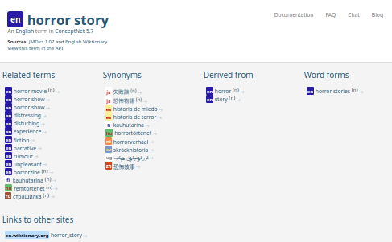
Fidelity vs. Utility Trade-off
Exact matches may exist, but are not always useful
Incorporate node degree?

Slide 31
Neuro-symbolic Reasoning Approaches

Slide 32
Neuro-Symbolic Reasoning Approaches
Knowledge enhances language models
Language models fill in knowledge gaps

Slide 33
Neuro-Symbolic Reasoning Approaches
Knowledge enhances language models
Language models fill in knowledge gaps
Kaixin Ma, Filip Ilievski, Jon Francis, Yonatan Bisk, Eric Nyberg, Alessandro Oltramari. In prep.

Slide 34
Structured evidence in CSKGs
Q: Bob the lizard lives in a warm place with lots of water. Where does he probably live?
A: tropical rainforest

Slide 35
Structured evidence in CSKGs
Q: Bob the lizard lives in a warm place with lots of water. Where does he probably live?
A: tropical rainforest
AtLocation (ConceptNet)

Slide 36
Structured evidence in CSKGs
Q: Bob the lizard lives in a warm place with lots of water. Where does he probably live?
A: tropical rainforest
HasInstance (FrameNet-ConceptNet)
AtLocation (ConceptNet)

Slide 37
Structured evidence in CSKGs
Q: Bob the lizard lives in a warm place with lots of water. Where does he probably live?
A: tropical rainforest
HasInstance (FrameNet-ConceptNet)
MayHaveProperty (Visual Genome)
AtLocation (ConceptNet)

Slide 38
HyKAS (based on Ma et al. 2019)
Q: /c/en/lizard, vg:water, …
A:/c/en/tropical, ...
(lizard, AtLocation, tropical rainforest)
(place, HasInstance, tropical)
(water, MayHaveProperty, tropical)
Path
extraction
Grounding
Q: Bob the lizard lives in a warm place with lots of water. Where does he probably live?
A: Tropical rainforest
Lexicalization
Lizards can be located in tropical rainforests.
Tropical is a kind of a place.
Water can be tropical.
Attention Layer

Slide 39
HyKAS (based on Ma et al. 2019)
Q: /c/en/lizard, vg:water, …
A:/c/en/tropical, ...
(lizard, AtLocation, tropical rainforest)
(place, HasInstance, tropical)
(water, MayHaveProperty, tropical)
Path
extraction
Grounding
Q: Bob the lizard lives in a warm place with lots of water. Where does he probably live?
A: Tropical rainforest
Lexicalization
Lizards can be located in tropical rainforests.
Tropical is a kind of a place.
Water can be tropical.
[CLS] | Bob the lizard lives in a warm place with lots of water. Where does he probably live? | [SEP] | tropical rainforest | [SEP]
Attention Layer

Slide 40
HyKAS (based on Ma et al. 2019)
Q: /c/en/lizard, vg:water, …
A:/c/en/tropical, ...
(lizard, AtLocation, tropical rainforest)
(place, HasInstance, tropical)
(water, MayHaveProperty, tropical)
Path
extraction
Grounding
Q: Bob the lizard lives in a warm place with lots of water. Where does he probably live?
A: Tropical rainforest
Lexicalization
Lizards can be located in tropical rainforests.
Tropical is a kind of a place.
Water can be tropical.
[CLS] | Bob the lizard lives in a warm place with lots of water. Where does he probably live? | [SEP] | tropical rainforest | [SEP]
Attention Layer
OCN cell
Lexicalized evidence
[CLS] | Bob the lizard lives in a warm place with lots of water. Where does he probably live? | [SEP] | mountain | [SEP]
Attention Layer
OCN cell
Lexicalized evidence
[CLS] | Bob the lizard lives in a warm place with lots of water. Where does he probably live? | [SEP] | desert | [SEP]
Attention Layer
OCN cell

Slide 41
‘No-knowledge’ baseline is strong
SocialIQA
Train knowledge | Inference Knowledge | Dev acc
- | - | 78.7
ATOMIC | ATOMIC | 79.04
CSKG | CSKG | 78.56
CSKG | - | 77.22
CSKG | -Visual Genome | 78.4
CSKG | ConceptNet | 78.61
CSKG | Visual Genome | 78.04
CSKG | ConceptNet+Visual Genome | 78.81
CSKG | -RelatedTo | 78.4
CSKG | -Synonym-Antonym | 78.66
CommonSense QA
Train+inference Knowledge | Dev acc
- | 76.7
ATOMIC | 77.1
ConceptNet | 80.1
CSKG | 79.5
CSKG -symmetric -overlapping | 79.7
CSKG in a separate OCN | 80.1
ConceptNet (2-hop) | 80.5

Slide 42
Adding knowledge helps
SocialIQA
Train knowledge | Inference Knowledge | Dev acc
- | - | 78.7
ATOMIC | ATOMIC | 79.04
CSKG | CSKG | 78.56
CSKG | - | 77.22
CSKG | -Visual Genome | 78.4
CSKG | ConceptNet | 78.61
CSKG | Visual Genome | 78.04
CSKG | ConceptNet+Visual Genome | 78.81
CSKG | -RelatedTo | 78.4
CSKG | -Synonym-Antonym | 78.66
CommonSense QA
Train+inference Knowledge | Dev acc
- | 76.7
ATOMIC | 77.1
ConceptNet | 80.1
CSKG | 79.5
CSKG -symmetric -overlapping | 79.7
CSKG in a separate OCN | 80.1
ConceptNet (2-hop) | 80.5

Slide 43
Different knowledge helps different problems
SocialIQA
Train knowledge | Inference Knowledge | Dev acc
- | - | 78.7
ATOMIC | ATOMIC | 79.04
CSKG | CSKG | 78.56
CSKG | - | 77.22
CSKG | -Visual Genome | 78.4
CSKG | ConceptNet | 78.61
CSKG | Visual Genome | 78.04
CSKG | ConceptNet+Visual Genome | 78.81
CSKG | -RelatedTo | 78.4
CSKG | -Synonym-Antonym | 78.66
CommonSense QA
Train+inference Knowledge | Dev acc
- | 76.7
ATOMIC | 77.1
ConceptNet | 80.1
CSKG | 79.5
CSKG -symmetric -overlapping | 79.7
CSKG in a separate OCN | 80.1
ConceptNet (2-hop) | 80.5

Slide 44
More knowledge is not always better
SocialIQA
Train knowledge | Inference Knowledge | Dev acc
- | - | 78.7
ATOMIC | ATOMIC | 79.04
CSKG | CSKG | 78.56
CSKG | - | 77.22
CSKG | -Visual Genome | 78.4
CSKG | ConceptNet | 78.61
CSKG | Visual Genome | 78.04
CSKG | ConceptNet+Visual Genome | 78.81
CSKG | -RelatedTo | 78.4
CSKG | -Synonym-Antonym | 78.66
CommonSense QA
Train+inference Knowledge | Dev acc
- | 76.7
ATOMIC | 77.1
ConceptNet | 80.1
CSKG | 79.5
CSKG -symmetric -overlapping | 79.7
CSKG in a separate OCN | 80.1
ConceptNet (2-hop) | 80.5

Slide 45
Enhancing CSKGs with Language Models
Wang et al. (2020). Connecting the Dots: A Knowledgeable Path Generator for Commonsense Question Answering. EMNLP Findings 2020

Slide 46
Neuro-Symbolic Reasoning Approaches
Knowledge enhances language models
Language models fill in knowledge gaps

Slide 47
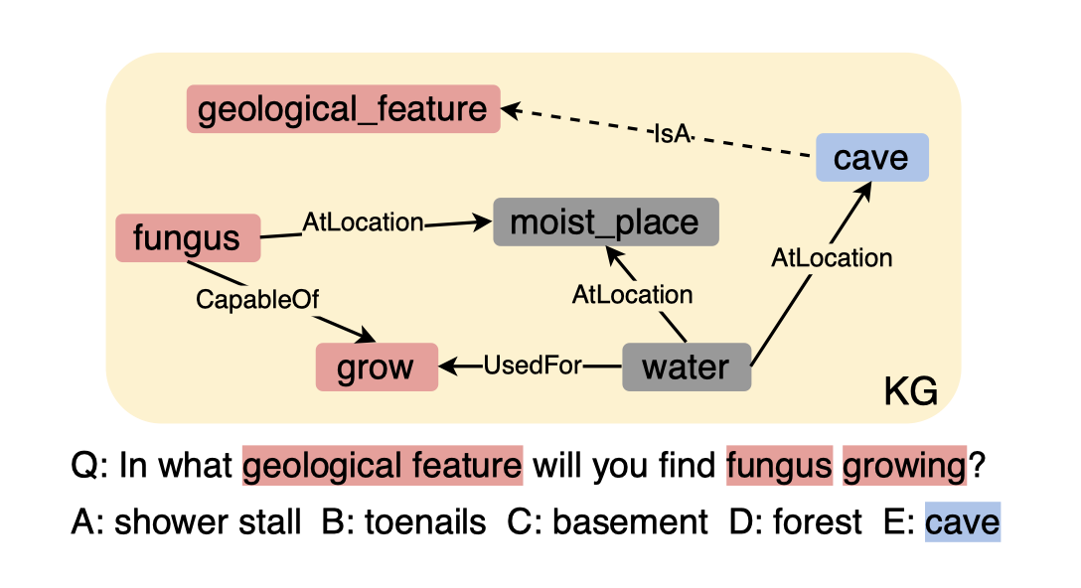
Retrieving KG facts does not suffice
Challenges
KG incompleteness
Introducing irrelevant facts

Slide 48
Retrieving KG facts does not suffice
Challenges
KG incompleteness
Introducing irrelevant facts
Solution
Learn a path generator to connect entities mentioned in context with novel multi-hop knowledge paths

Slide 49
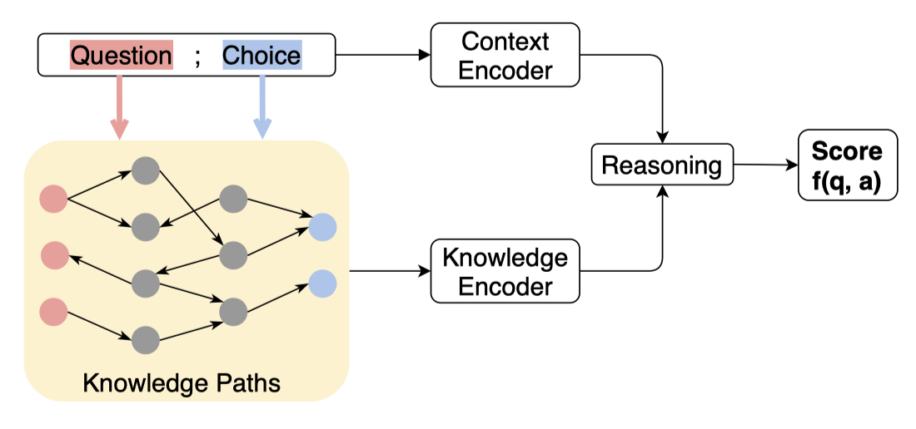
A KG-augmented QA Framework
Context Module
Encode question and answer choices as unstructured evidence
Knowledge Module
Encode knowledge facts (paths) as structured evidence
Reasoning Module
Score a question-choice pair based on un/structured evidence

Slide 50
Path Generator for Connecting Dots
Goal: generate a multi-hop path between two entities
Path Sampling with KG random walk
Training by fine-tuning GPT-2
Inference by using greedy decoding

Slide 51
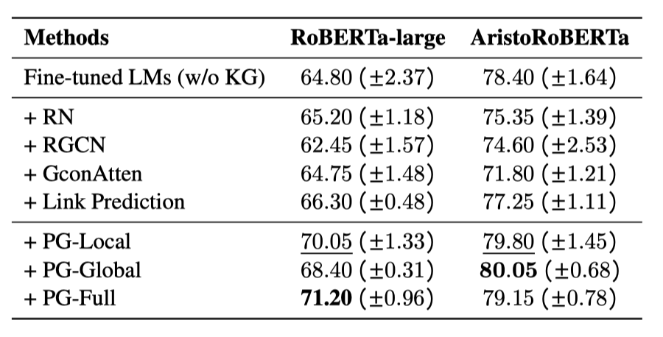
Generating knowledge paths is better than merely retrieving them
Test Accuracy on OpenBookQA

Slide 52
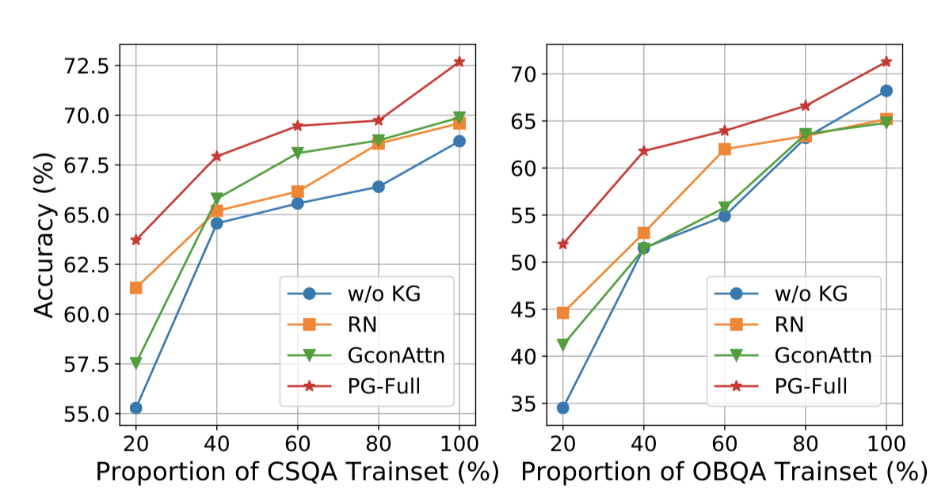
Consistent improvements with less training data
Test Accuracy on CommonsenseQA and OpenBookQA with different amount of training data.

Slide 53
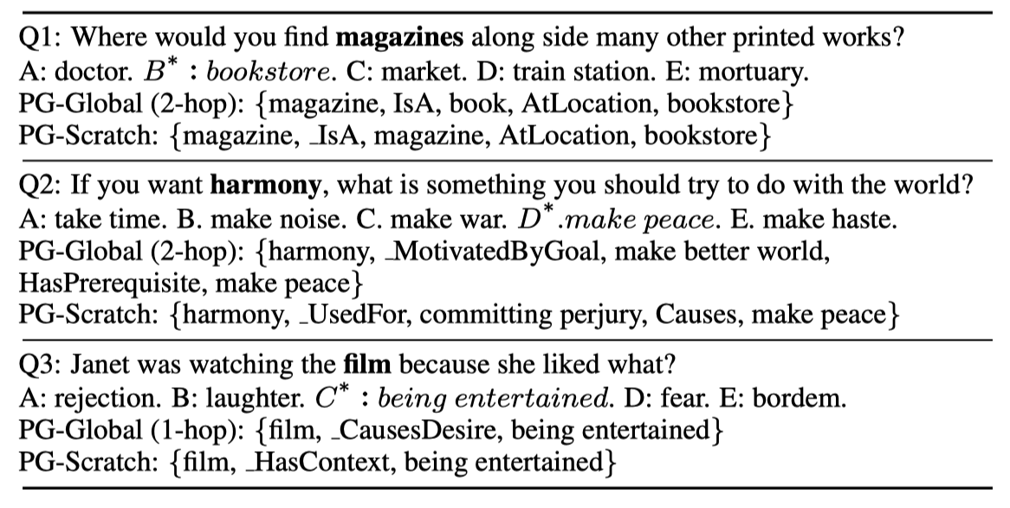
Interpretability with “real” structured paths

Slide 54
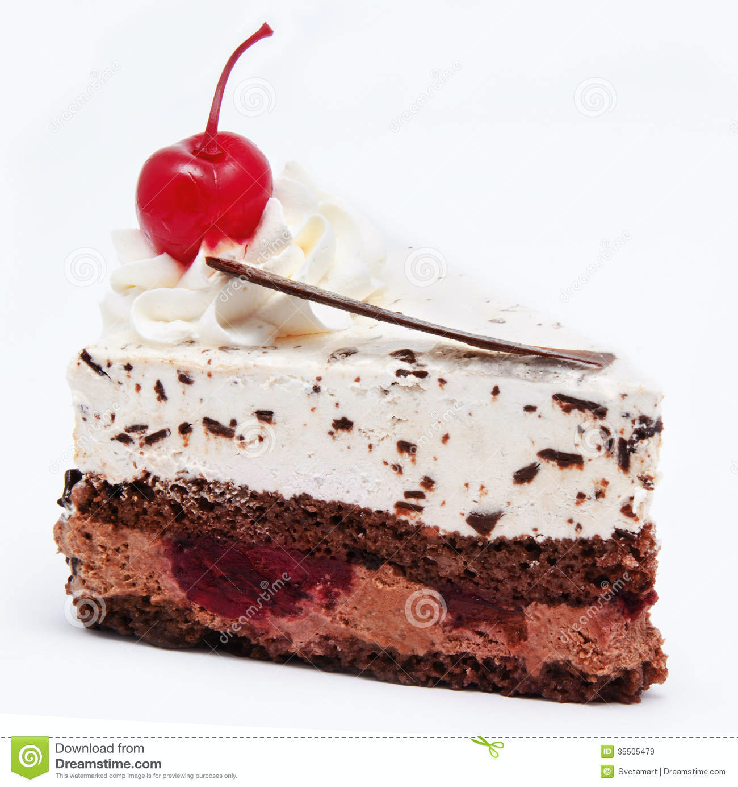
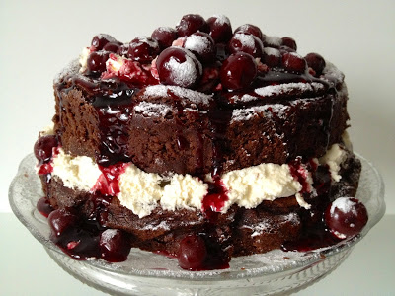
Role of knowledge
Existing benchmarks
knowledge
New benchmarks?
language models
Few shot, zero shot

Slide 55
Agenda
08:00 PST | 1 hr 50 mins | Part I - Review of CSKGs
 | 15 min | Introduction to commonsense knowledge (slides) - Pedro
 | 25 min | Review of top-down commonsense knowledge graphs (slides) - Mayank
 | 70 min | Review of bottom-up commonsense knowledge graphs (slides+demo) - Mayank, Filip, Pedro
 | 10 min | Break
10:00 PST | 45 min | Part II - Integration and analysis
 | 35 min | Consolidating commonsense graphs (slides) - Filip
 | 10 min | Consolidating commonsense graphs (demo) - Pedro
 | 10 min | Break
10:55 PST | 1 hr 05 mins | Part III - Downstream use of CSKGs
 | 50 min | Answering questions with CSKGs (slides+demo) - Filip
 | 15 min | Wrap-up (slides) - Mayank

Slide 56
Wrap-up

Slide 57
What Is Common Sense?
Common sense is sound practical judgement concerning everyday matters,
or a basic ability to perceive, understand, and judge that is shared by ("common to") nearly all people.
Wikipedia

Slide 58
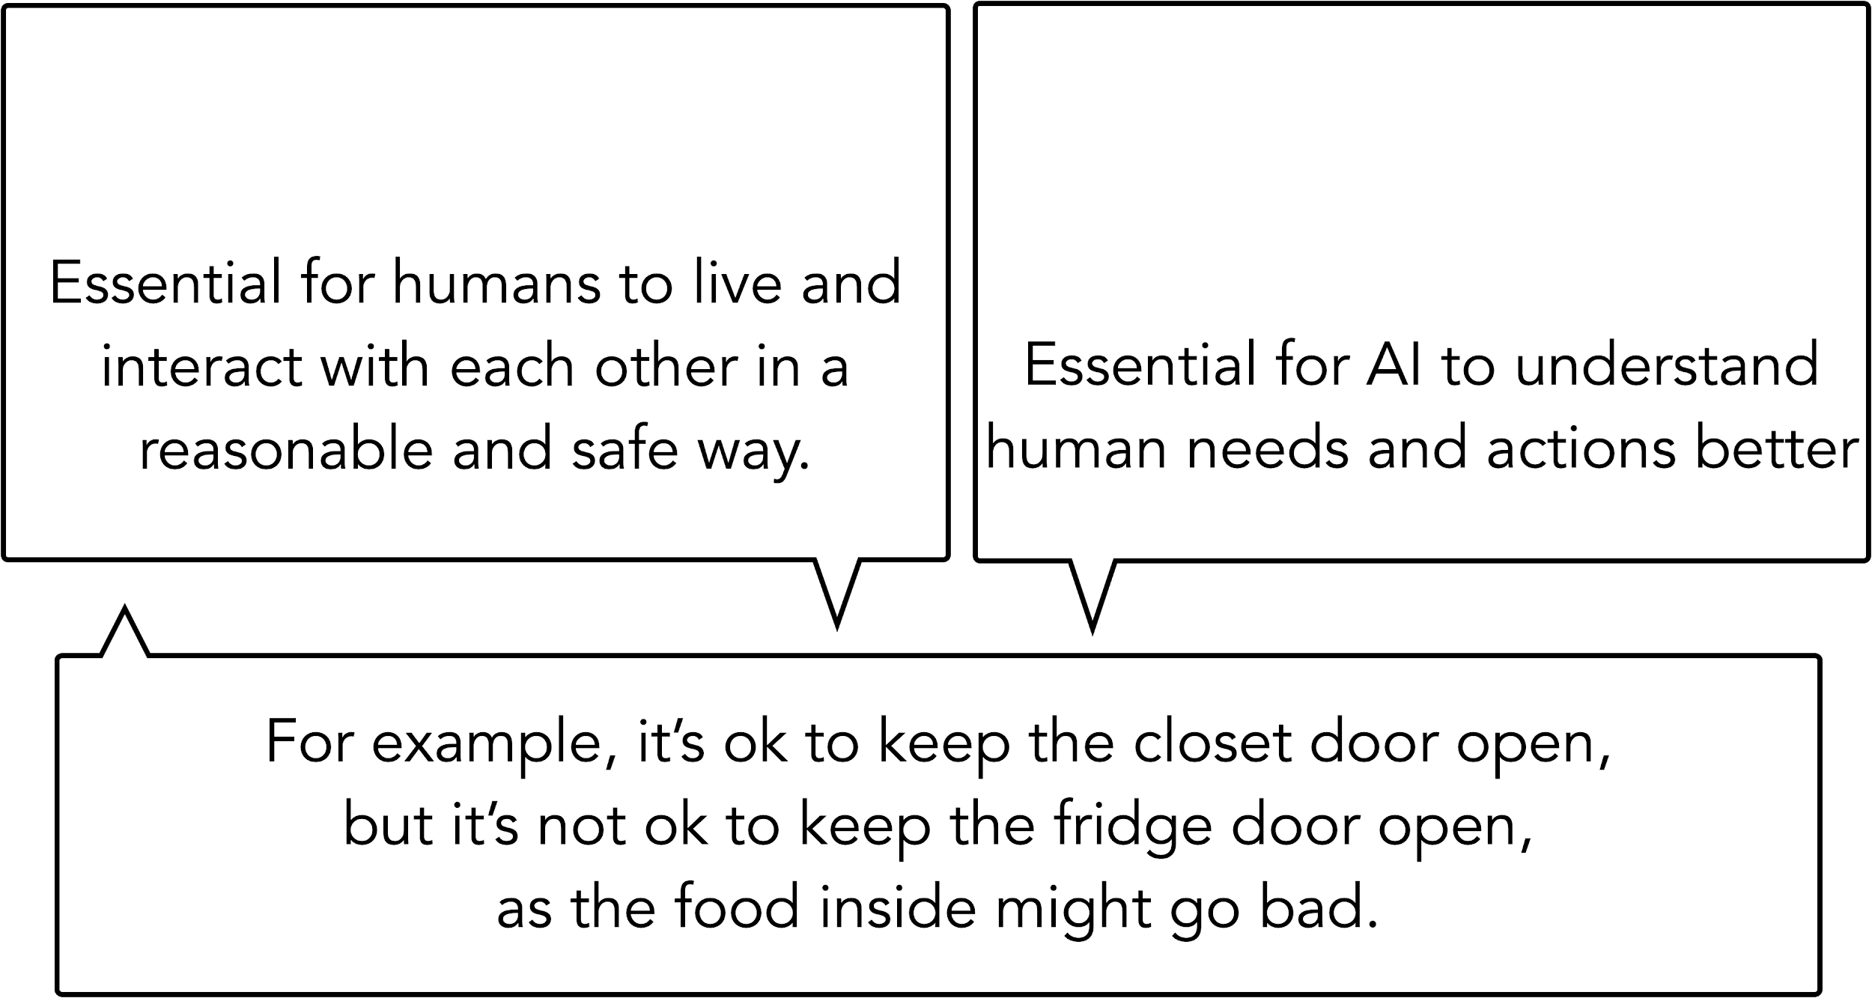
Slide by Yejin Choi

Slide 59
A Common Sense Task
Input: a set of common concepts
dog | frisbee | catch | throw
Output: a sentence using these concepts
https://inklab.usc.edu/CommonGen/

Slide 60
Role Of Knowledge
catch frisbee
has property
fun for dog
created by
is a
related to
others then
game
wants to
play
type of
located at
catch
dog
PersonX throws a frisbee
play
game
park
antonym
capable of
used for
located at
throw
play frisbee
frisbee
used for
synonym
flying
disk
disc
subclass of

Slide 61
Common Sense Knowledge Graphs
COMET
[Bosselut et al., 2019]
Atomic
[Sap et al., 2019]
WebChild
[Tandon et al., 2014]
WebChild 2.0
[Tandon et al., 2017]
Open Mind Common Sense
[Minski, Singh, Havasi,1999]
ConceptNet
[Liu, Singh, 2004]
ConceptNet 5.5
[Speer et al., 2017]
NELL
[Carlson et al., 2010]
NELL
[Mitchell et al., 2015]
Wikidata
[Vrandečić, 2012]
Cyc
[Lenat et al., 1984]
OpenCyc 4.0
[Lenat 2012]

Slide 62
Dimensions Of Common Sense Knowledge
Representation
symbolic
natural language
neural
Creation method
expert input
crowdsourcing
information extraction, machine learning
Knowledge type
entities and actions
inferential/rules
Topic
general
social
COMET
Atomic
WebChild
ConceptNet
NELL
Wikidata
OpenCyc

Slide 63
Why is top-down knowledge necessary?
“In Artificial intelligence, commonsense knowledge is the set of background information that an individual is intended to know or assume and the ability to use it when appropriate.”
Argument: This knowledge cannot be acquired simply through text (or in an otherwise ‘inductive’ fashion)

Slide 64
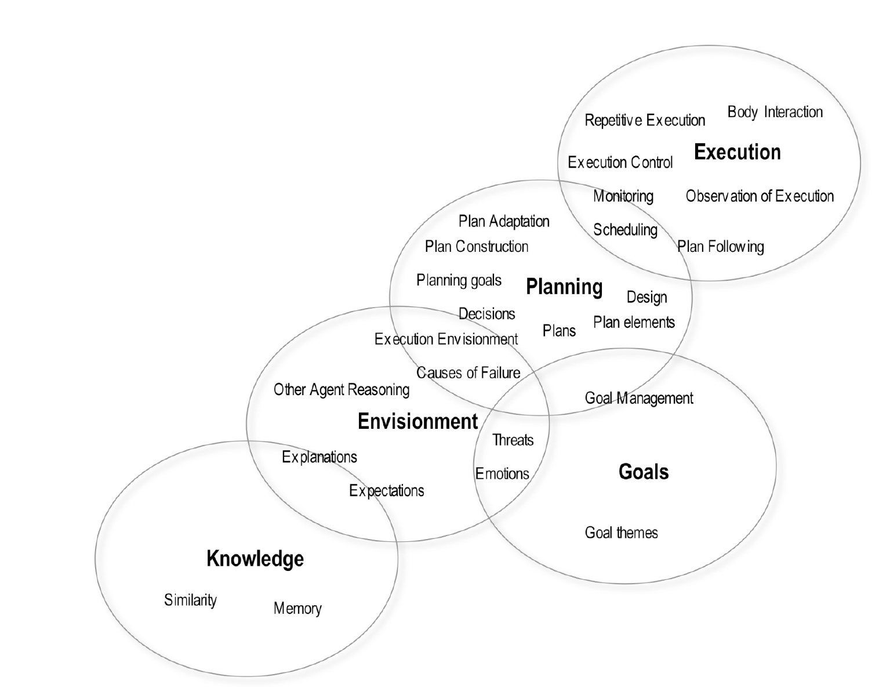
Taxonomy of 30 representational areas

Slide 65
Example of a ‘top-down’ CSKG: Cyc

Slide 66
Evolution of Cyc

Slide 67
Limitations of top-down CSKGs
Many of the same issues that other top-down systems (including, famously, expert systems) have, such as brittleness, expense of acquisition...
Even if it were possible, we can never get away from language models completely

Slide 68
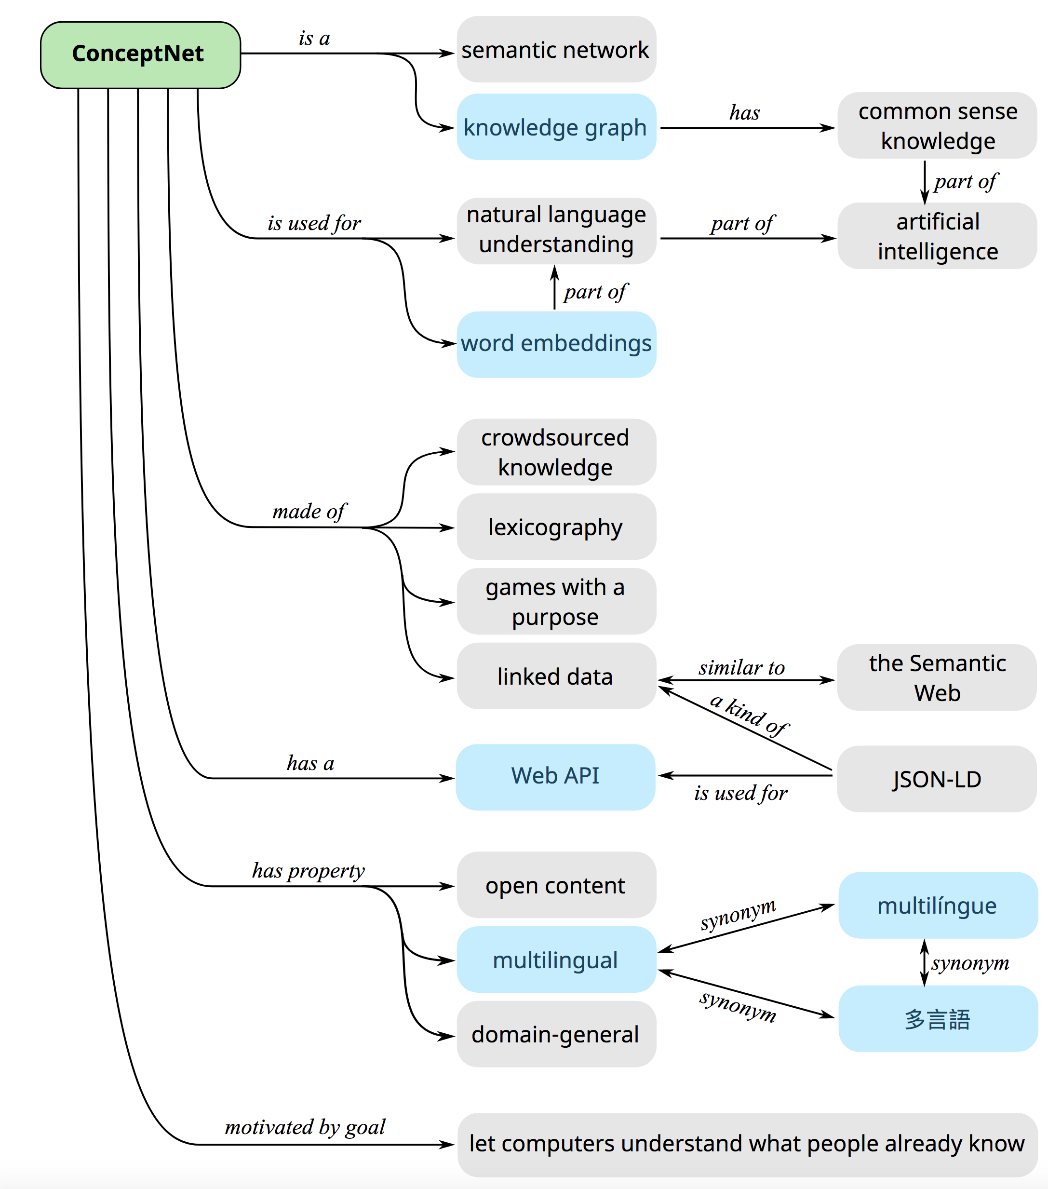
The many faces of ConceptNet

Slide 69
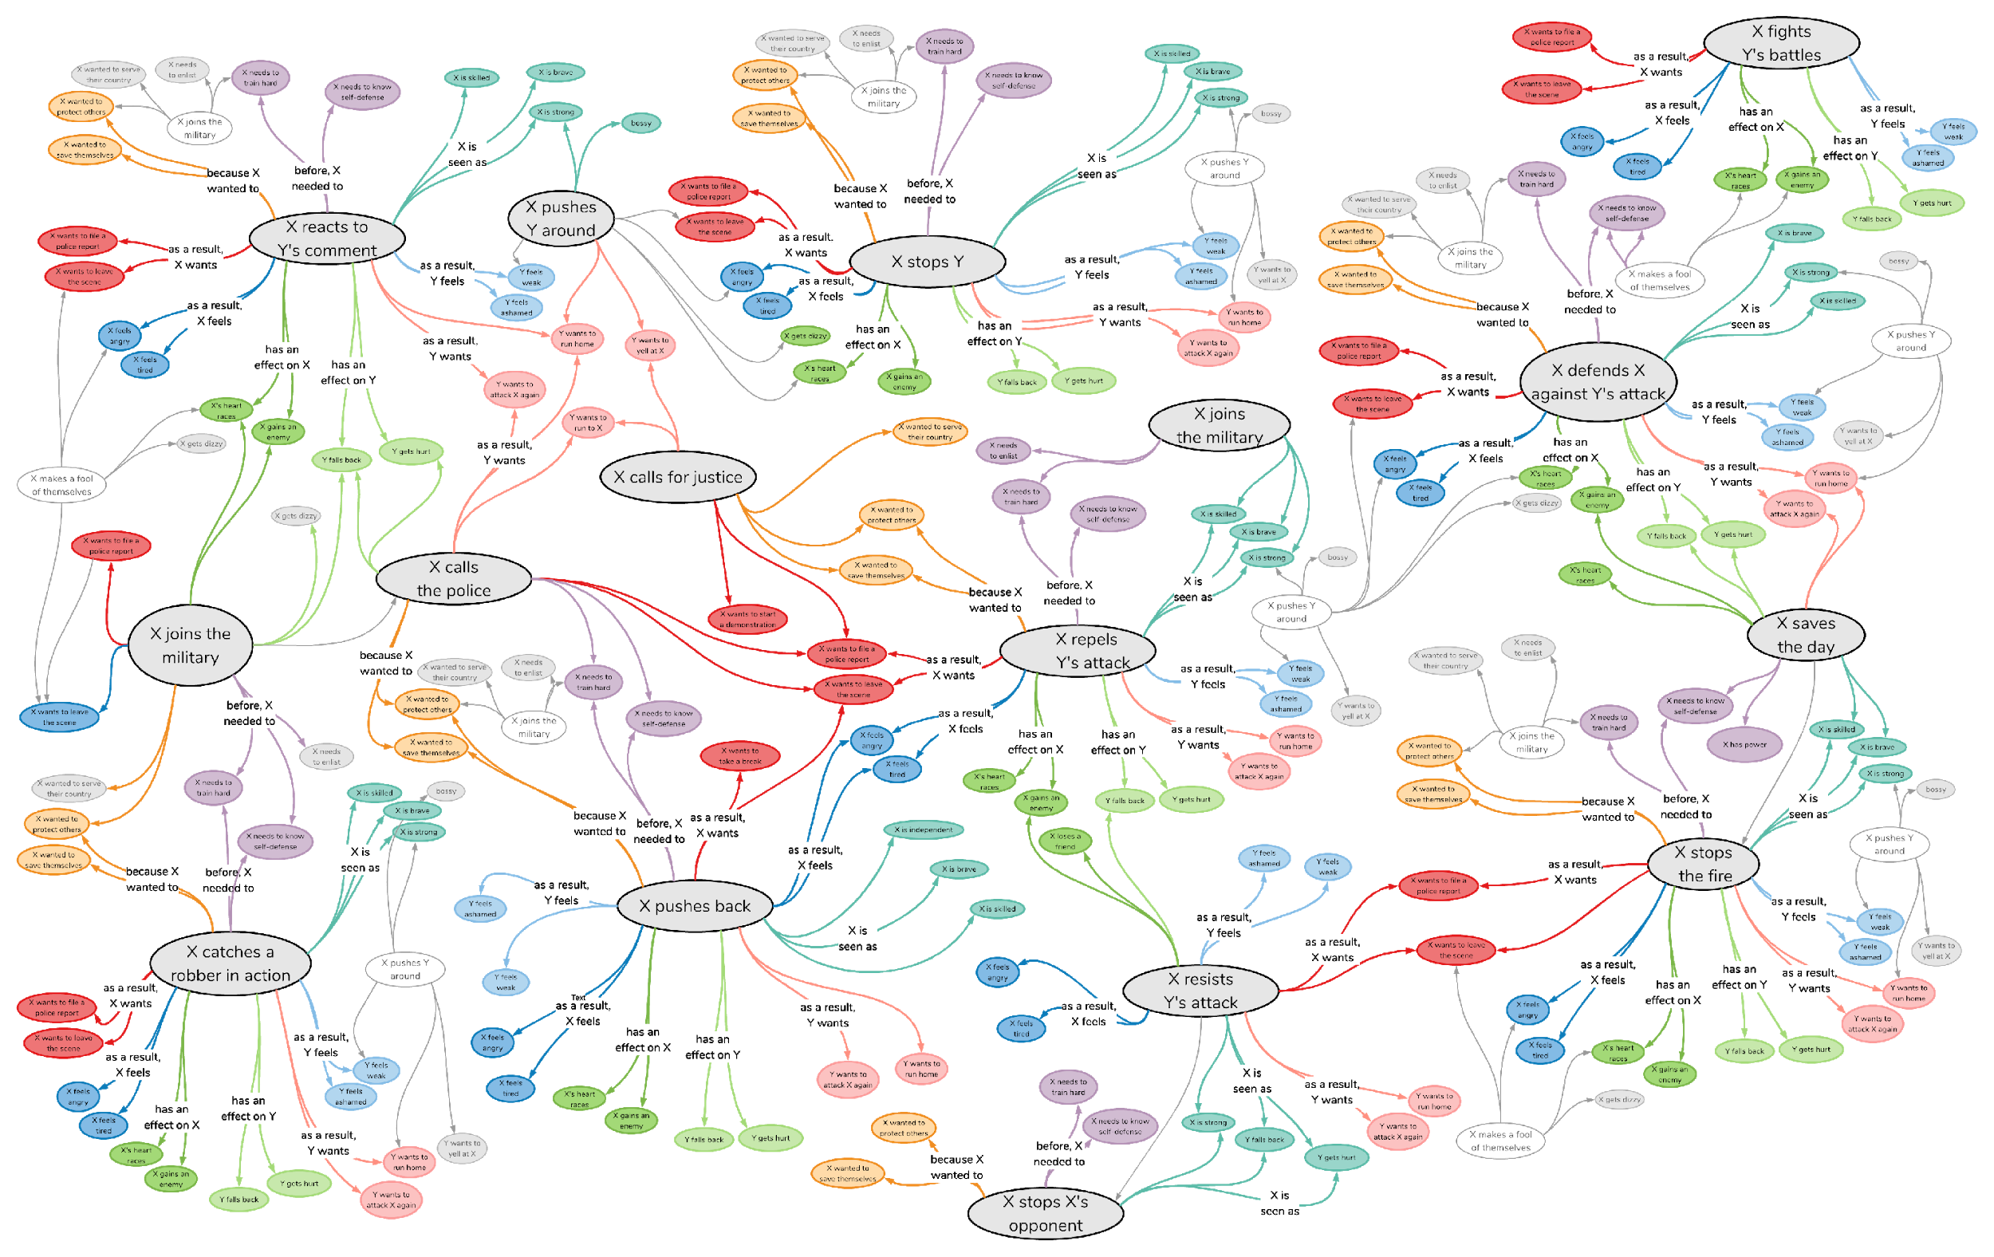
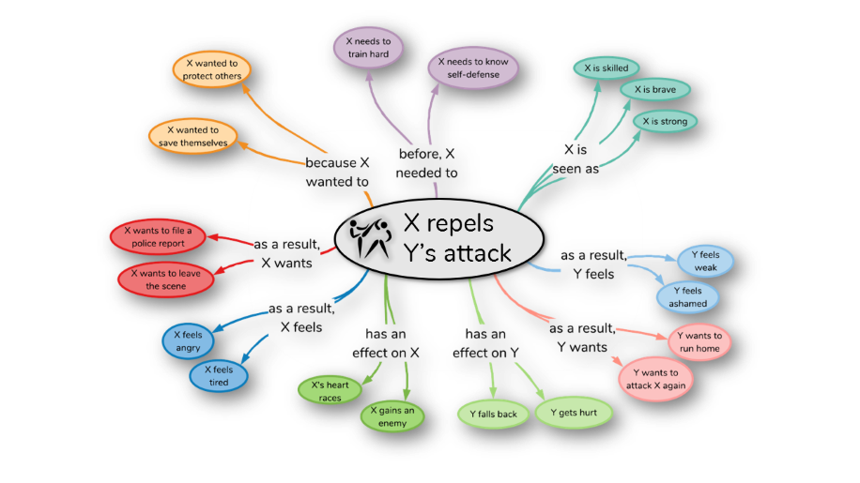
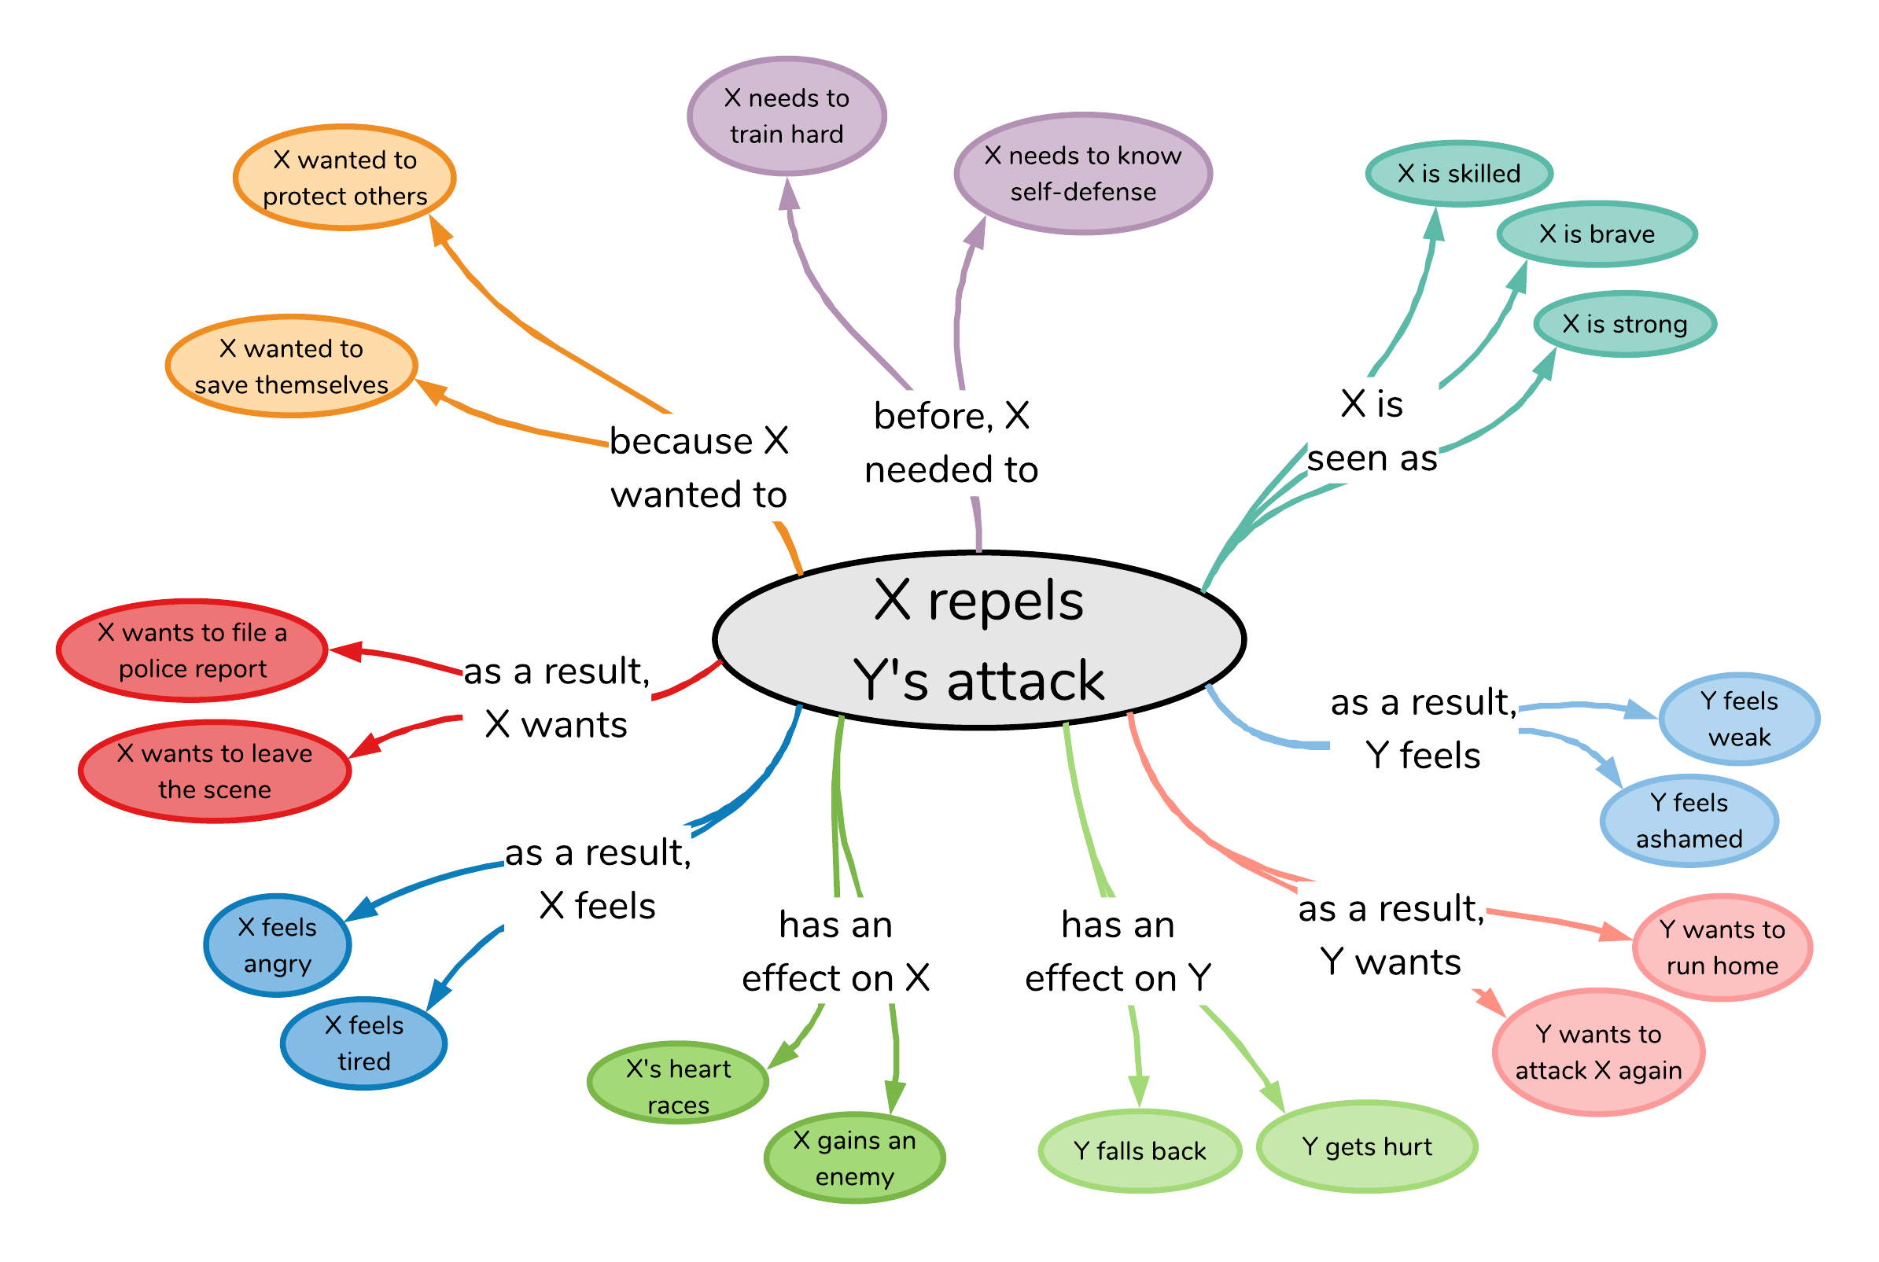
X repels Y’s attack
Atomic: 880,000 triples for AI systems to reason about causes and effects of everyday situations
Notes:
and what I mean by ATLAS is this HUGE knowledge graph that covers knowledge about the causes and effects of everyday situations.
What I mean by this is, given an event like

Slide 70
Commonsense Knowledge in Wikidata
shower part of bathroom
reading uses written work
queen follows jack
political opposition opposite of government

Slide 71
Wikidata-CS Is Small But Novel
ConceptNet
3.4M edges
2.4K edges
Wikidata-CS
102K edges

Slide 72
Commonsense Knowledge Sources
•ConceptNet
–Information about everyday objects, actions, states and relationships among them, extensive links to WordNet
–Incomplete coverage, “related-to” accounts for 75% of statements
•ATOMIC
–Pre- and post-states for events and their participants, physical and mental aspects covered
–Only 25% of nodes have links to ConceptNet, difficult to combine with other resources
•WordNet
–Meanings of words & relationships to other words, high coverage, many resources have links to WordNet, example sentences
–No description of the properties of objects or roles in verbs, only is-a and part-of relations
•VerbNet, FrameNet
–Defines participants/roles for a large number of situations/frames, links to verbs, syntactic forms and example sentences
–No semantic typing of roles, many roles are very abstract (e.g., Agent), lacks info about state changes, or pre-post conditions
•Visual Genome
–“Visual” commonsense, many possible attributes, relationships/actions among objects, linked to WordNet, many edges for a KG
–No abstraction mechanism to understand prevalence of relations
•Wikidata
–Comprehensive descriptions of objects, both specific (named entities) and generic (nouns)
–Sparse information about events and states, much knowledge is on instance-level and abstraction is non-trivial

Slide 73
Consolidation Hypothesis
Integrating multiple knowledge sources in CSKG is beneficial for downstream reasoning tasks.

Slide 74
Principles for a modular and useful CSKG
P1. Embrace heterogeneity of nodes objects, classes, words, actions, frames, states P2. Reuse edge types across resources /r/HasProperty from ConceptNet applicable for attributes in Visual Genome P3. Leverage external links many sources map to WordNet P4. Generate high-quality probabilistic links many facts not explicitly stated P5. Enable access to labels text labels and aliases are the key, in particular for NLP use cases

Slide 75
The Commonsense Knowledge Graph (CSKG)
Roget
7 sources 2.3M nodes
6M edges
Preprint: Consolidating Commonsense Knowledge. Filip Ilievski, Pedro Szekely, Jingwei Cheng, Fu Zhang, Ehsan Qasemi.

Slide 76
Neuro-Symbolic Reasoning Approaches
Knowledge enhances language models
Language models fill in knowledge gaps

Slide 77
A KG-augmented QA Framework
Context Module
Encode question and answer choices as unstructured evidence
Knowledge Module
Encode knowledge facts (paths) as structured evidence
Reasoning Module
Score a question-choice pair based on un/structured evidence

Slide 78
Our final takeaways
Commonsense (CS) reasoning is a difficult general AI problem that has come of age
Ironically, exposed both the strengths and limitations of neural networks, including language representation learning
We hypothesize that a neuro-symbolic approach is necessary for CS reasoning
CS knowledge, appropriately contextualized, is critical for robust CS reasoning and QA
Much progress has been achieved in integrating multiple sources into a single CSKG, but many open challenges remain

Slide 79
Bibliography
Baker, C. F., Fillmore, C. J., & Lowe, J. B. (1998, August). The berkeley framenet project. In 36th Annual Meeting of the Association for Computational Linguistics and 17th International Conference on Computational Linguistics, Volume 1 (pp. 86-90).
Bosselut, A., Rashkin, H., Sap, M., Malaviya, C., Celikyilmaz, A., & Choi, Y. (2019). COMET: Commonsense transformers for automatic knowledge graph construction. arXiv preprint arXiv:1906.05317.
Devlin, J., Chang, M. W., Lee, K., & Toutanova, K. (2018). Bert: Pre-training of deep bidirectional transformers for language understanding. arXiv preprint arXiv:1810.04805.
Fellbaum, C. (2012). WordNet. The encyclopedia of applied linguistics.
Gordon, A. S., & Hobbs, J. R. (2004). Formalizations of commonsense psychology. AI Magazine, 25(4), 49-49.
Hobbs, J., Croft, W., Davies, T., Edwards, D., & Laws, K. (1987). Commonsense metaphysics and lexical semantics. Computational linguistics, 13(3-4), 241-250.

Slide 80
Bibliography
Hobbs, J. R., & Gordon, A. S. (2010, July). Goals in a Formal Theory of Commonsense Psychology. In FOIS (pp. 59-72).
Ilievski, F., Szekely, P., Cheng, J., Zhang, F., & Qasemi, E. (2020). Consolidating Commonsense Knowledge. arXiv preprint arXiv:2006.06114.
Ilievski, F., Szekely, P., & Schwabe, D. (2020). Commonsense Knowledge in Wikidata. Wikidata Workshop at ISWC 2020.
Lenat, D. B., Guha, R. V., Pittman, K., Pratt, D., & Shepherd, M. (1990). Cyc: toward programs with common sense. Communications of the ACM, 33(8), 30-49.
Krishna, R., Zhu, Y., Groth, O., Johnson, J., Hata, K., Kravitz, J., ... & Bernstein, M. S. (2017). Visual genome: Connecting language and vision using crowdsourced dense image annotations. International journal of computer vision, 123(1), 32-73.
Mitchell, T., Cohen, W., Hruschka, E., Talukdar, P., Yang, B., Betteridge, J., ... & Krishnamurthy, J. (2018). Never-ending learning. Communications of the ACM, 61(5), 103-115.

Slide 81
Bibliography
Matuszek, C., Witbrock, M., Kahlert, R. C., Cabral, J., Schneider, D., Shah, P., & Lenat, D. (2005). Searching for common sense: Populating cyc from the web. UMBC Computer Science and Electrical Engineering Department Collection.
Roget, P. M. (2008). Roget'S International Thesaurus, 3/E. Oxford and IBH Publishing.
Sap, M., Le Bras, R., Allaway, E., Bhagavatula, C., Lourie, N., Rashkin, H., ... & Choi, Y. (2019, July). Atomic: An atlas of machine commonsense for if-then reasoning. In Proceedings of the AAAI Conference on Artificial Intelligence (Vol. 33, pp. 3027-3035).
Speer, R., Chin, J., & Havasi, C. (2016). Conceptnet 5.5: An open multilingual graph of general knowledge. AAAI 2017.
Storks, S., Gao, Q., & Chai, J. Y. (2019). Commonsense reasoning for natural language understanding: A survey of benchmarks, resources, and approaches. arXiv preprint arXiv:1904.01172, 1-60.
Von Ahn, L., & Dabbish, L. (2008). Designing games with a purpose. Communications of the ACM, 51(8), 58-67.

Slide 82
Bibliography
Wang, P., Peng, N., Ilievski, F., Szekely, P., & Ren, X. (2020). Connecting the Dots: A Knowledgeable Path Generator for Commonsense Question Answering. EMNLP Findings 2020.

